Slide 1
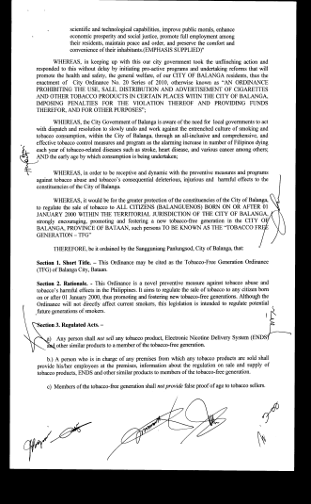
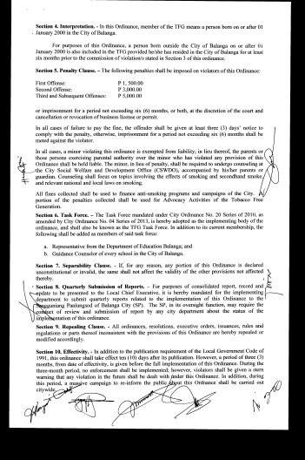
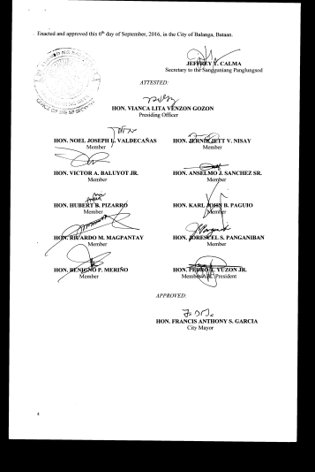
Tobacco Free Generation End-Game Strategy Ordinance of Balanga City

Slide 2
Tobacco Endgame Strategy Ordinance of Balanga City, Bataan City Ordinance No. 16, S. 2016
Member of the tobacco-free generation means a person born on or after 1 January 2000 in the City of Balanga
For purposes of this Ordinance, a person born outside the City of Balanga on or after 1 January 2000 may also be included in the TFG if he has resided in the City of Balanga for at least six monthS before the violation under this ordinance is committed against him or by him.
Regulated Acts –
Any person shall not sell any tobacco product, Electronic Nicotine Delivery System (ENDS) and other similar products to a member of tobacco-free generation.
A person who is in charge of any premises from which any tobacco product are sold shall provide his/her employees at the premises, information about the regulation on sale and supply of tobacco products, ENDS and other similar products to a member of tobacco-free generation.
Members of the tobacco-free generation shall not provide false proof og age to tobacco sellers.

Slide 3
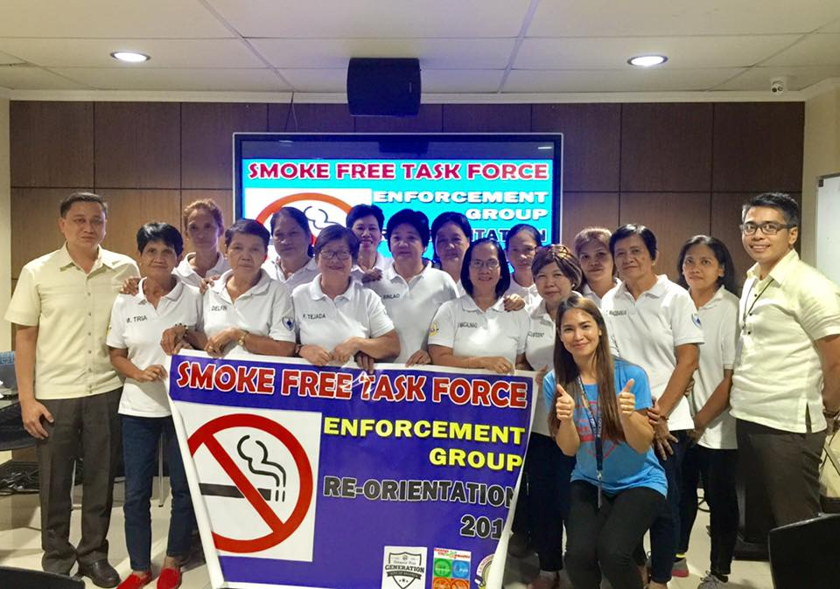
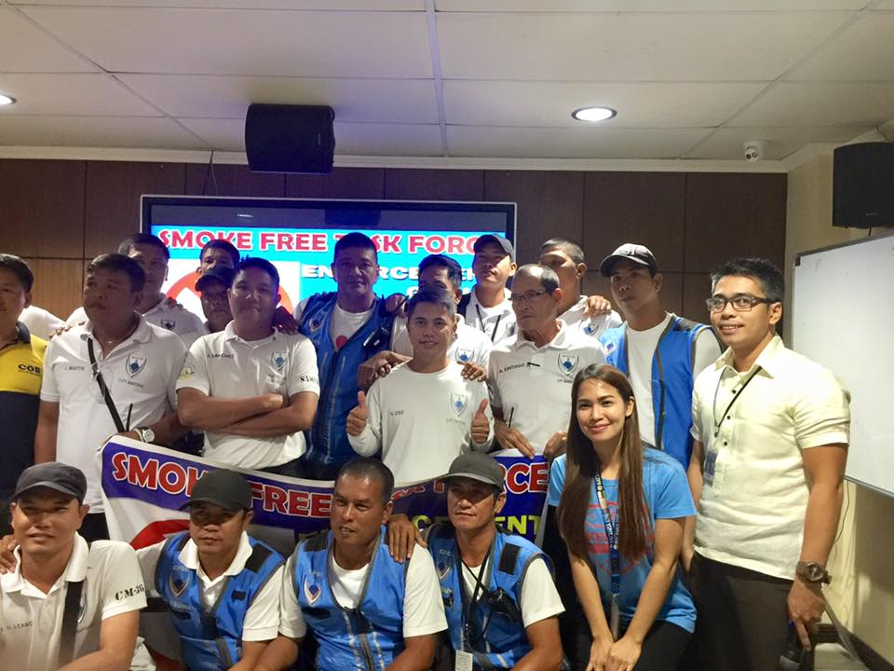
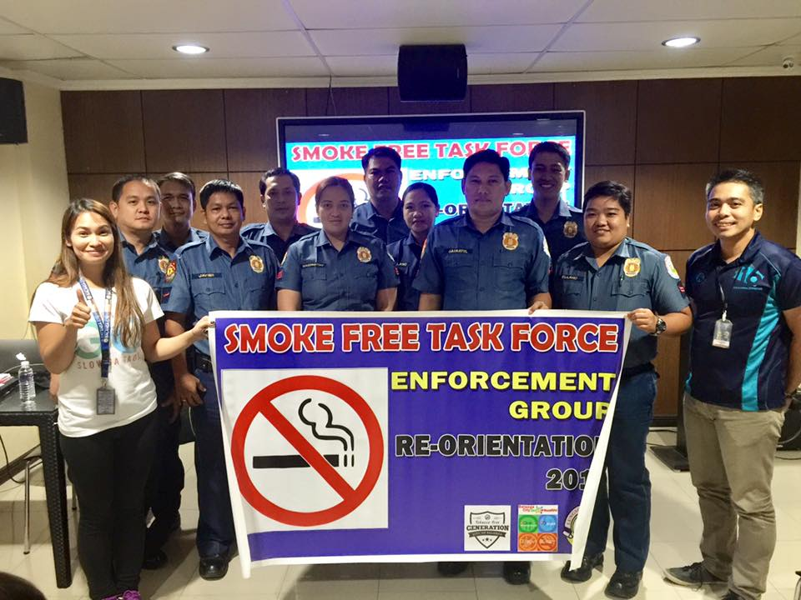
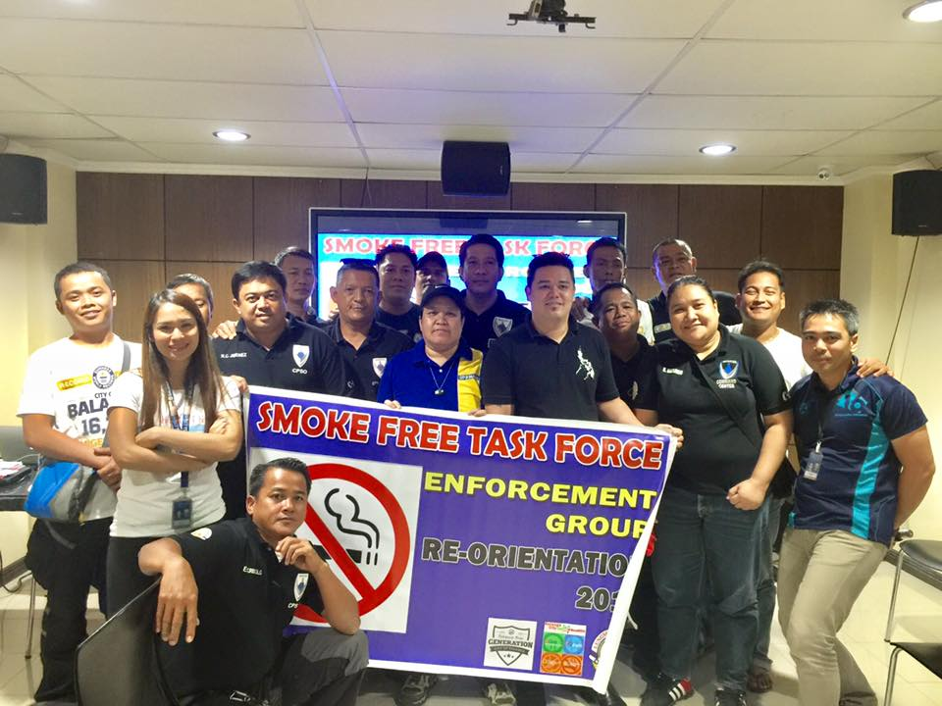
Smoke Free Task Force-Re-orientation Seminar
City Public Safety Office, Barangay Officials and PNP
January 23 – February 10,2017

Slide 4
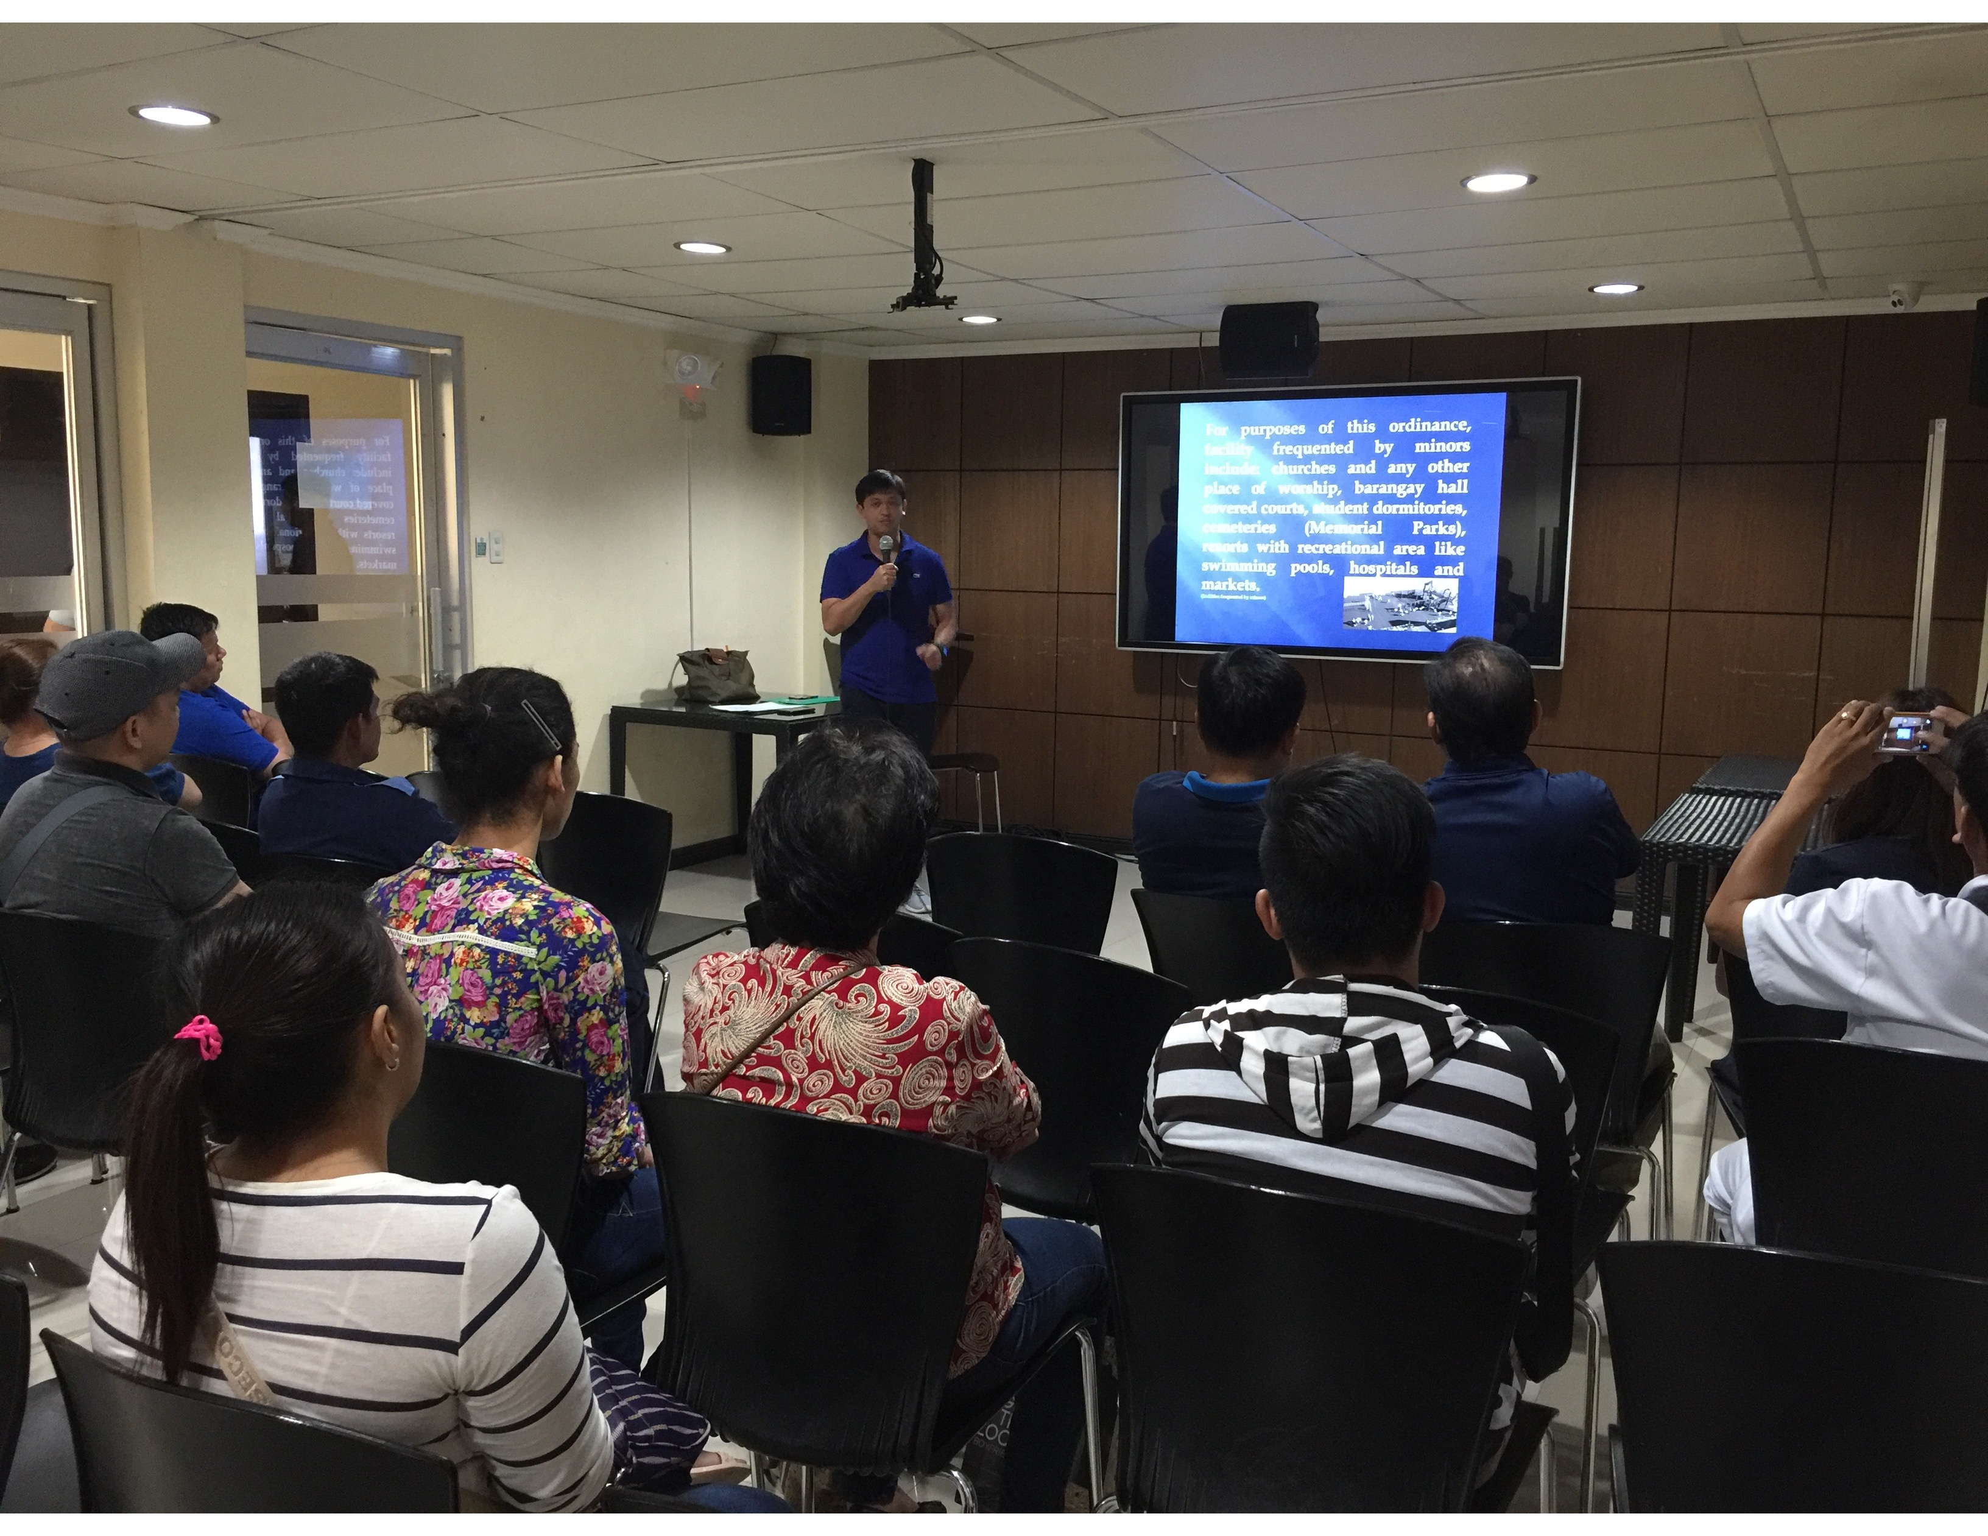
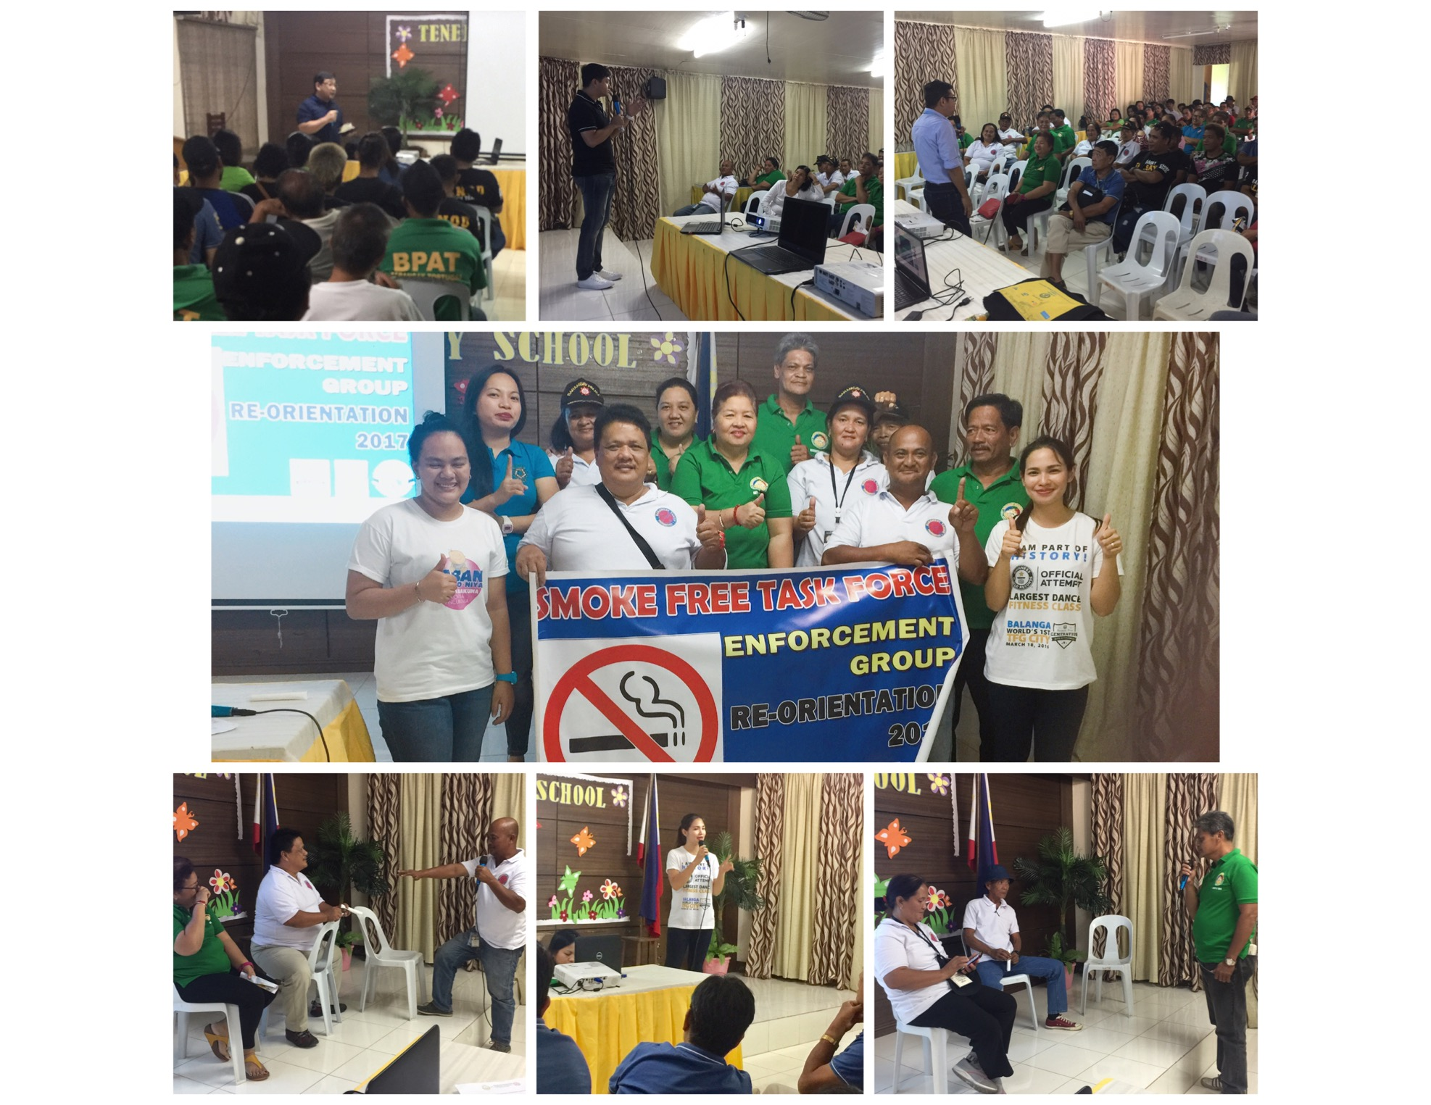
Smoke Free Task Force-Re-orientation Seminar
City Public Safety Office, Barangay Officials and PNP
January 23 – February 10,2017

Slide 5
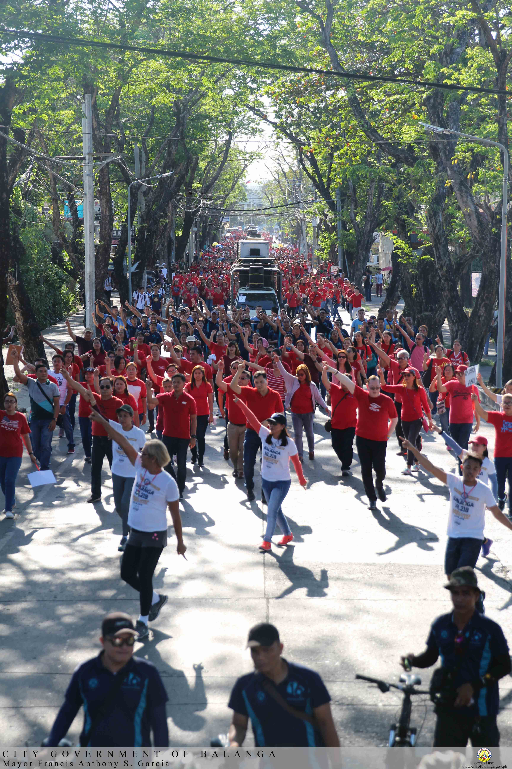
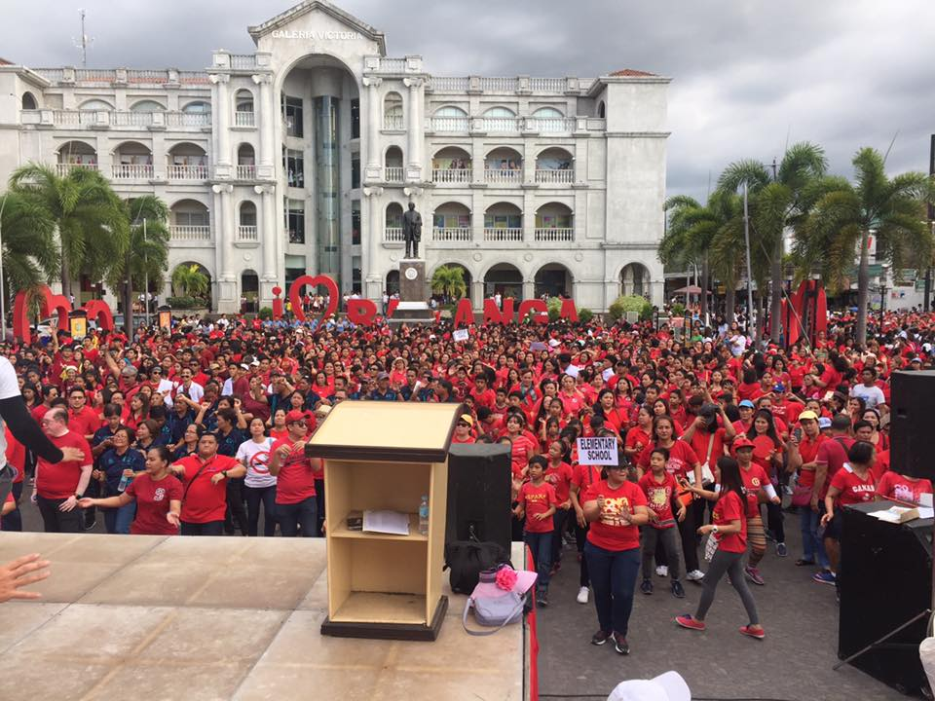
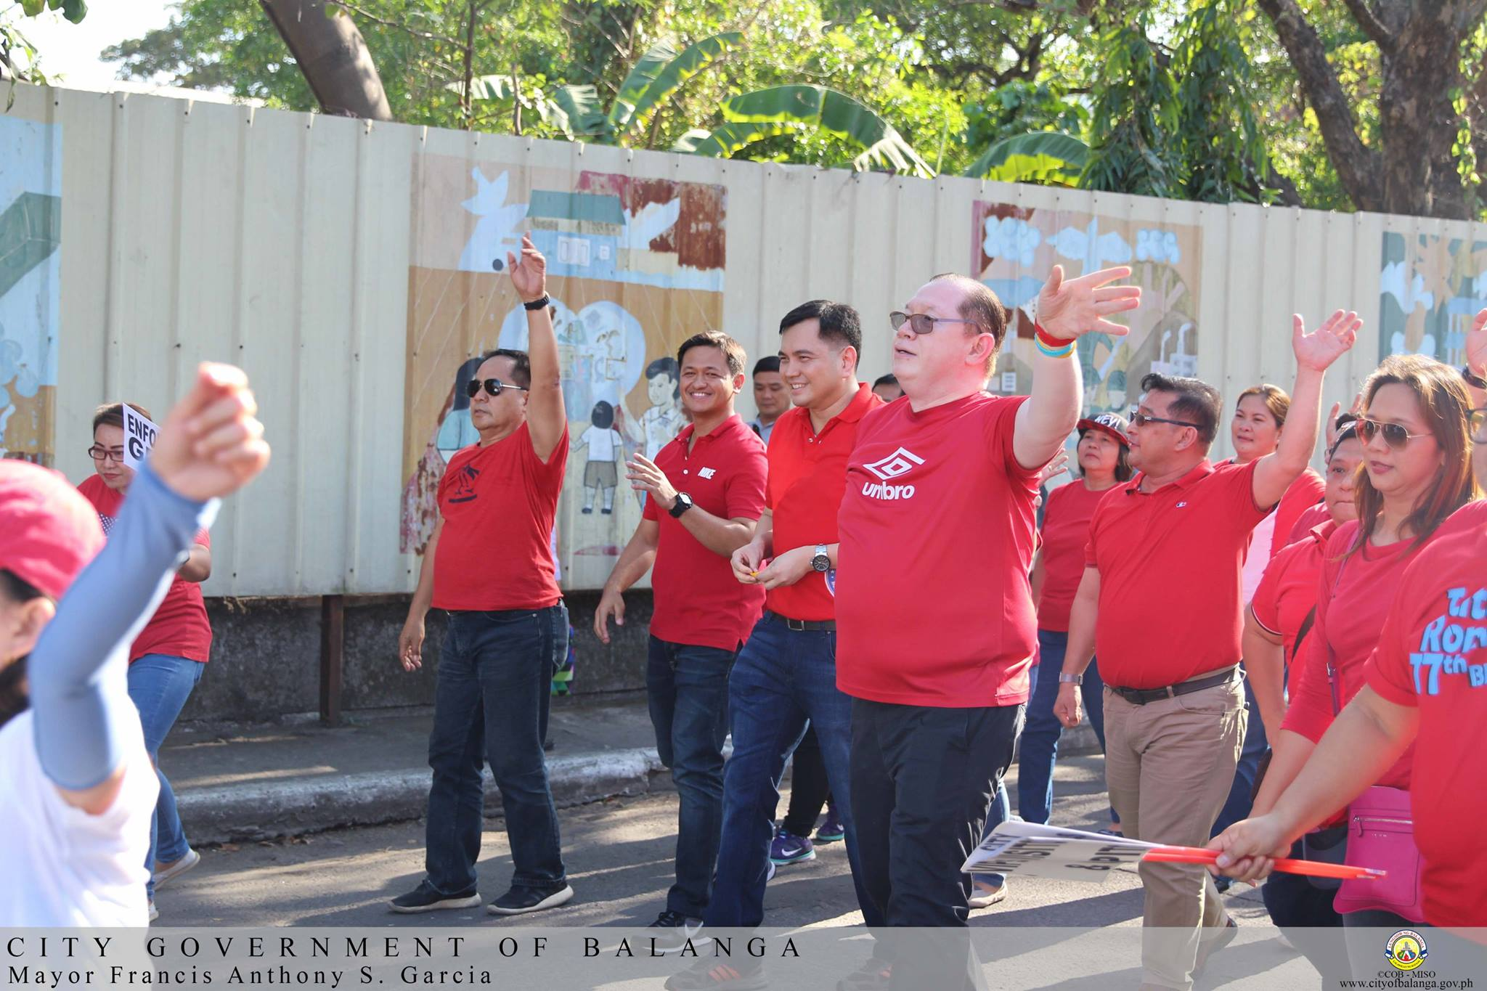
Re-launching of Smoke Free Balanga for the implementation of TFG and Amendments of Comprehensive Anti-Smoking Ordinance 1,800+ Participants Feb. 28,2017

Slide 6
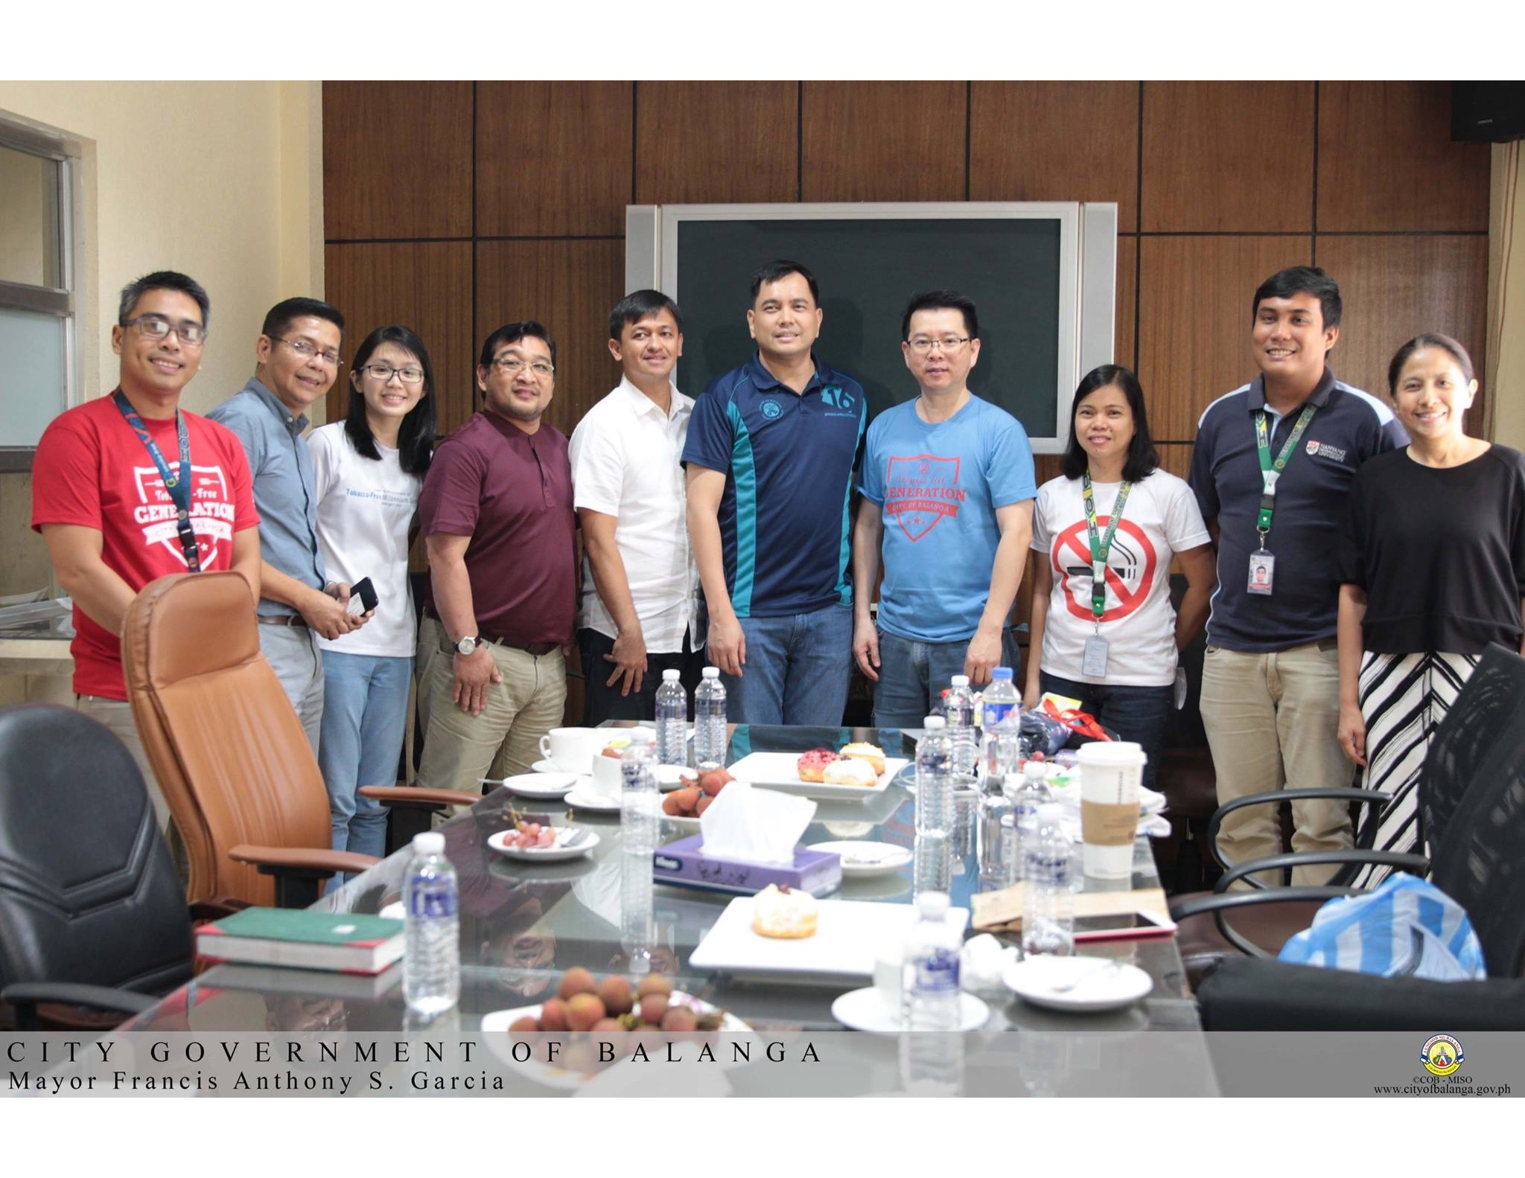
Meeting with Dr. Koong(TFGi), Mayor Francis Garcia and Mayor Gila Garcia Balanga City Hall June 16,2017

Slide 7
BALANGA INSPIRES...
COME and SHARE OUR DREAM

