Slide 1
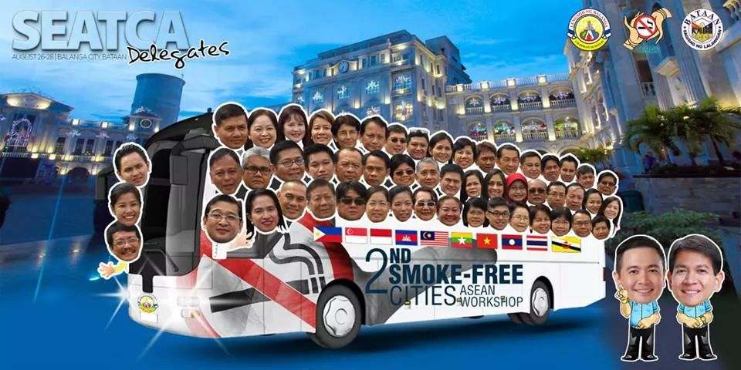
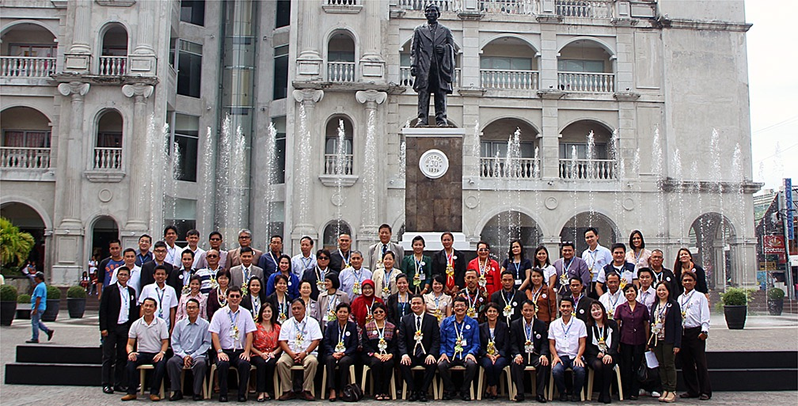
2ND SMOKE-FREE CITIES ASEAN Workshops in BALANGA CITY
August 2014
SCAN Davao CITY 2013

Slide 2
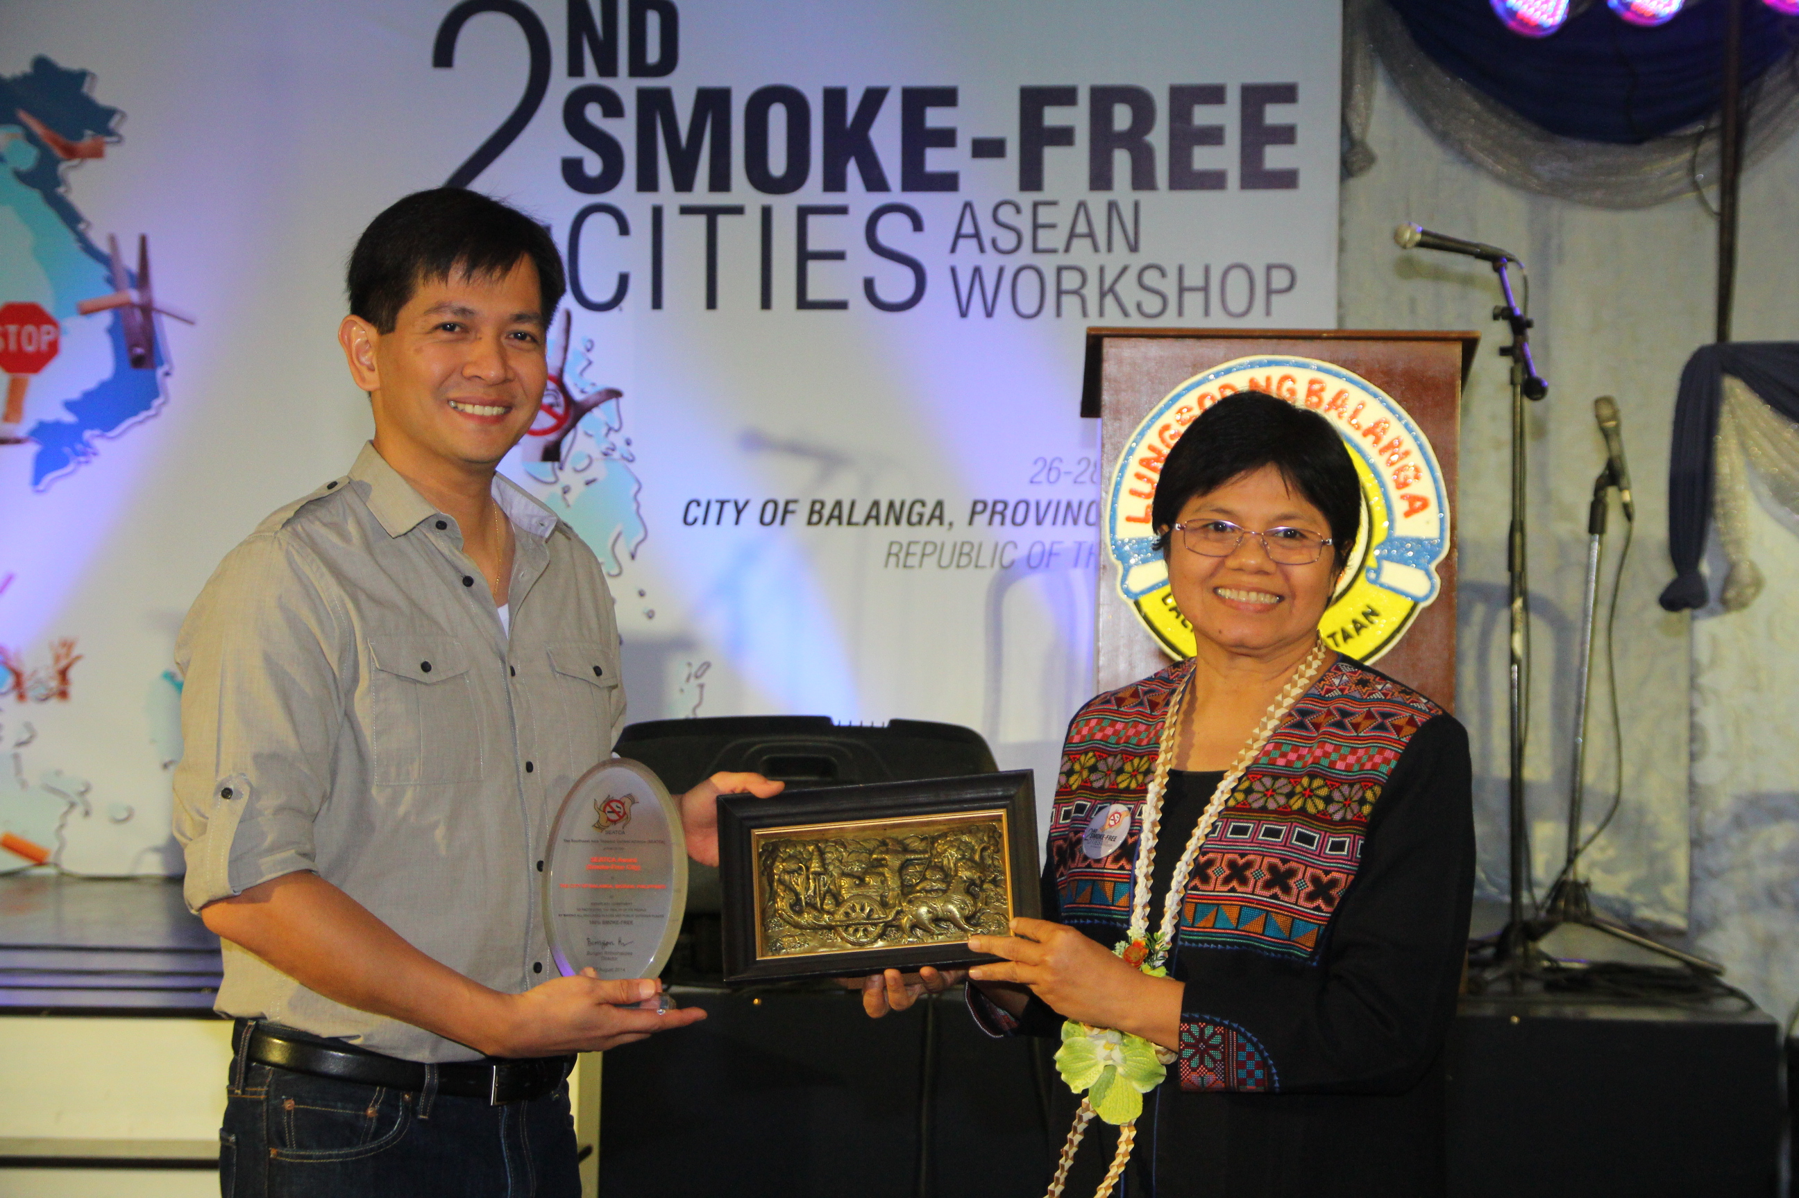
2ND SMOKE-FREE CITIES ASEAN Workshops in BALANGA CITY
Effective Tobacco Control Policy in the ASEAN - August 2014

Slide 3
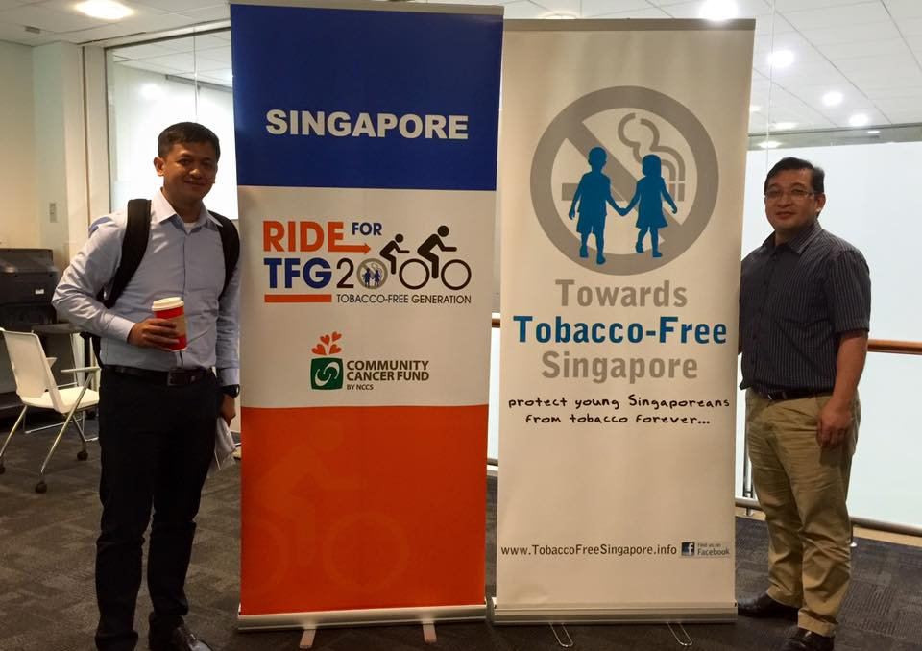
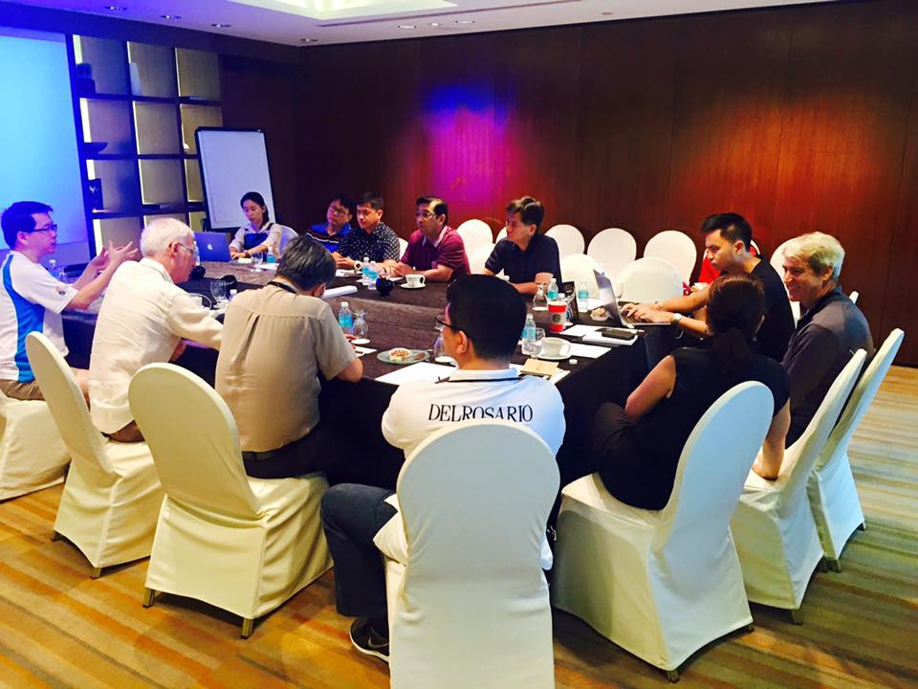
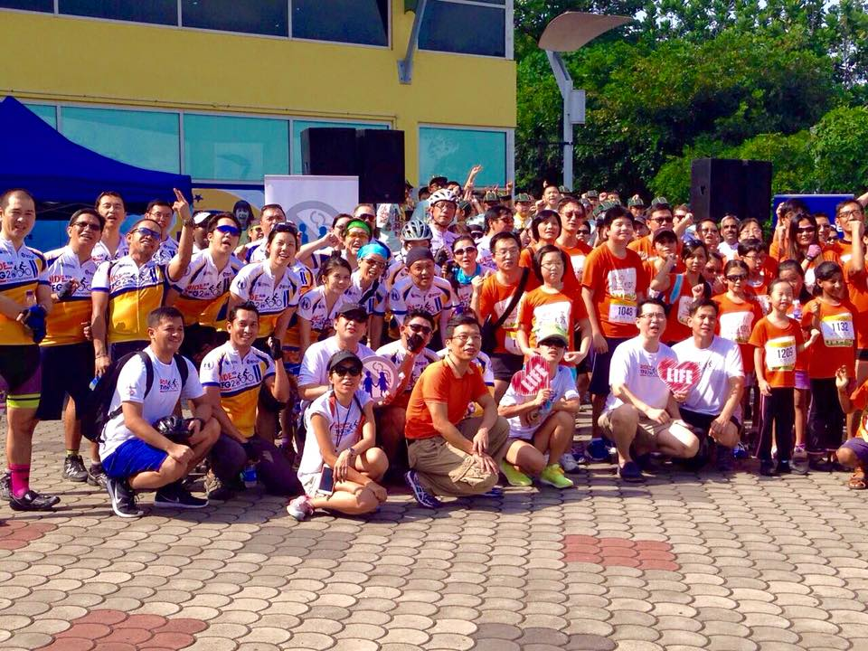
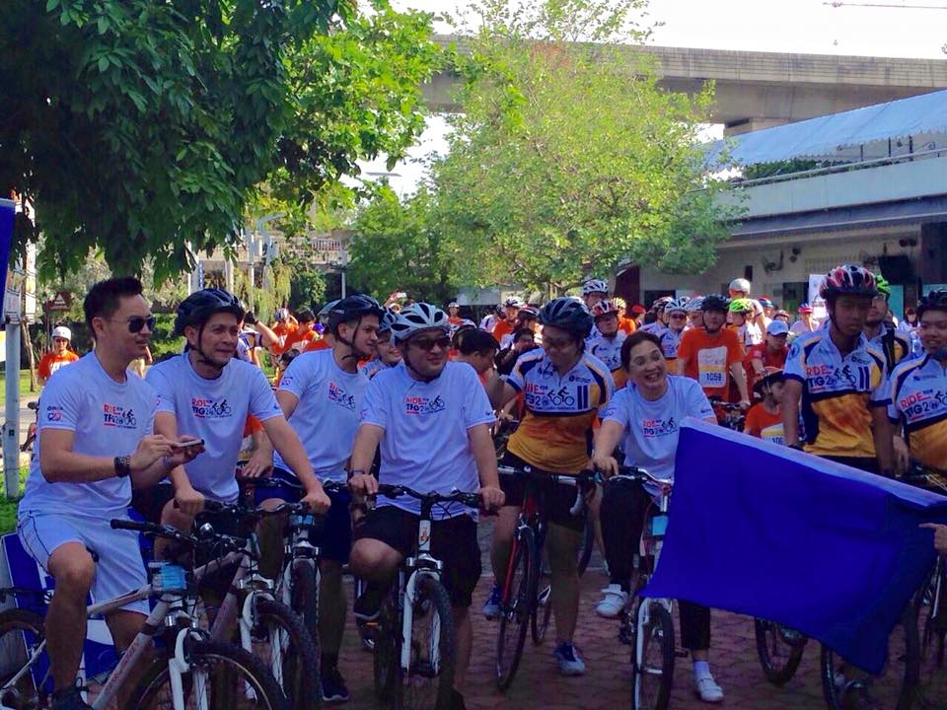
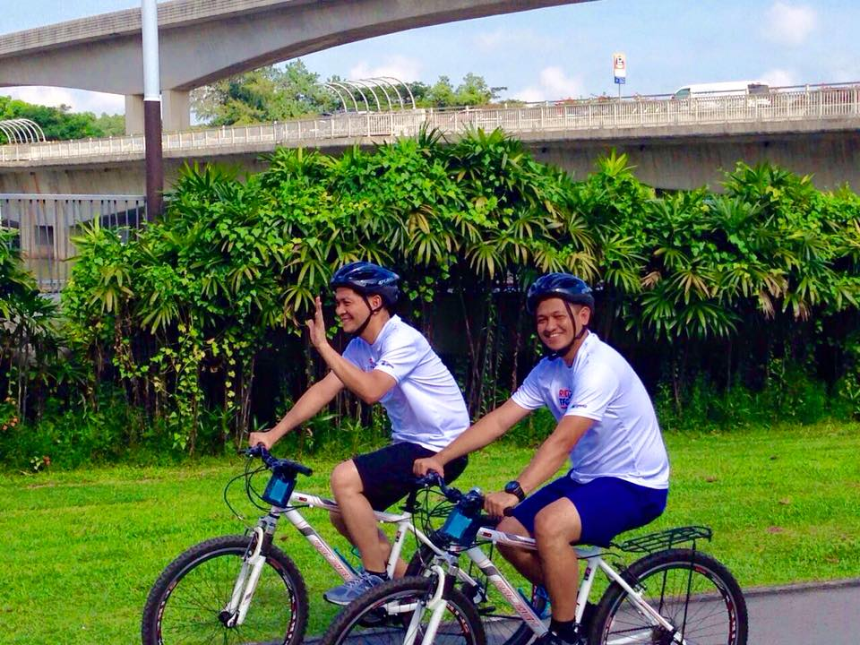
TOBACCO FREE GENERATION 2000 (SINGAPORE NOVEMBER 2015)

Slide 4
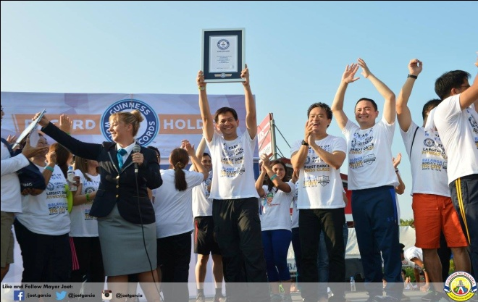
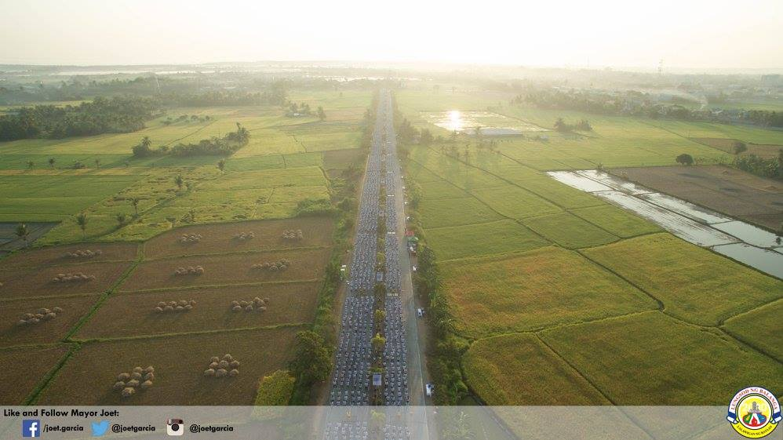
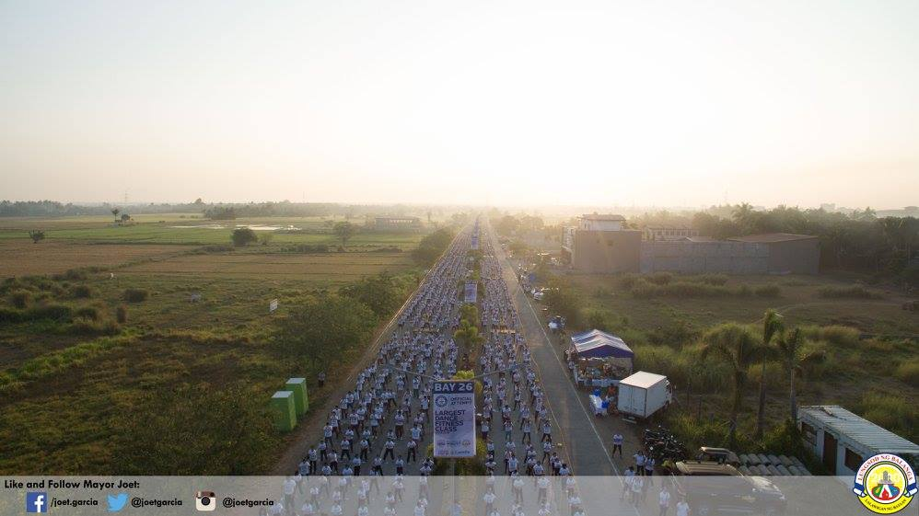
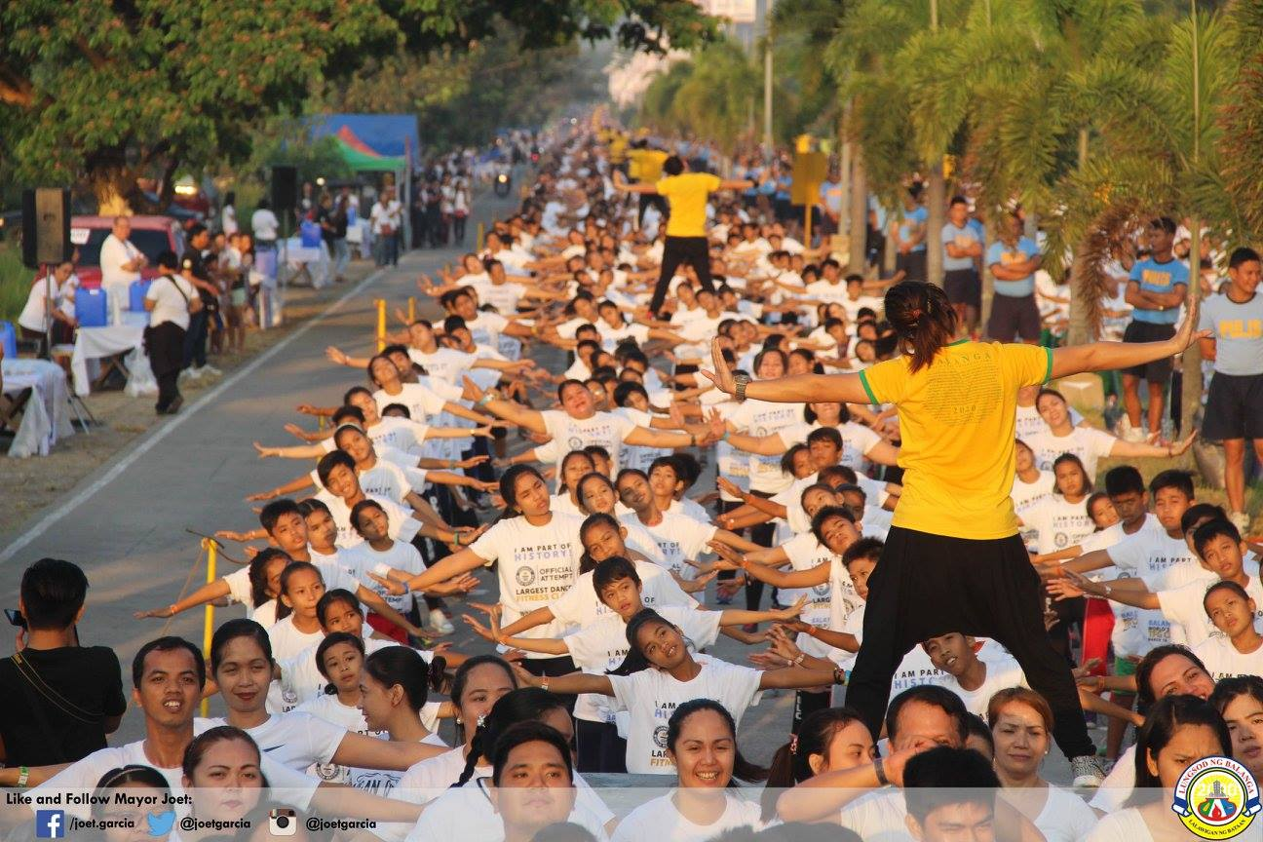
Guinness World Record for the Largest Dance Fitness Class in a Single Venue
16,218 Participants
March 18,2016

Slide 5
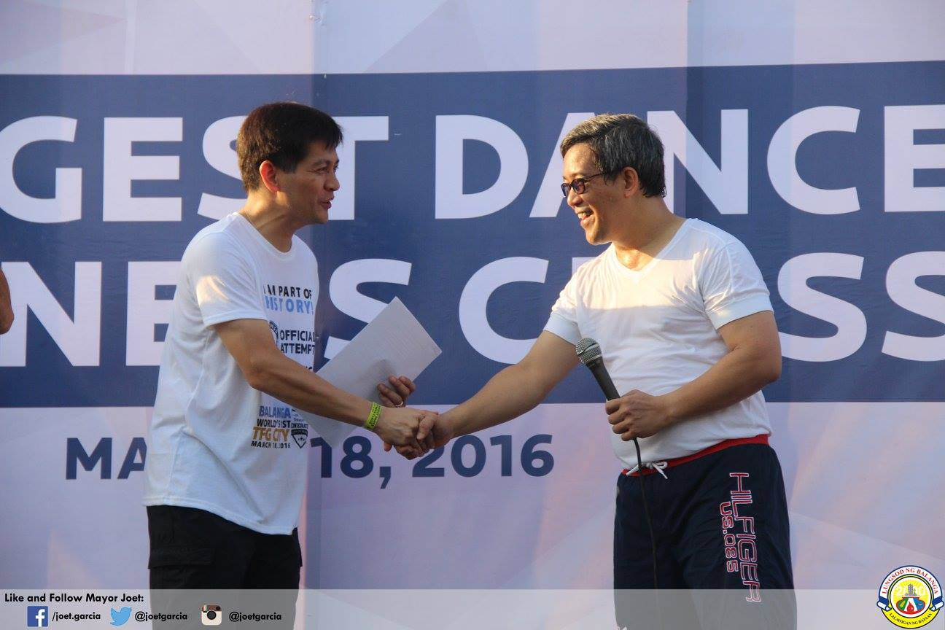
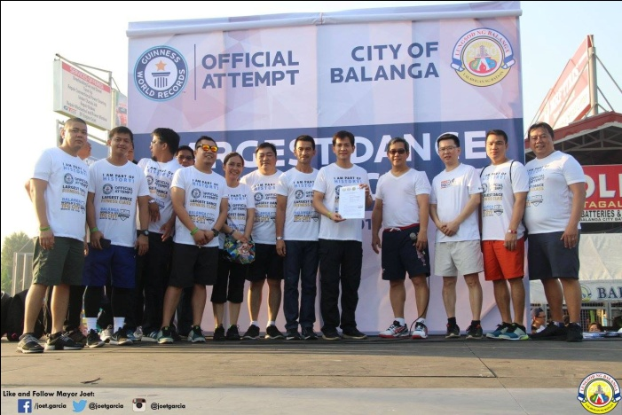
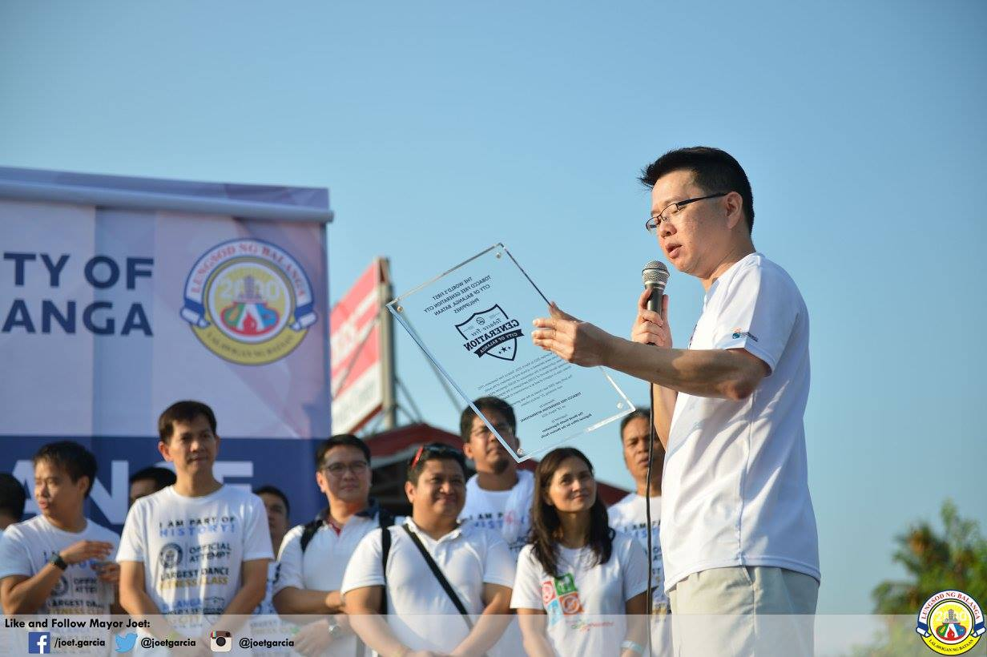
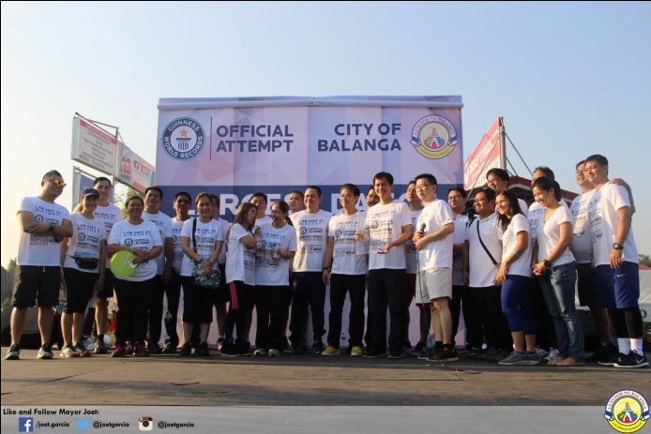
Dr. Ariel Ilaya, President of MSGC presented the 30, 000+ signatures supporting the Tobacco Free Generation Movement in Balanga City.
Dr. Heng Nung Koong together with other members of TFG International awarded the City of Balanga as the First Tobacco Free Generation City.

Slide 6
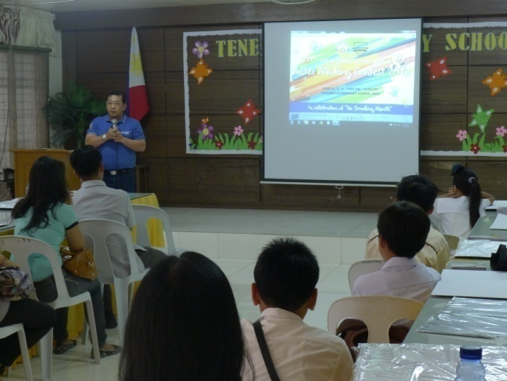
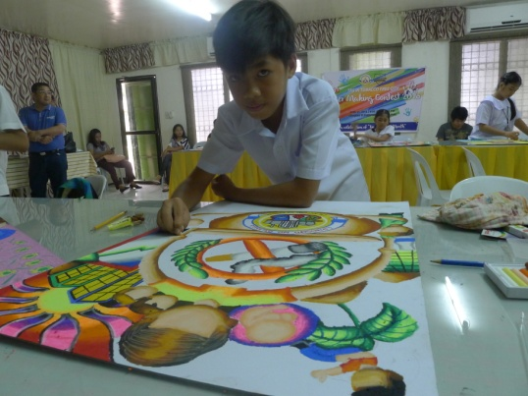
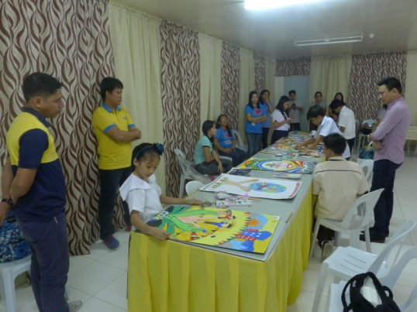
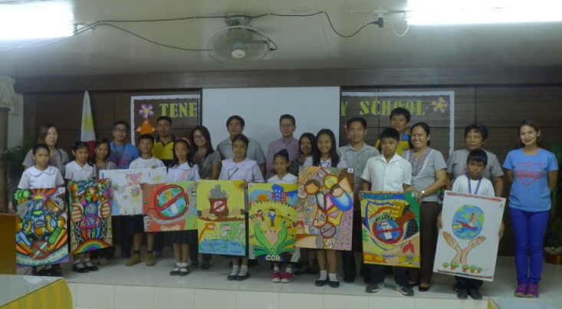
“TOBACCO ENDGAME BALANGA CITY”
TFG Poster Making Contest
In Celebration of NO SMOKING MONTH
June 21,2016

Slide 7
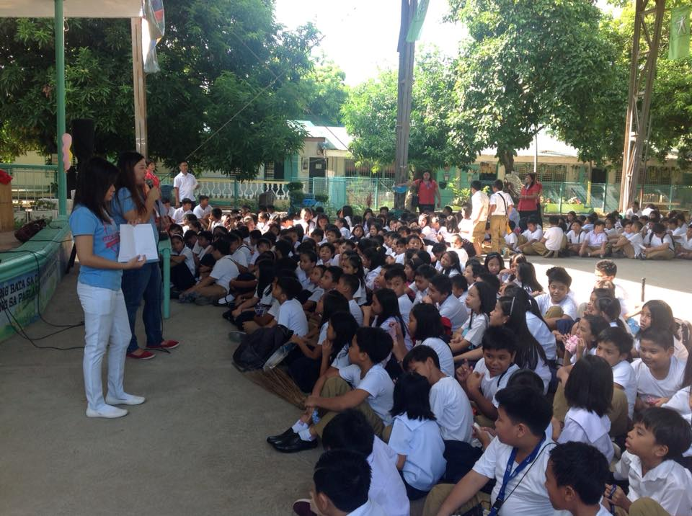
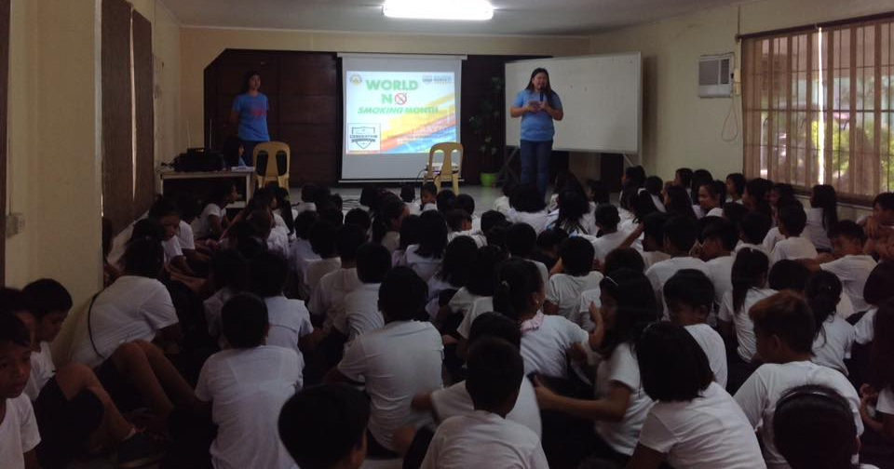
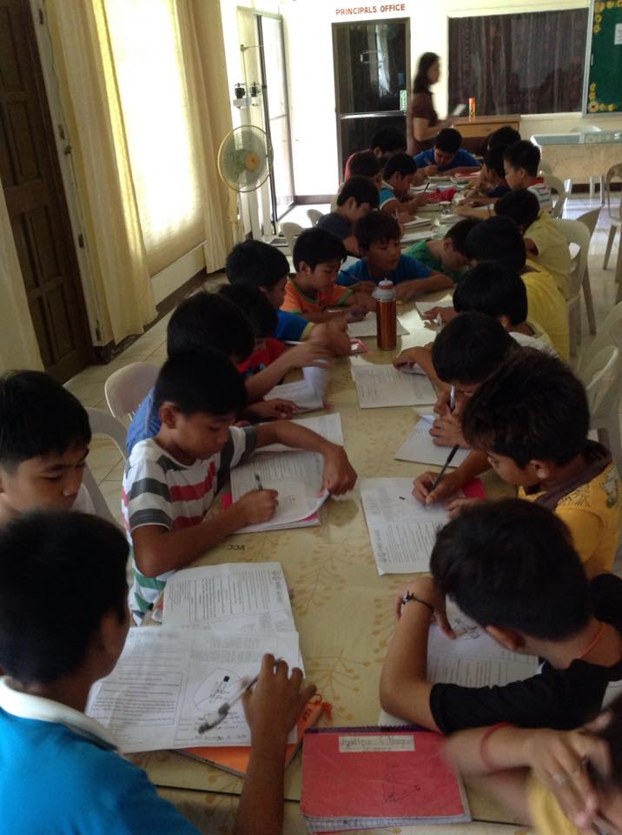
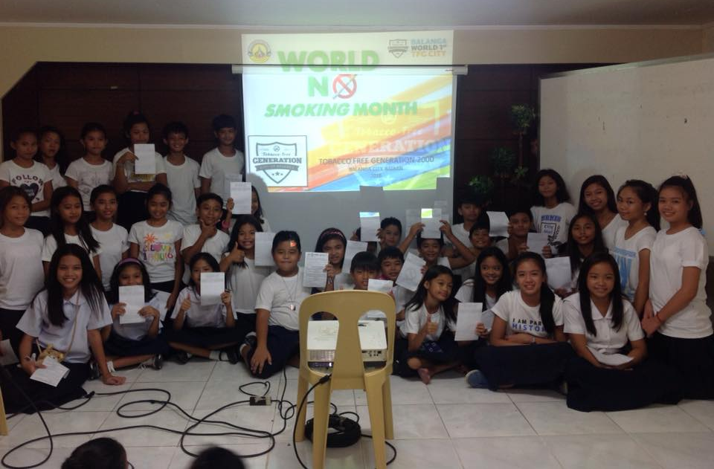
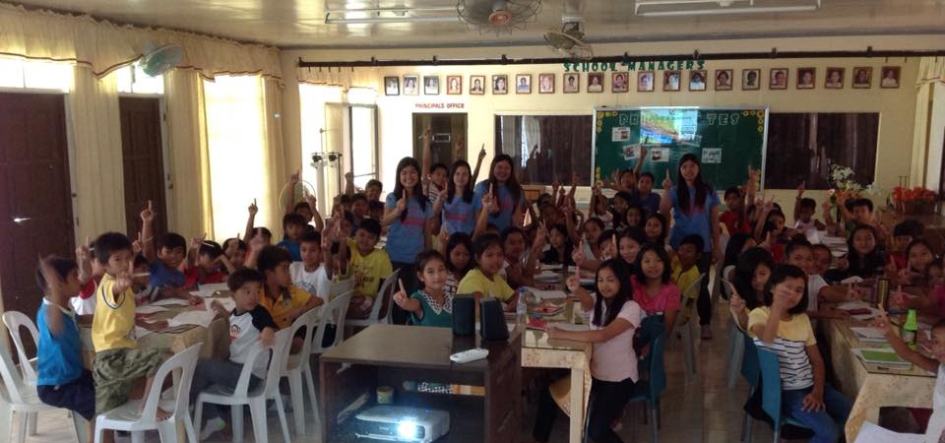
“TOBACCO END GAME Balanga City” TFG Letter Writing Contest In Celebration of NO SMOKING MONTH

Slide 8
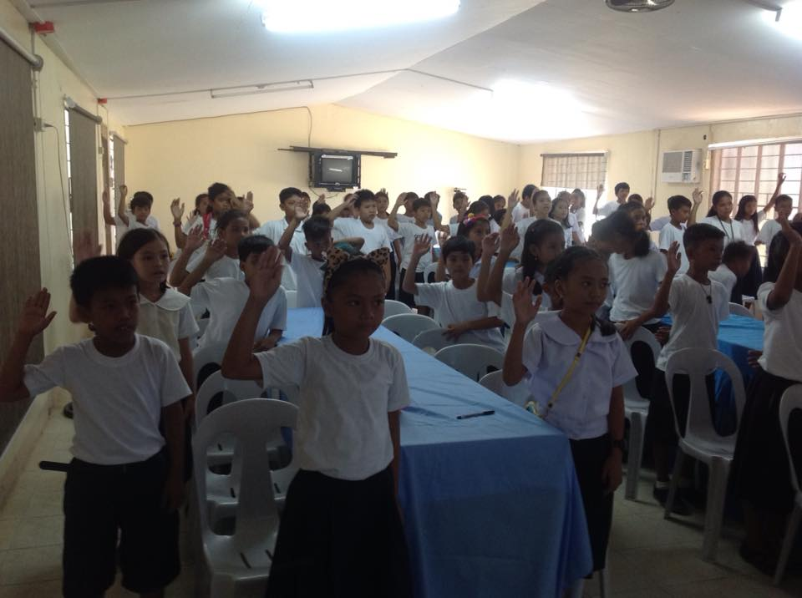
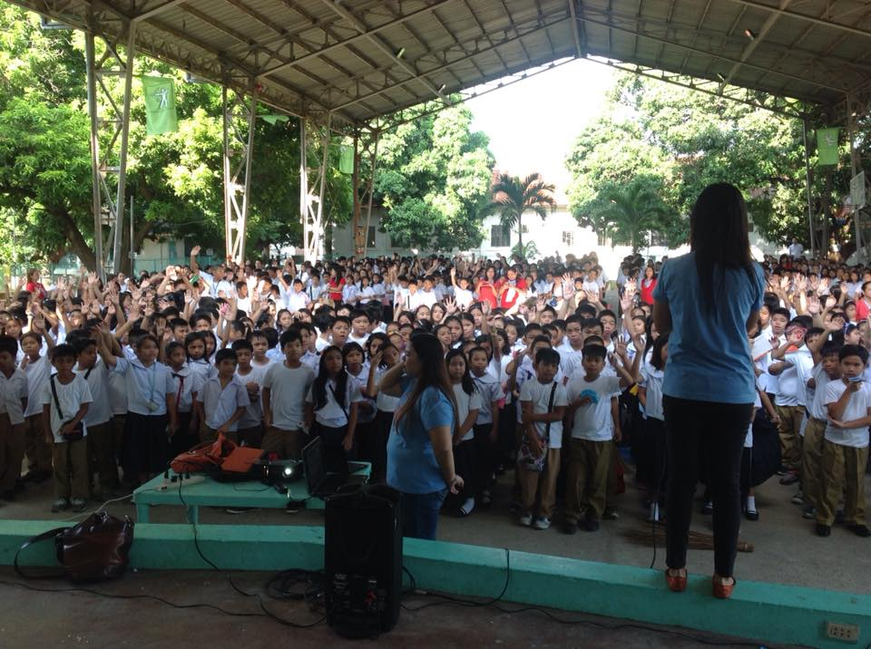
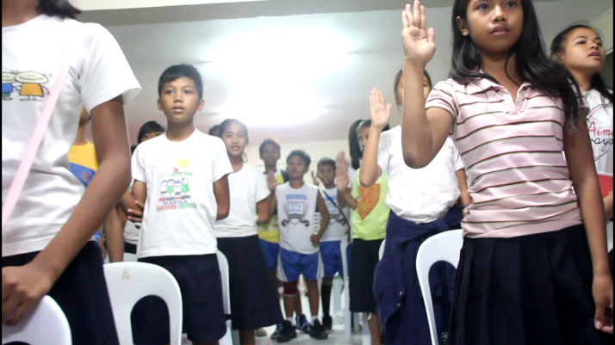
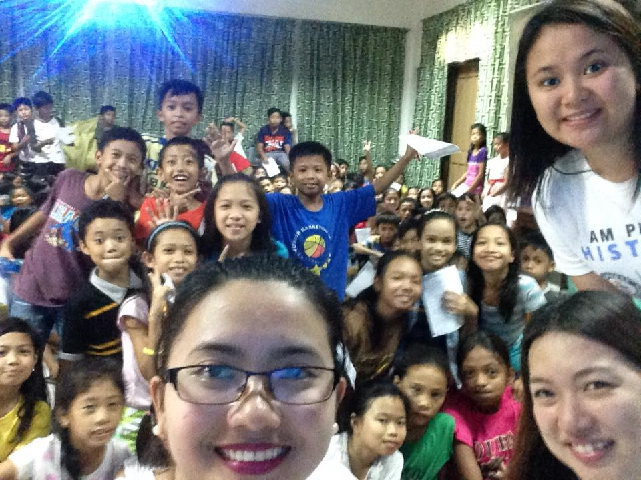
BALANGA CITY TOBACCO FREE GENERATION SCHOOL CAMPAIGN PUBLIC & PRIVATE ELEMENTARY LEVEL w/ 3,292 participants JULY 2016

Slide 9
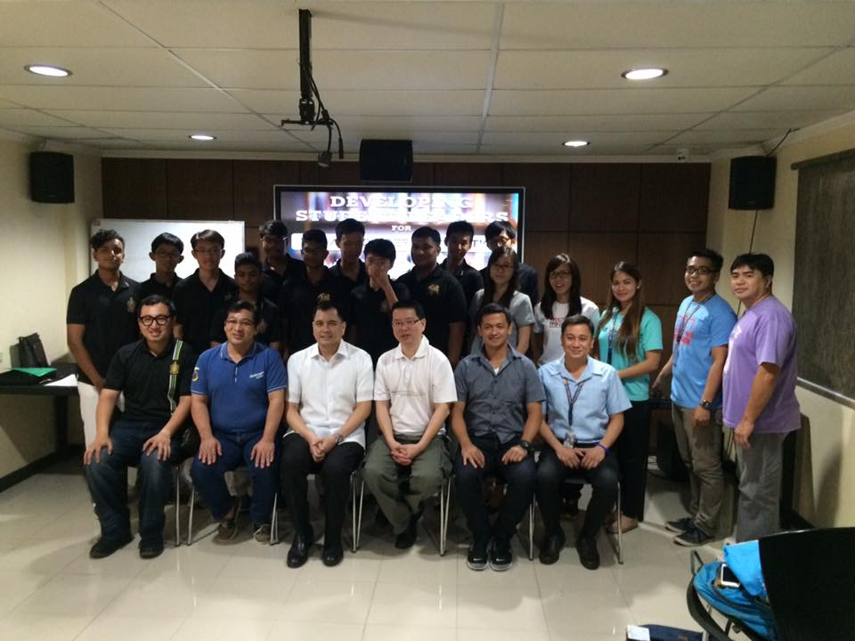
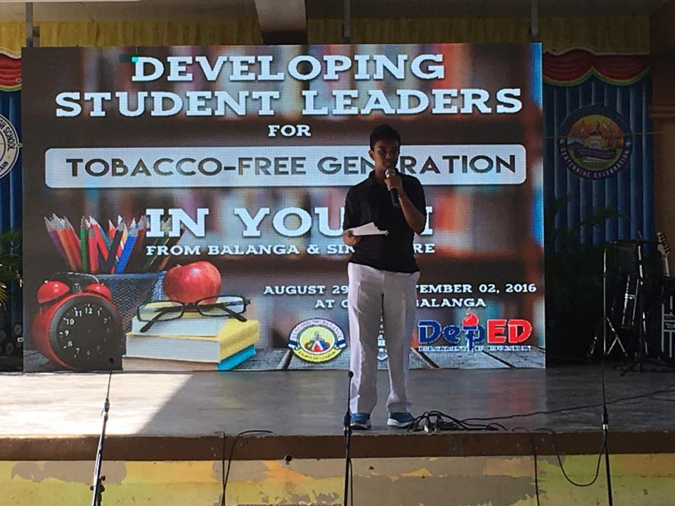
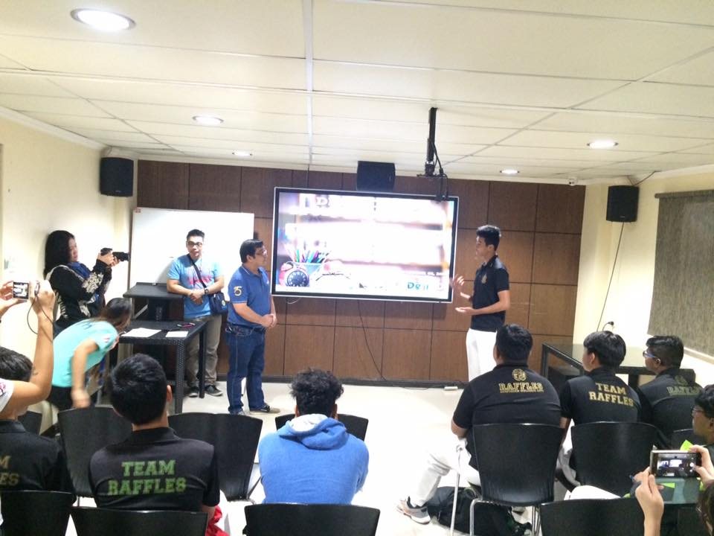
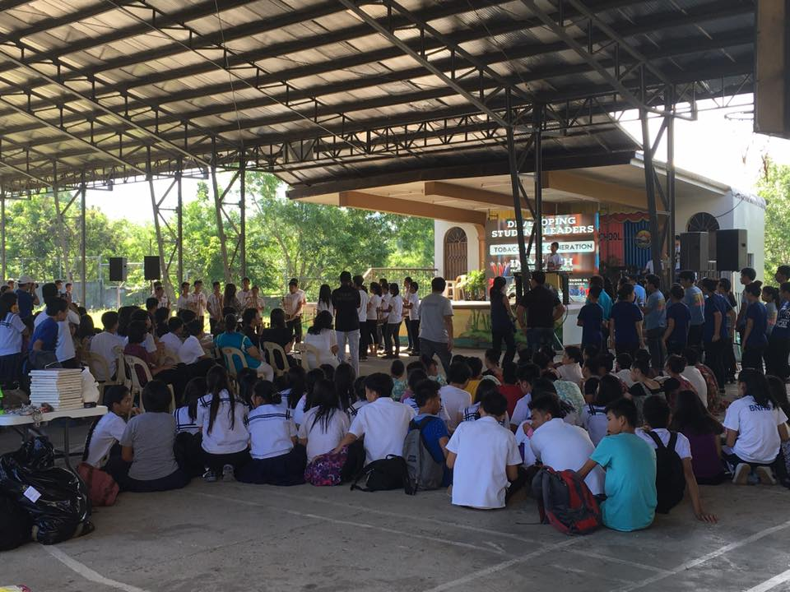
Developing Student Leaders for TFG
Bataan National Highschool & Raffles Institution Singapore
August 29- September 2,2016

Slide 10
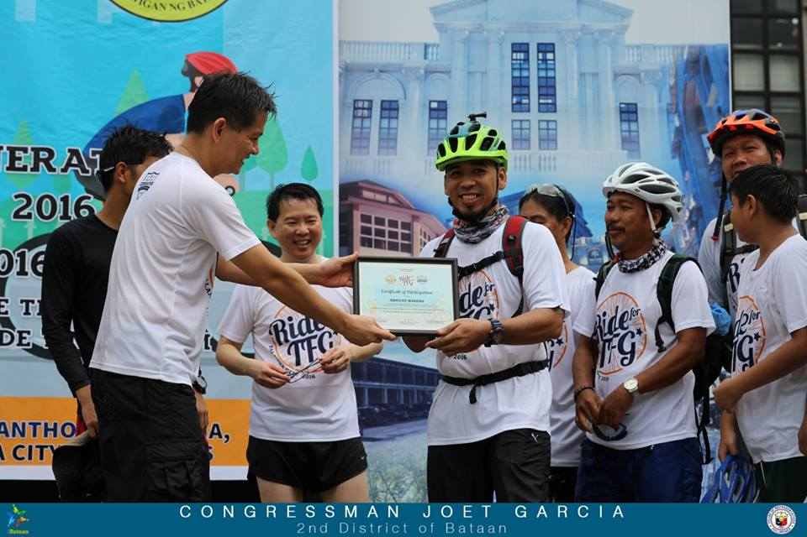
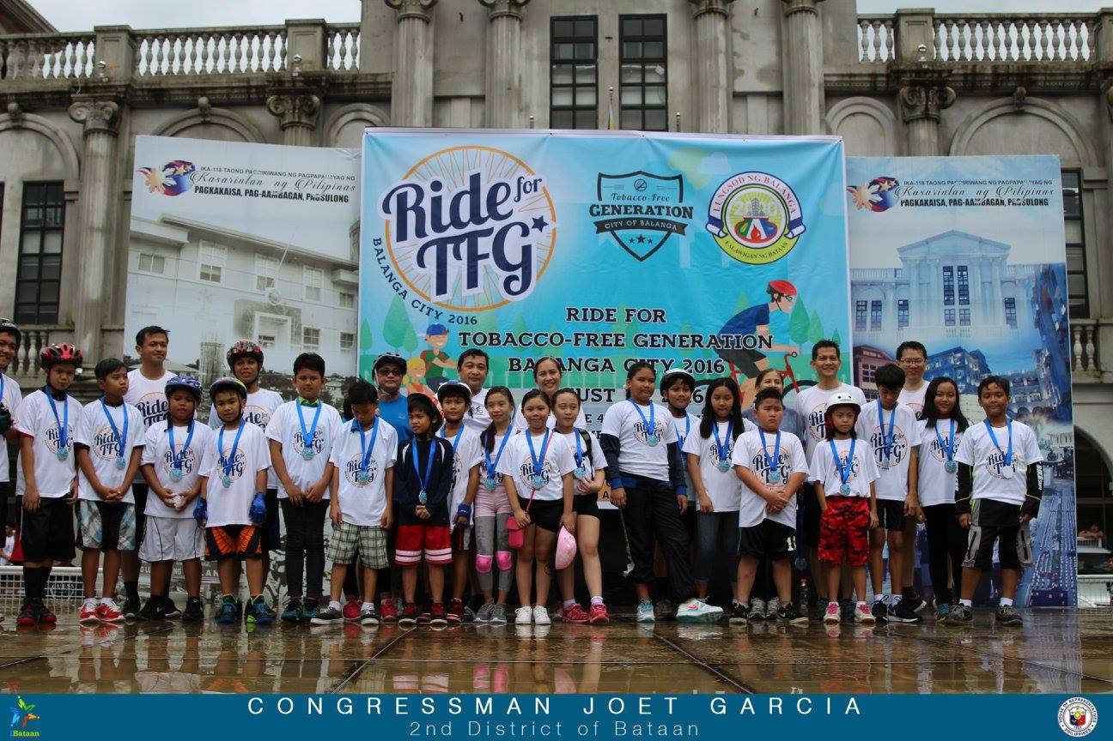
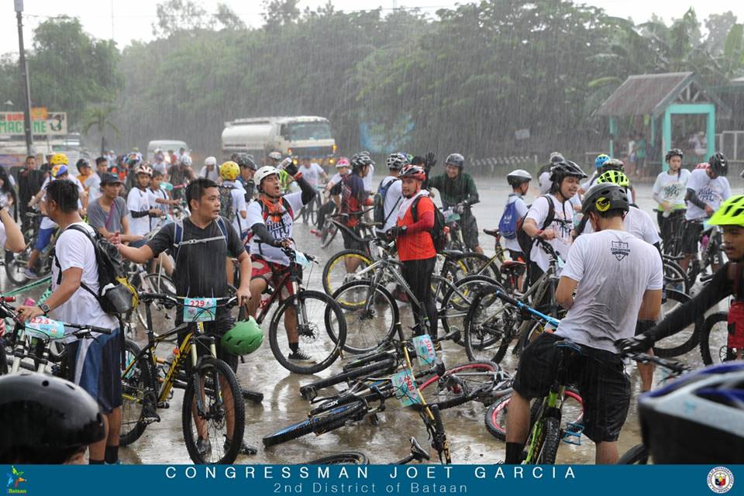
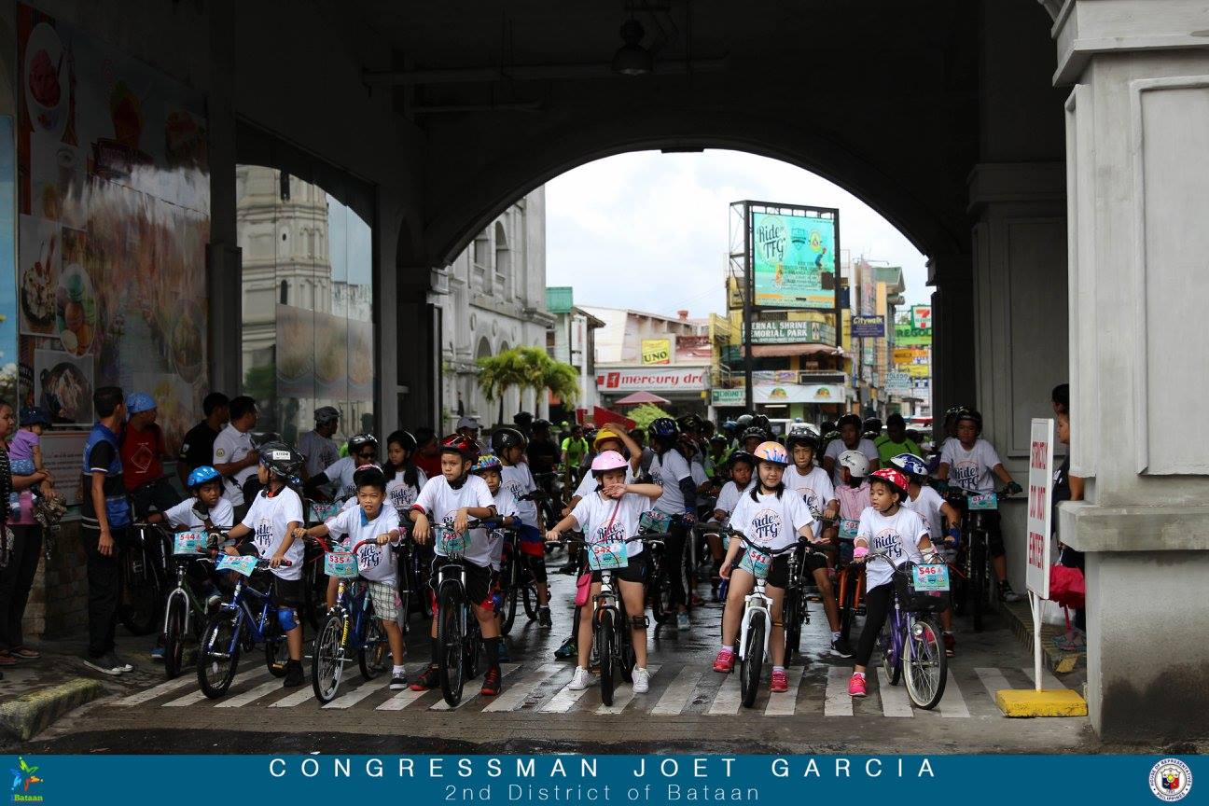
Ride 1st Ride for Tobacco Free Generation with 600+ participants Plaza Mayor Balanga
August 29, 2016

