Slide 1
Dr. Kathryn Barnsley
Presentation to Legislative council members
August 2019
PUBLIC HEALTH AMENDMENT (PREVENTION OF SALE OF SMOKING PRODUCTS TO UNDERAGE PERSONS) BILL 2018

Slide 2
How is the tobacco industry deceiving you?
Saying that the legislation is too complex for retailers and hotels
Scaring small retailers – by saying that they will lose jobs/go broke.
Using “front” organisations to deliver their message.
Misleading you about the proposed legislation – floodgates arguments
Arguing tobacco is a legal drug (product)
Using fear regarding organised crime and prohibition
Expressing unfounded concern for tourist industry
Alleging lack of consultation
Allege “rights” for adults (over 18) to do as they “choose”
Emphasizing “choice” without mentioning addiction
Sowing fear
Creating doubt
Avoiding the real issues

Slide 3
Job losses for SMALL retailers? Will they “go broke”? …………NO
There will still be 75,000 smokers buying cigarettes long after the bill is passed.
1
Only a small cohort of potentially NEW smokers will be restricted from sales.
2
Only one per cent of Tasmanian smokers who buy from small retailers are aged 18-24.
3
As there are fewer than 700 licensed retailers in Tasmania, they have only one young customer each.
4
If a retailer currently only has one customer in the 18-21 age group NOW they are unlikely to go broke.
5
The new age cohort of 18-21 young people will hopefully smoke less-no impact on retailers in the short term.
6
Only 600 “new” smokers each year. It will be some decades before all the current smokers die or quit.
7
Smokers over 21 years can start buying cigarettes in 2023.
8

Slide 4
Tourism – tourists will have problems with smoking Laws
Tourists are accustomed to different cultures and rules – for example not buying alcohol in Muslim countries
Less than half of one per cent of tourists will be smokers in the age group 18 to 25 years.
Tourists can bring their own cigarettes with them. Possession is not an offence.

Slide 5
Tobacco industry “Fake News”
Stories about Illicit tobacco sales increasing.
Illicit tobacco allegations are repeatedly debunked by research from the Cancer Council Victoria
Retailers will sack staff if there are any tobacco reforms
Tasmanian research shows that small business is unaffected by giving up selling tobacco altogether
The legislation wont work and will be ineffective
If it doesn’t work it will have no effect on retailers – so what is their problem?
There is no public support
Repeated surveys by the Cancer council, media outlets and a big Galaxy poll conducted by Minderoo show around 78% or more support

Slide 6
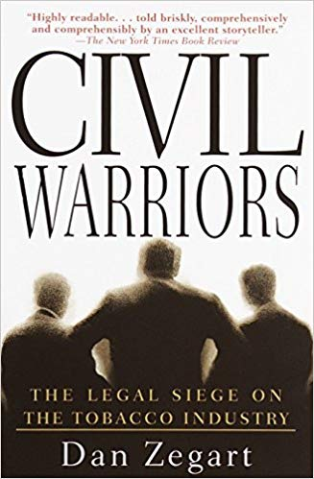
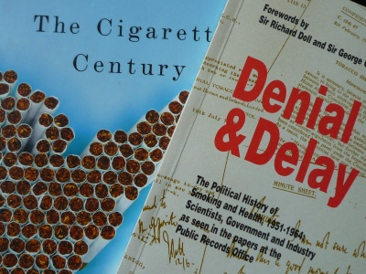
Delay, Delay, Delay……. TACTIC… Create uncertainty, fear, doubt
The most important tactic of the tobacco industry is to delay any action
Their tactic is to create doubt and uncertainty – so people become frightened and do not act.
The biggest threat to our children and our health system is a continuation of smoking uptake.

Slide 7
Floodgates arguments
The industry argues that this bill will lead to bans on alcohol sales to anyone under 21
That it will lead to younger people being banned from selling tobacco
FALSE DISTRACTION

Slide 8
Is The law too complex for retailers?
NO
It will be very easy for retailers to implement because they will only have to remember one date….much easier than at present
When ID is presented all they have to know is that the person was born before of after 1 July 2002
If they are born after 1 July 2002 the customer cannot be sold cigarettes.

Slide 9
“Choice” is illusory
Addictiveness of cigarettes has been increased:
• Increasing nicotine levels
• Adding ammonia or ammonia compounds, which increase the speed at which nicotine is delivered to the brain
• Adding sugars, which increase the addictive effects of nicotine and make it easier to inhale tobacco smoke.
“Defendants have designed their cigarettes to precisely control nicotine delivery levels and provide doses of nicotine sufficient to create and sustain addiction.” Kessler
“Lights” fraud – ACCC condemned industry for misleading and deceptive conduct
Recessed filters, “crush” menthol balls designed to hook new smokers;cigarette engineering is a continuous theme
Tobacco industry uses “Choice” labelling on its businesses and products

Slide 10
Addictive by design
“The scientific evidence is incontrovertible: inhaling the combustion compounds from tobacco smoke, particularly from cigarettes, is deadly. It has been stated that :
“The cigarette is also a defective product, meaning not just dangerous but unreasonably dangerous, killing half its long-term users. And addictive by design” (Proctor 2013, p. i27). “ Quote by US Surgeon-General
We know that smoking kills two-thirds of smokers. (Banks, BMC Medicine 2015)

Slide 11
Tobacco is a “legal” product
Many products
are
strictly regulated.
Poisons – Nicotine is a Schedule 7 poison and has an exemption for tobacco
Food – is highly regulated; when there are outbreaks of salmonella or listeriosis the public is concerned about lack of standards and enforcement of regulation

Slide 12
Age 18 – Adults can “choose” ……………….or can they?
Exceptions
Brain development and changing one’s mind with age
Newstart – cannot get until 21
Driving – limitations on alcohol use and cannot get full license for three years – usually around 21.
Car hire – 21 years (25 for prestige cars)
Marriage – can get divorced later
Voting – can change parties at every election
Alcohol – can drink in moderation
Joining the military – can leave or stay.
Risky choices – cannot make decisions about addictive substances until 25

Slide 13
Will tobacco21 “work”?
Yes
In all jurisdictions where T21 has been implemented there has been a fall in uptake of smoking by young people
All predictive models show that it will reduce smoking rates and uptake of smoking.
Raising the age from 16 years to 18 years in Tasmania reduced uptake amongst young people.

Slide 14
Why delay? restrict uptake- young mothers
Reduction in smoking uptake in young people, particularly young women, will lead to immediate health benefits.
Reductions in premature births.
Two generations of lives saved – the mother and the baby.

Slide 15
Public health Law is not criminal law
About safe food, clean water, preventing disease.
Public health law protects communities.
Tobacco is a global pandemic driven by tobacco industry and their lawyers.

Slide 16
Ethics and “prohibition”
Ethics
“Ultimately, our analysis suggests that Tobacco 21 laws are ethically appropriate.
Policymakers should move quickly toward adopting these laws in jurisdictions where they are not yet in effect and in so doing taking an important step to protect the health of current and future adolescents.”
AJPH Law and Ethics Journal, Morain and Malek 2017
Not prohibition because there is :
No restriction on 18-21 year old smoking
No penalties for possession
No penalties for gifting
The only penalties are for sale

Slide 17
The most damaging option – do nothing
Decades more of this….
“Ambulance ramping at Royal Hobart Hospital hits nearly 10,000 hours in nine months
17 Jun 2019, 8:11am”

Slide 18
Public health
Old saying – do you put an ambulance at the bottom of the cliff to collect the people who fall off?
Or do you put a fence at the top to stop them from falling off?
This bill is the fence at the top of the cliff.
Some people will climb over – but most will be deterred.
It saves lives – and saves hospital costs
This Photo by Unknown Author is

Slide 19
The safest option for Tasmania is to support the bill
A once in a lifetime opportunity to exert the power - oblige the government to act on preventive health.
The safest option is to reduce the strain on hospitals, by reducing the uptake of smoking.
Not let the tobacco industry or their lawyers dictate to and misinform Tasmanians.
We should – in the words of Jason Trewin – protect our kids

