Slide 1
WORKSHOP: Choosing Tobacco or Health: Where to from here?
Tasmania
History of Tobacco Control – Which Way Ahead?
Harley Stanton

Slide 2
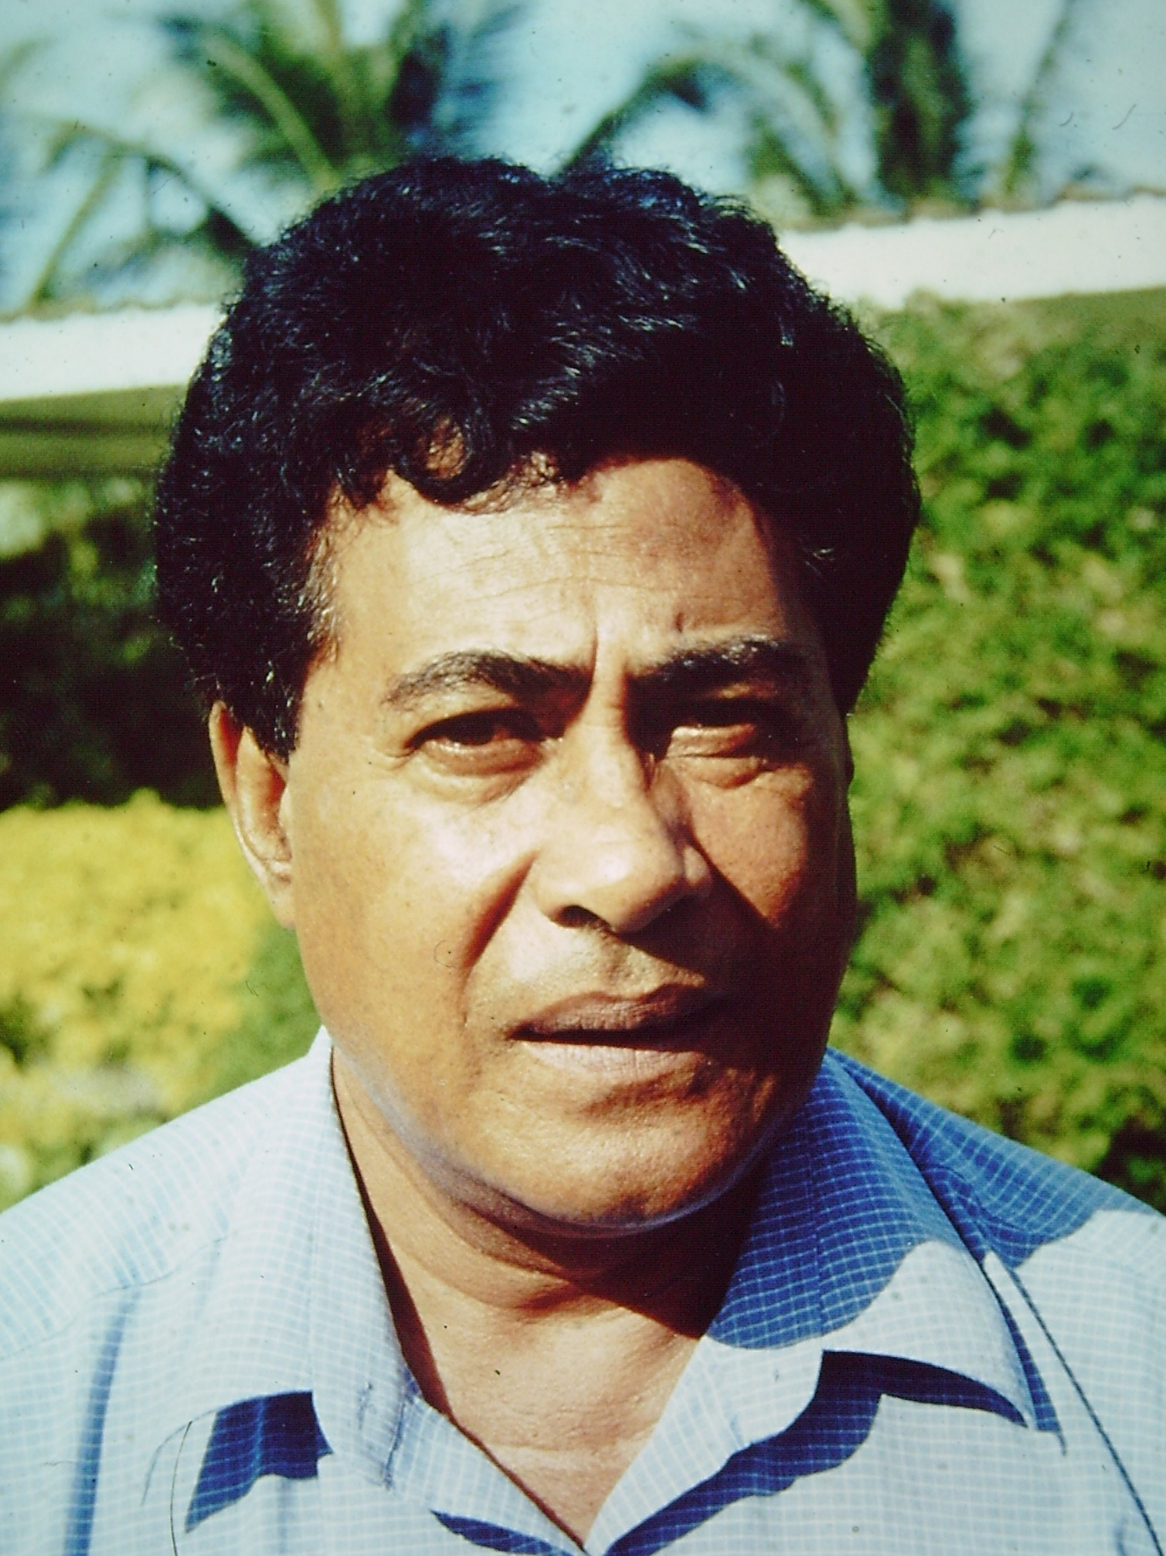
Nofoa Petana
Samoa

Slide 3
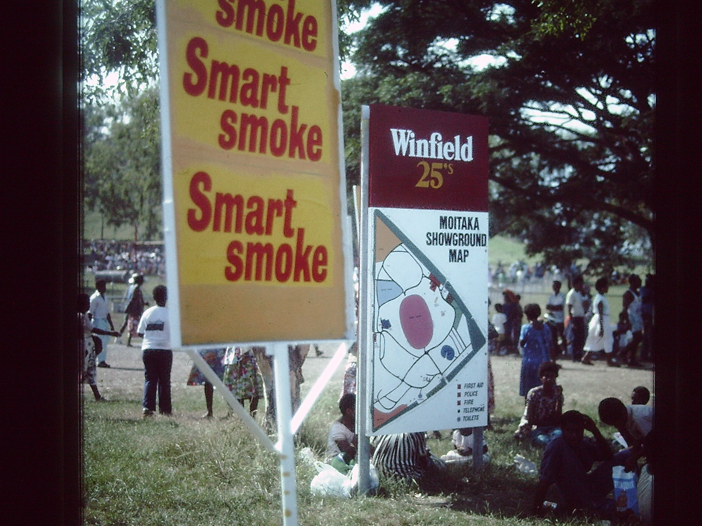
1. My epiphany with tobacco

Slide 4
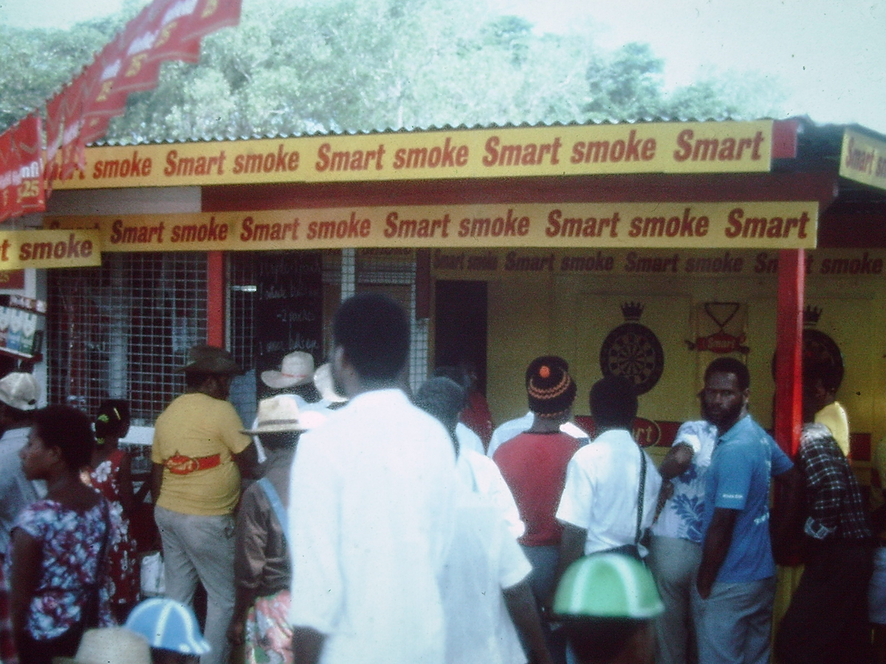

Slide 5
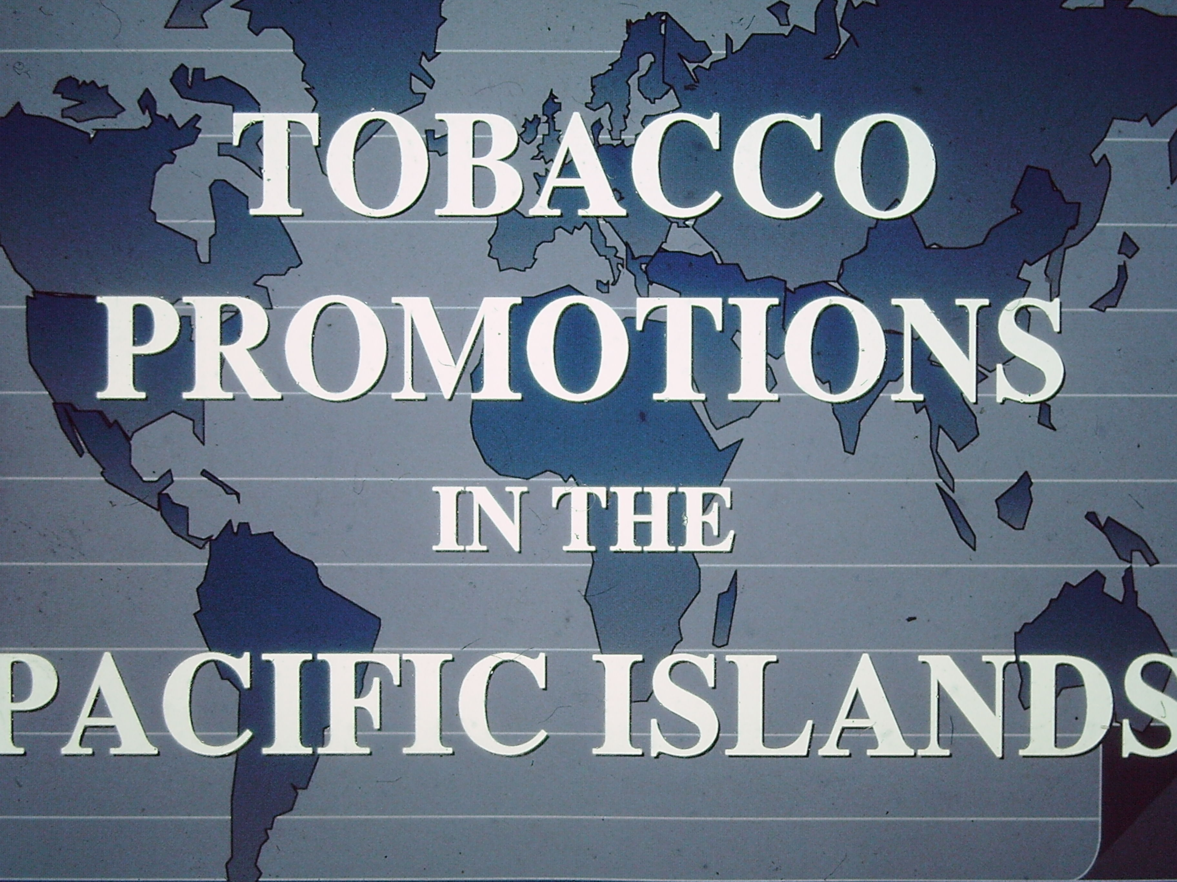
2. 1990 World Conference on Tobacco or Health Perth, Australia

Slide 6
Former Federal Trade Commissioner – Mike Pertschuk spoke:
“Take words seriously – Beware of those who would misappropriate your words!”
Also the release of the first “Insider” documents from the tobacco industry:
“How to deal with Anti-Tobacco advocates”

Slide 7
3. 1990 Legislation to ban tobacco advertising and sponsorship NSW then Federal
The BUGA-UP Campaign started to bite
ASH in NSW was supporting Rev. Fred Nile in a bill to ban tobacco advertising
Health and Universities were supportive
LNP Government of Nick Greiner opposed
Labour and Independents had a majority
SD Woodward suggested a letter from the bishops
Within a week 16 of 21 Church leaders supported
Tobacco Advertising Prohibition Bill passed with full party support
A similar success occurred in Tasmania much later in relation to ‘smoking in cars with minors’

Slide 9
Sir Robert Platt – 1964 – Immediate Past President of Royal College of Physicians, U.K.
Honorary Fellow of the Royal Australian College of Physicians said:
“In 50 years’ time smoking cigarettes will be as outmoded a social custom as taking snuff or sniffing salts.”

Slide 10
4. Other developments in the 1990’s
Expansion of package health warnings
Legal action on smoke-free environments
Exposing the lies of the tobacco companies – disclosure

Slide 11
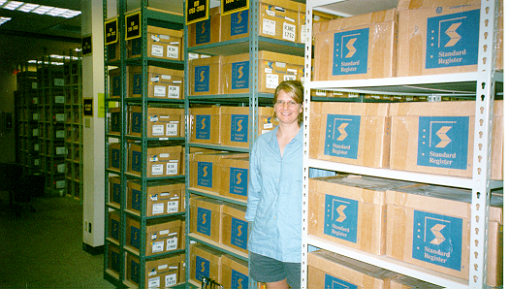
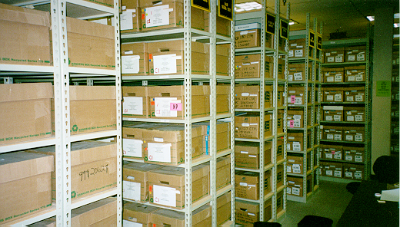
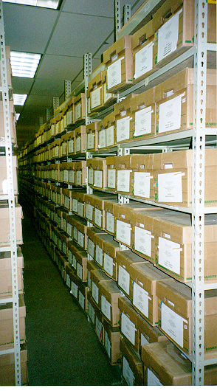
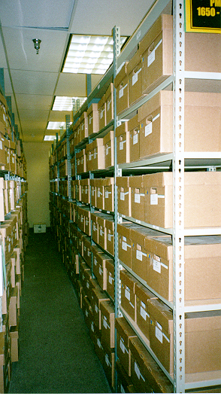
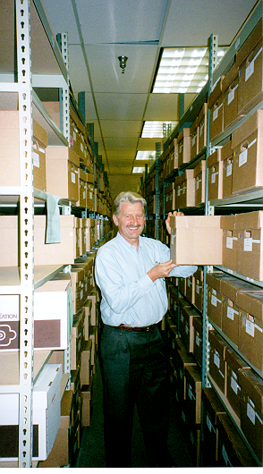
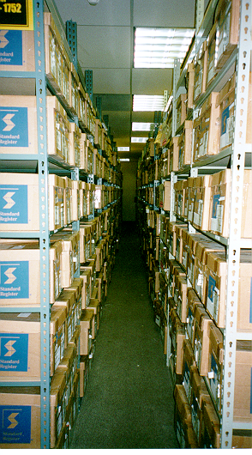

Slide 12
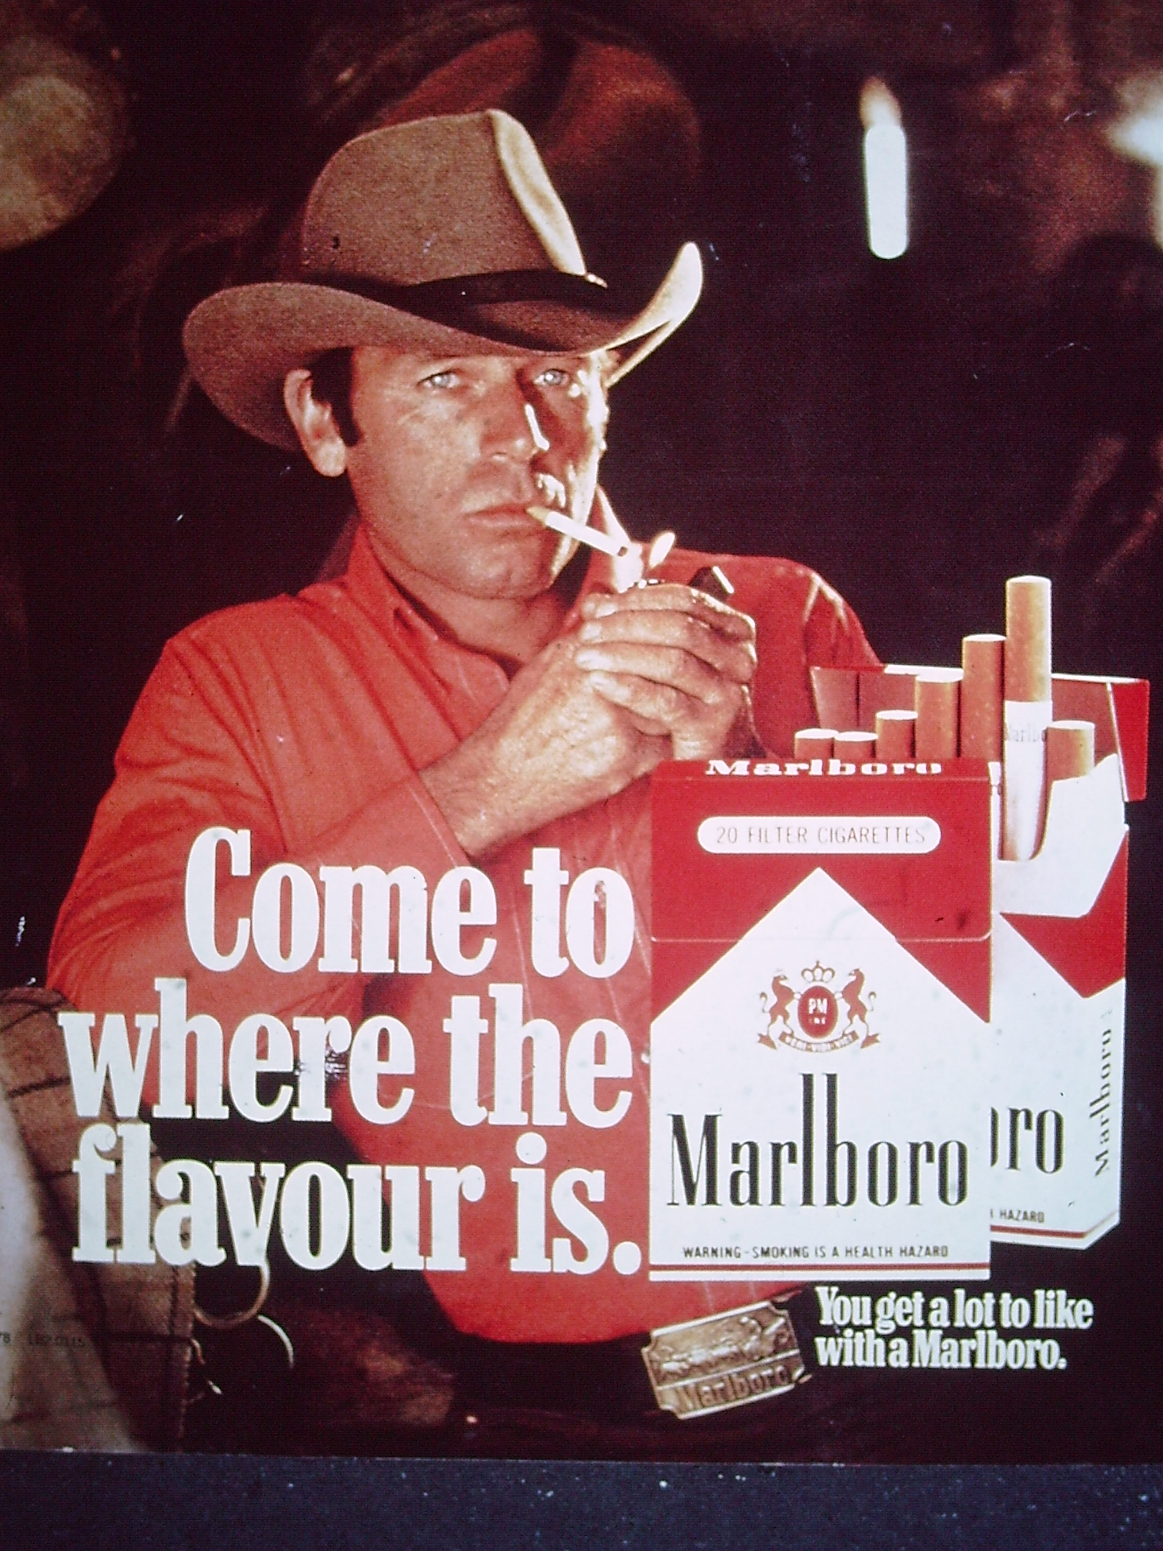
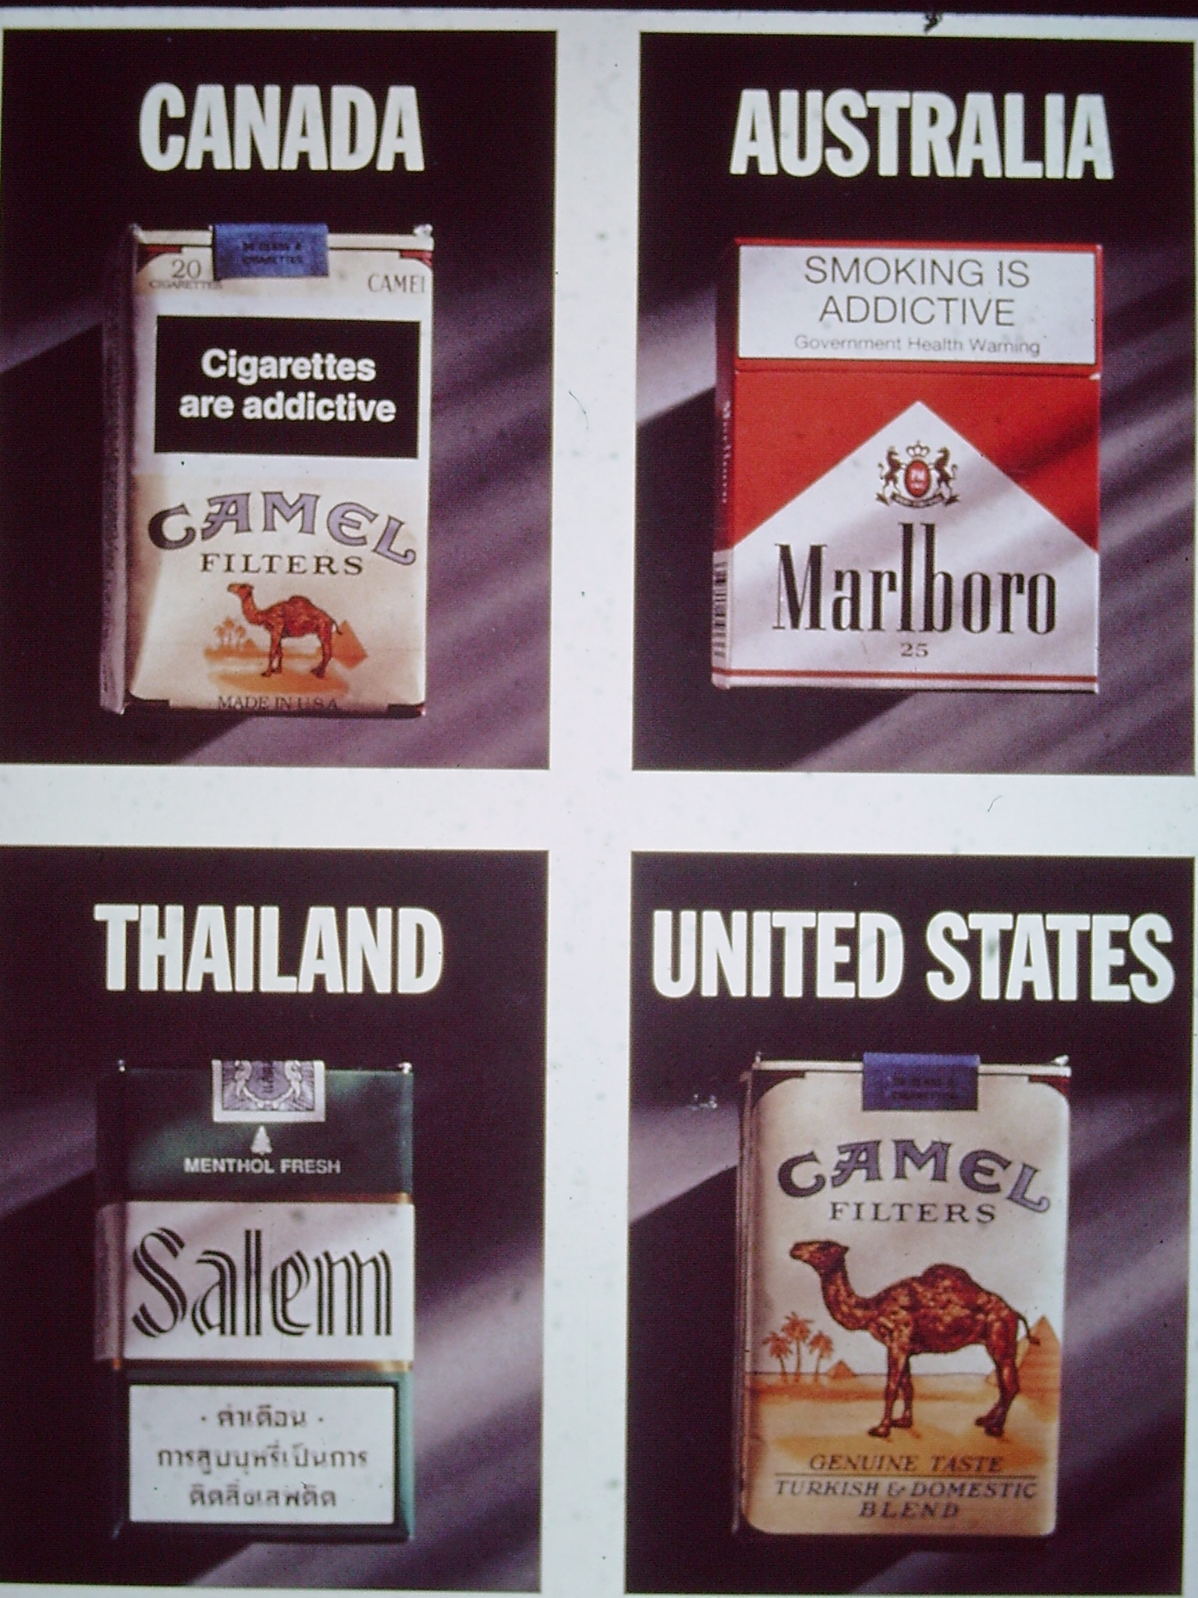

Slide 13
5. Submissions to Treasury on Taxation
Treasury said, “These are the most impressive submissions to treasury ever received!”

Slide 14
6. Implementation of Mass Media Counter Advertising
There was a two way impact of the removal of advertising and promotion by the Federal ban in 1992 and the support to using media to promote forceful and impacting messages to counter tobacco use. This was also supported by Quit lines and to a lesser measure by cessation support either pharamacological or behavioural.

Slide 15
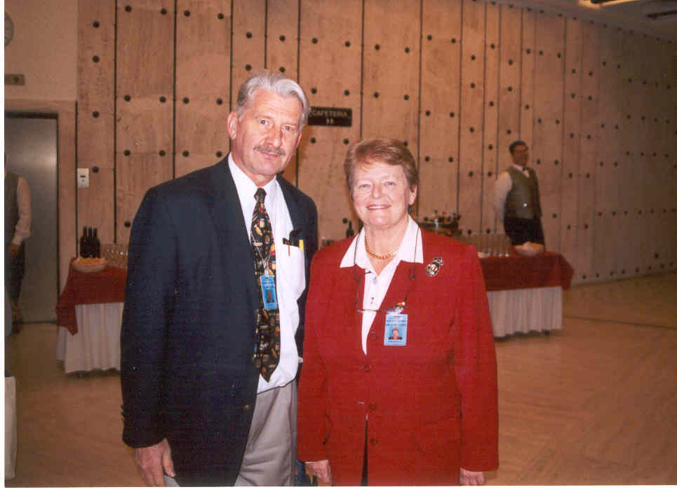
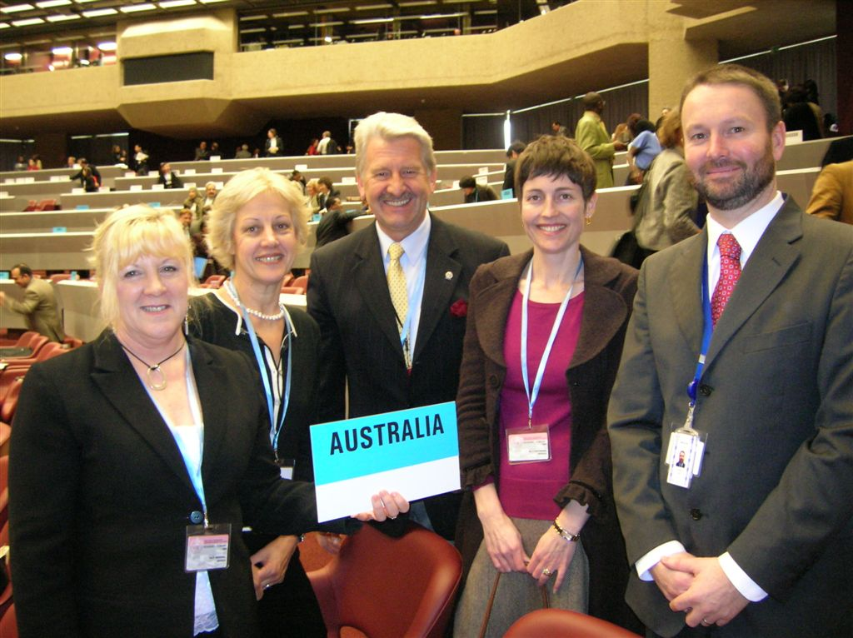
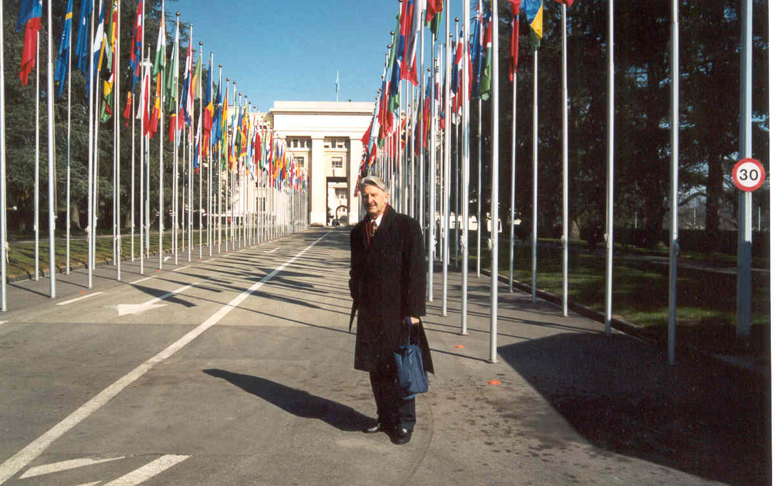
7. Global push by UICC and WHO
GlobaLink
WHO Framework Convention on Tobacco Control (WHO FCTC)

Slide 16
8. Tobacco industry push-back
The tobacco industry have adapted to new developments and regulation with alacrity.
They continue to use front groups and political mavericks to promote their cause.
Politicians who engage with them do so in contravention of Article 5.3 of the WHO FCTC.

Slide 17
9. Great challenges in moving forward
The decrease in funding for tobacco control and the demise of key people and agencies.
Failure to hold the industry accountable for the harm from a faulty lethal product.
The dramatic growth of non-combustible alternatives – ecigs and vaping products
The failure of politicians to vision a future free from tobacco
There will be need to engage a wide range of partners
To ensure funding is restored to media campaigns

Slide 18
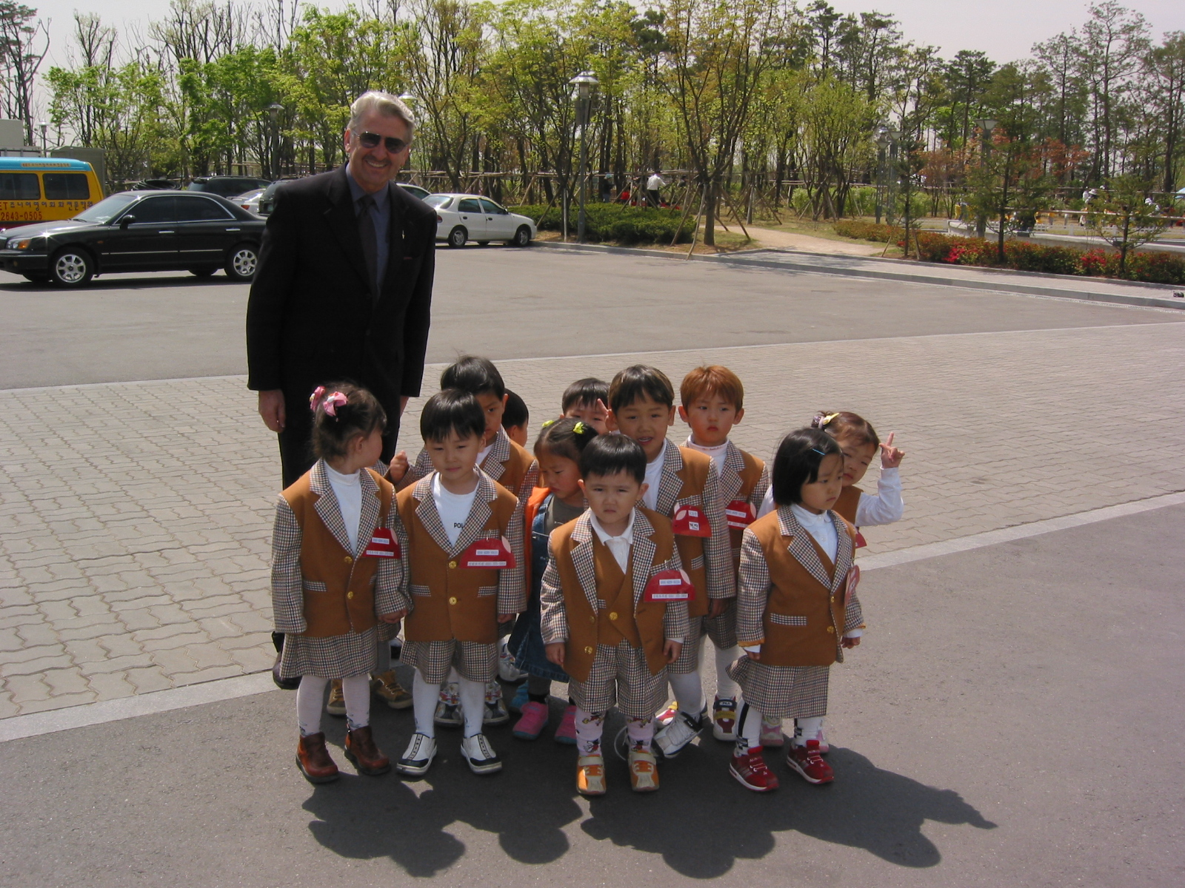
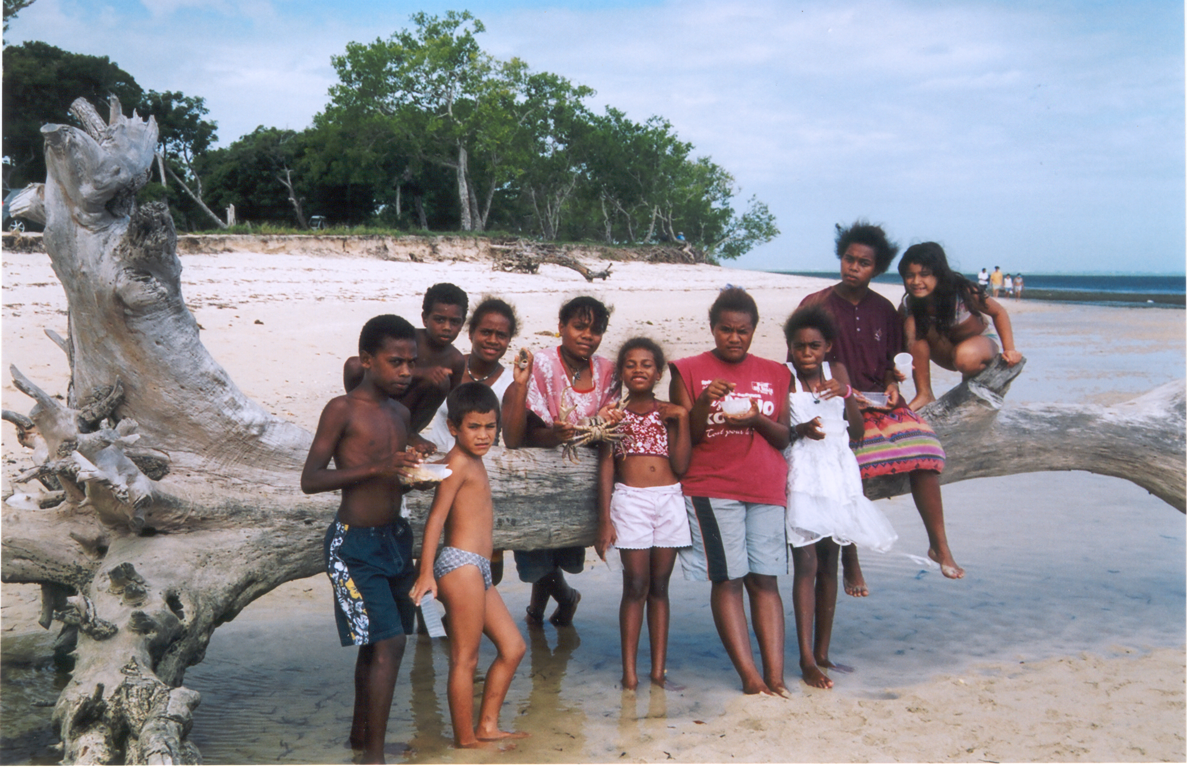
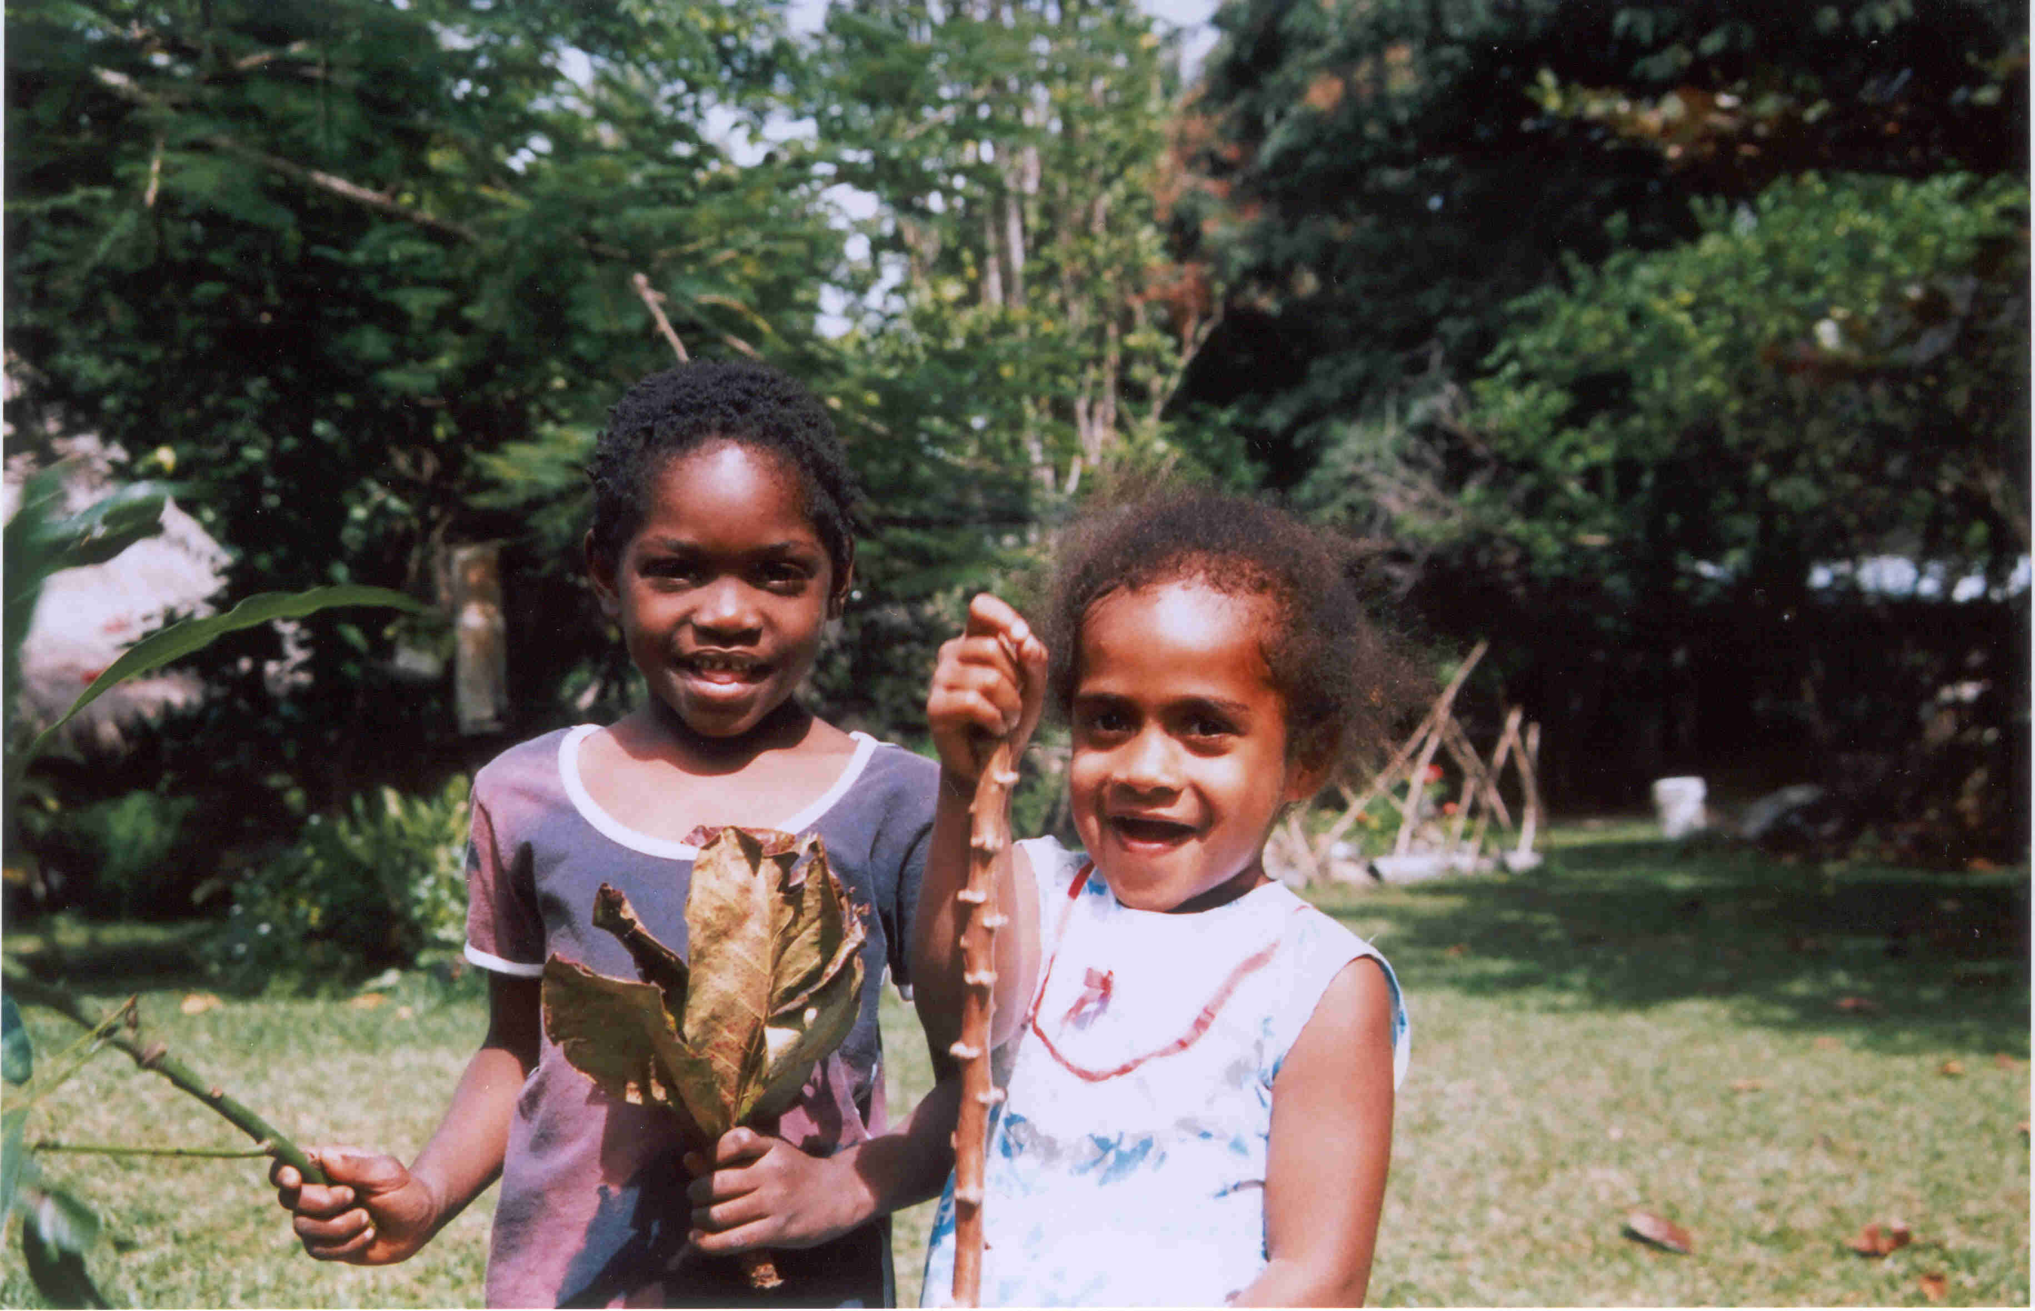
My goal 35 years ago - To enable the children of Asia-Pacific to grow up in a healthier smoke-free environment.

