Slide 1
Tobacco industry interference in public policy making – in Tasmania and internationally
Dr. Kathryn Barnsley, Co-convenor SmokeFree Tasmania
Launceston 2021

Slide 2
Interference takes many forms
Front groups – lobbying and media
Research – TI funds research and co-opts doctors and scientists
Funding – of political parties
Funding – of established organizations and front groups
Secret lobbying (breach of FCTC Article 5.3)
Threats, bullying, intimidation, coercion, litigation
Undermining of government border and taxation (smuggling)

Slide 3
Australia and Tasmania in recent years
People
Organizations
Newsagents
Alcohol
Gambling
Pro Vaping groups
Civil rights lawyers

Slide 4
Robert Mallett
Member of the Liberal Party, candidate, and on the State Council.
CEO Small Business Council

Slide 5
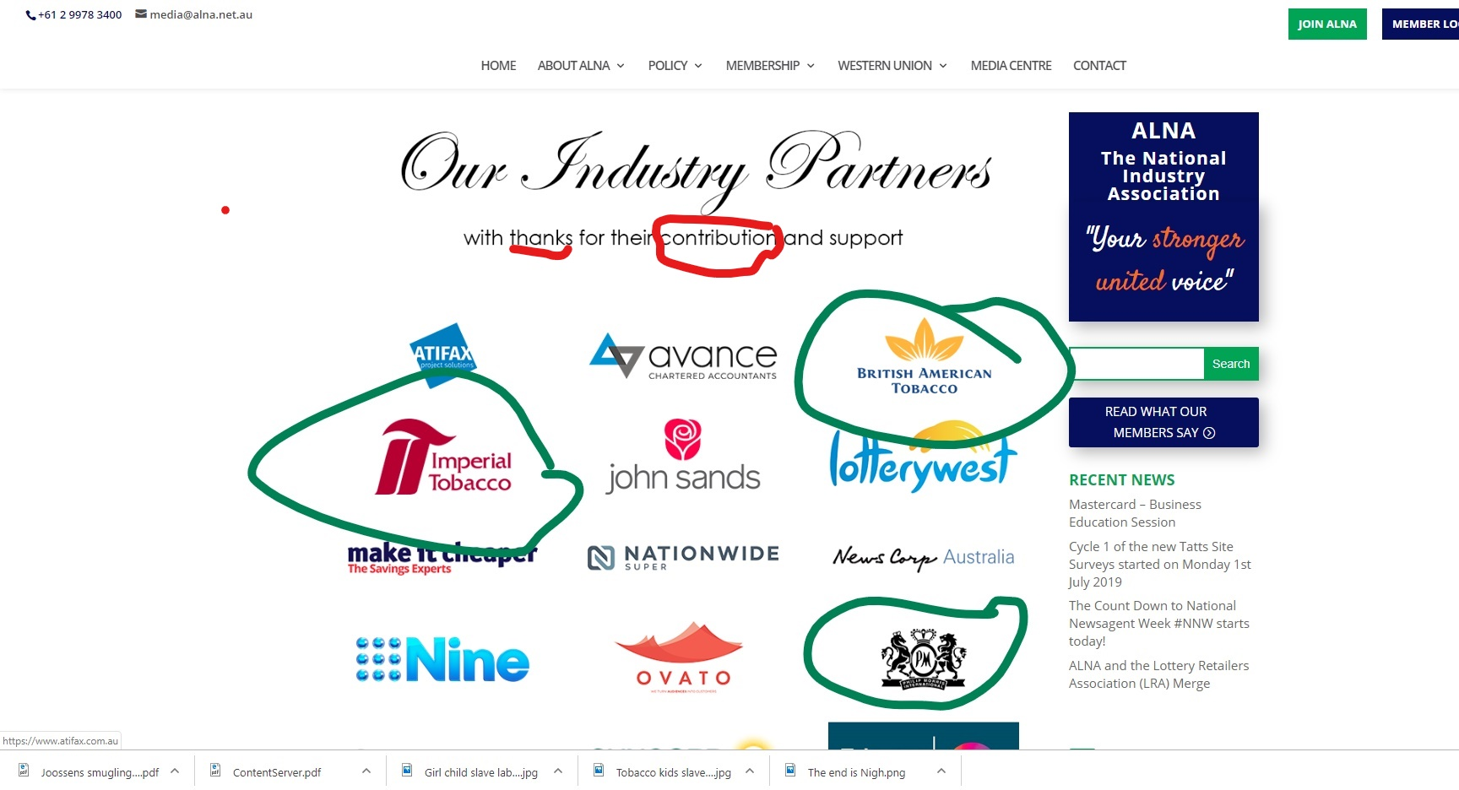
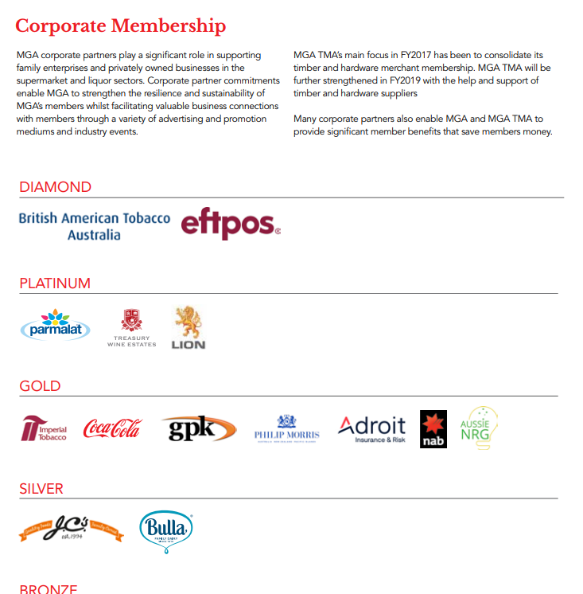
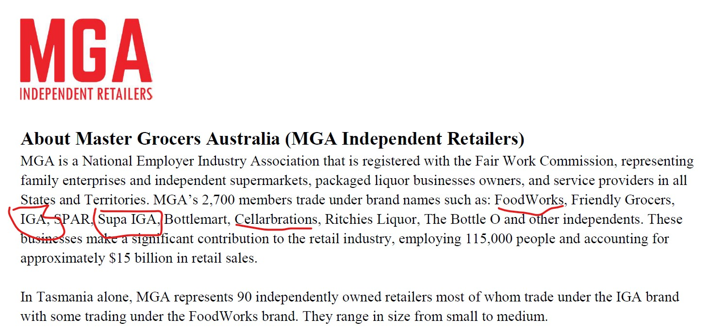
The web of influence
The newsagents
The Master Grocers
Notes:
Funding can be funneled through any of these organizations from tobacco companies to smaller retail or front organizations, without them having to admit to receiving tobacco industry funds.

Slide 6
Russell Zimmerman made a presentation to the Tasmanian Legislative Council in 2019
opposing T21

Slide 7
HOTELS – Long history of opposing reform
Hansard 29 March 2001
“In 2001, Hon. Cathy Edwards in this Chamber expressed concern about the
underwriting by the tobacco industry of lobbying by the AHA, now the Tasmanian Hotels
Association.
She said she was:
… disturbed by the fact that the tobacco industry had paid the AHA to
produce a very expensive information package and CD for parliamentarians,
….and some research by UMR Research was underwritten by Philip Morris.”
2016
2014
2016

Slide 8
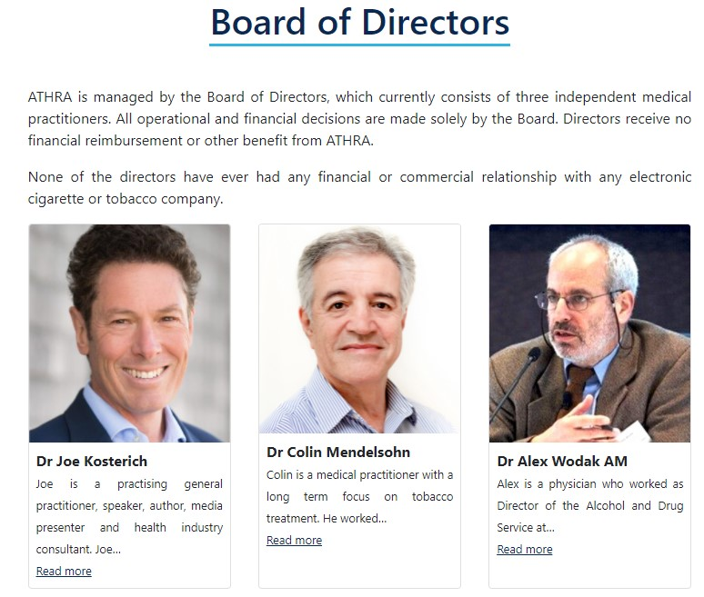
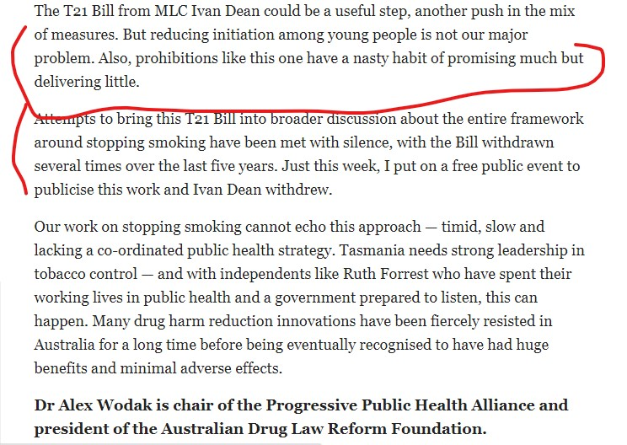
ATHRA
September 2020
Mercury
ATHRA attacked the T21 Bill and campaigned against it in Tasmania just before it was due to be debated. Not a coincidence. Who funded them?

Slide 9
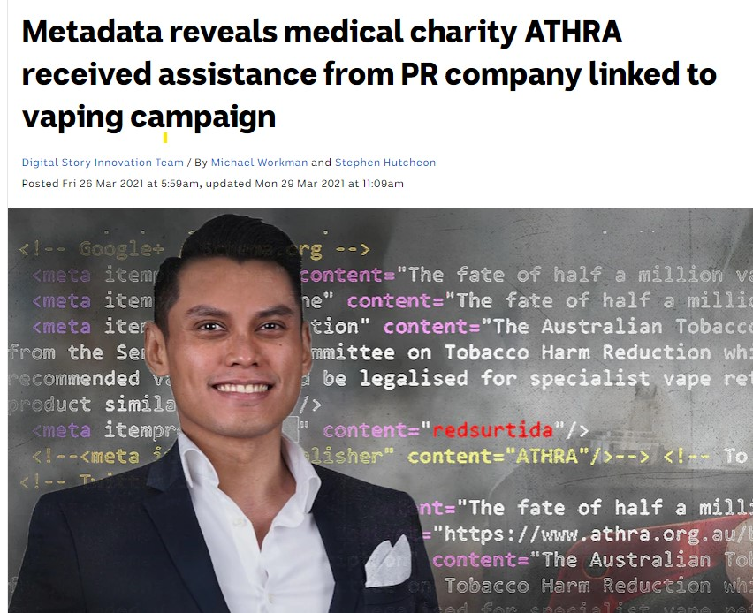
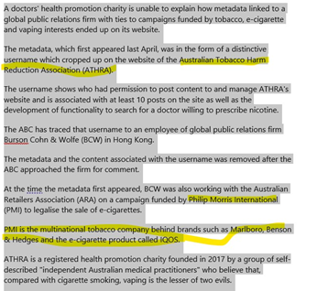
Philip Morris International linked to ATHRA

Slide 10
So – what do we have?
Links between big tobacco, and
Retailers
Small business
Newsagents
Hotels
Vaping promoters
ALL OF WHOM OPPOSED T21and other tobacco reforms

Slide 11
Health groups – “supportive” but only a few “active” on endgame tobacco control reforms in Tasmania
AMA
Cancer Council
Lung Foundation
ATDC
Heart Foundation
RACGP
Dental Association

Slide 12
Department of Health
Tobacco Coalition
Government controlled
Interference by senior bureaucrats in proposals
Lack of ability to speak publicly
No direct line to Minister or even head of agency
Some members ex officio (and have no tobacco knowledge or expertise)
Some members never attend – some sporadic
Too many other committees and pathways, polices get watered down and lost
Healthy Tasmania Strategy section on tobacco was written by Imperial Tobacco
A Vaping supporter is on the Coalition

Slide 13
International
Smuggling – Canada, Europe, Asia
Use of big Four Audit companies to oppose tax hikes
RICO (convicted of racketeering)
Hong Kong – concrete boots
Bribing politicians
Marketing to children
Use of child labor
Undermining legislation
Resisting reforms to tracking
Notes:
Racketeering - On August 17, 2006, Judge Kessler issued her verdict against the major U.S. tobacco companies. In a 1,683-page opinion, Judge Kessler detailed how the tobacco companies “have marketed and sold their lethal products with zeal, with deception, with a single-minded focus on their financial success, and without regard for the human tragedy or social costs that success exacted.”
Importantly, Judge Kessler concluded, “The evidence in this case clearly establishes that Defendants have not ceased engaging in unlawful activity…. Their continuing misconduct misleads consumers in order to maximize Defendants’ revenues by recruiting new smokers (the majority of whom are under the age of 18), preventing current smokers from quitting, and thereby sustaining the industry.”
In May 2009, a three-judge panel of the U.S. Court of Appeals for the District of Columbia unanimously upheld Judge Kessler’s judgment and almost all of her remedies, including the corrective statements. In 2010, the U.S. Supreme Court declined to hear appeals in the case.”
Smuggling – https://tobaccotactics.org/wiki/tobacco-smuggling/
Tobacco companies have facilitated the smuggling of their own cigarettes and roll your own tobacco for decades. Internal company documents reveal that in the 1990s smuggling was an integral part of tobacco companies’ business strategies. By the late 1990s and early 2000s, the tobacco industry’s involvement in smuggling had been exposed leading to public investigations, court cases and extremely negative publicity for the tobacco companies. Using a massive public relations drive, they claimed they had changed and were now the victims, not the perpetrators of tobacco smuggling. But contemporary evidence indicates significant ongoing tobacco company involvement in the illicit tobacco trade.
Why Would Tobacco Companies Smuggle their Own Product?
The tobacco industry can benefit from smuggling in the following ways:
The tobacco companies are paid for the product whether it is smuggled or not. In other words, they are paid when they sell to the distributor regardless of whether it then enters the legal or illegal channel.
The reduced average market price as a result of smuggling discourages quitting and increases total sales, particularly sales among key industry targets – the young and the least well off.
Illegal sales undermine tobacco control measures including packaging laws, and age restrictions on sales.
The industry uses smuggling to press the case for reduced excise taxes, leading to increased sales in the legal market.
The industry uses smuggling to argue against tobacco control policies claiming that every policy will increase tobacco smuggling (this despite their documented involvement).
The industry uses smuggling as a market entry strategy – where imports are restricted or tariffs are high, it smuggles to avoid these restrictions and tariffs. It then argues that the presence of illicit on the market indicates a need to lift the import restrictions or privatise the state owned tobacco company.
Death threats not hyperbole – Quote from Dr Judith Mackay in Hong Kong “That is not hyperbole. I had to give evidence as an expert witness in a major tobacco smuggling trial, involving British American Tobacco cigarettes being smuggled into China. The chief witness was murdered, and eleven others disappeared. Another witness jumped out of a window – on the 22nd floor. ”
The big Four The four global accounting firms, Deloitte, PricewaterhouseCoopers (PwC), Ernst & Young (EY) and KPMG – collectively known as the “Big Four” – are multinational networks of professional services firms. In 2019, they audited all of the companies in the FTSE 100.¹ The majority of their revenue, however, comes from other services, such as tax advice, management consulting, corporate finance and legal services.² The Big Four have been employed by the tobacco industry as both auditors and advisors for many decades.
Bribery – Russia, Danishevski K, Gilmore A, McKee M. Public attitudes towards smoking and tobacco control policy in Russia. Tobacco control. 2008 Aug 1;17(4):276-83.
United State
The “Policy dystopia model”
Africa – the cost of doing business. Adeyeye A. Bribery: cost of doing business in Africa. Journal of Financial Crime. 2017 Jan 3.
Other industries have learned from big tobacco. Collin J, Hill S. Structure and Tactics of the Tobacco, Alcohol, and Sugary Beverage Industries. Backgr. Pap., Task Force on Fiscal Policy for Health, New York. 2019.
“Multi-national firms are a defining feature of modern economies. Competitive pressures and technological innovation allow firms to integrate their production and supply chains, invent new products, and influence consumer choice on a global scale. However, economists and public health experts have pointed to important ways in which the structure and organization of some industries can lead to non-optimal outcomes. In the case of tobacco, sugary drinks and unhealthy foods and alcohol -- products increasingly produced and aggressively promoted at an unprecedented scale by large international firms -- increased use is imposing staggering health and economic costs. “
Child Labor https://www.ncbi.nlm.nih.gov/pmc/articles/PMC6293346/
http://www.fairtradetobacco.org/wp-content/uploads/2012/02/Palitza_Sep2011.pdf
https://smeru.or.id/sites/default/files/publication/rr_ecltbase-2019_en_0.pdf
Opposition to Tracking
Abstract Gallagher AW, Gilmore AB, Eads M. Tracking and tracing the tobacco industry: potential tobacco industry influence over the EU’s system for tobacco traceability and security features. Tobacco control. 2020 Dec 1;29(e1):e56-62.
Background Subsequent to the transnational tobacco companies’ (TTC) history of involvement in tobacco smuggling, the Illicit Trade Protocol (ITP) requires that tobacco tracking and tracing (T&T) systems be established independent of the industry. In response, TTCs developed a T&T system, originally called Codentify, promoting it via an elaborate set of front groups to create a false impression of independence. The European Union (EU) is one of the first and largest jurisdictions to operationalise T&T. We explore how industry efforts to influence T&T have evolved.
Methods Analysis of tobacco industry documents, policy documents, submissions to a relevant consultation and relationships between the tobacco industry and organisations proposed by it and approved by the European Commission to provide a data repository function within the EU’s T&T system.
Findings 17 months after TTCs sold Codentify to Inexto and Philip Morris International claimed Inexto was independent, leaked documents suggest TTCs and Inexto continued to have a financial and operational relationship. Inexto’s meetings with TTCs, engagement with EU Member States and promotion of industry-favoured technical standards suggest TTCs influenced Inexto’s activities, using the company to undermine EU T&T. The EU’s T&T system appears to be inconsistent with the ITP due to its ‘mixed’ governance and seven of eight organisations approved as data repository providers having pre-existing industry business links.
Conclusions TTC’s efforts to maximise their control and minimise external scrutiny of T&T systems seriously limit attempts to address tobacco smuggling. Countries implementing T&T should be alert to such efforts and should not replicate the EU system.
This is an open access article distributed in accordance with the Creative Commons Attribution Non Commercial (CC BY-NC 4.0) license, which permits others to distribute, remix, adapt, build upon this work non-commercially, and license their derivative works on different terms, provided the original work is properly cited, appropriate credit is given, any changes made indicated, and the use is non-commercial. See: http://creativecommons.org/licenses/by-nc/4.0/.
http://dx.doi.org/10.1136/tobaccocontrol-2019-055094

Slide 14
Death
Quote from Dr Judith Mackay in Hong Kong
“That is not hyperbole. I had to give evidence as an expert witness in a major tobacco smuggling trial, involving British American Tobacco cigarettes being smuggled into China. The chief witness was murdered, and eleven others disappeared. Another witness jumped out of a window – on the 22nd floor. ”
Notes:
https://dangerouswomenproject.org/2016/08/11/judith-mackay/
Dr Judith Mackay is a British medical doctor based in Hong Kong since 1967. She is Senior Advisor, Vital Strategies/Bloomberg Initiative to Reduce Tobacco Use; Director of the Asian Consultancy on Tobacco Control; and Senior Policy Advisor to World Health Organisation. She has authored 12 atlases on health topics. In addition to many international awards, ranging from the WHO Commemorative Medal and the TIME 100 award to the first BMJ Group Lifetime Achievement Award, she has been identified by the tobacco industry as one of the three most dangerous people in the world.
A Danger to Big Tobacco
I’ve faced the greatest danger since moving from clinical to preventive medicine. There were three main reasons for making the shift from hospital medicine to public health. First, during my work as a physician in the 1970s and 1980s, I came increasingly to feel that clinical work was like ‘a band-aid.’ In fact, we had a maxim on our male medical ward that we never admitted a non-smoker, our wards being full of people with end-stage tobacco illnesses, often too late to prevent morbidity and mortality.
Second was the realisation that although women’s health in those days was defined as reproductive health, tobacco was killing far more women than were dying from birth control – and the tobacco industry was actively recruiting women with promises of beauty, slimness, popularity and emancipation.
What finally galvanised my determination to combat tobacco use was the response to a piece I wrote on tobacco as part of my series on women’s health in the South China Morning Post. One of the British transnational cigarette companies published a booklet labelling me as ‘entirely unrepresentative and unaccountable.’ In contrast, the self-promotional booklet claimed ‘the tobacco industry comprises identifiable, legal, accountable, commercial organizations.’ This booklet, denying the health evidence (‘it has not been proven that these illnesses are actually caused by smoking’) and claiming to be an ‘important source of reliable information’ on smoking, so enraged me that from that moment on I worked on tobacco control, abandoning curative hospital medicine in 1984.
Why was my job so dangerous? It was partly location. The tobacco industry thought they could gallop their Marlboro cowboy into Asia, and it was theirs for the taking. They even said ‘What do we want? We want Asia,’ with the dream of converting the 60% of men who smoked local cigarettes to switch to international brands, and the second dream of persuading Asian women to start smoking. Given the numbers concerned, it would not have mattered if every smoker in the UK had stopped smoking the next day, if they could have captured the massive Asian markets.
There was no career structure and no pay, but I set about thwarting their goals. I was in touch with colleagues in the UK and elsewhere who were unstinting in their assistance, but it was a lonely job in Asia in the 1980s.
This brought me into conflict with one of the world’s most wealthy and powerful industries – and its supporters. I’m frequently subjected to verbal abuse and have been described over the years as sanctimonious, dogmatic, pontificating, meddlesome, heretic, puritanical, hysterical, prejudiced, a ‘Nanny,’ and more recently a ‘jihadist’.
In 1993, a smokers’ rights group in the USA described me as ‘psychotic human garbage, a gibbering Satan, an insane psychotic just like Hitler, using fatuous, smarmy drivel and distortions, and diatribes full of putrid corruption, lies, conspiracy, and total censorship.’ They concluded by stating that I was ‘devoid of any sanity, any morality, or any human-being-ness of any kind’, was ‘nothing more than an evil-possessed, power-lusting piece of meat’ and they threatened to ‘utterly destroy’ me!
The group had made similar threats to a US government health official, so the last sentence – perceived by the FBI as a death threat – had to be investigated by the agency, and I was added-on to that investigation. At this point, I was offered 24-hour police protection by the Hong Kong government.
The industry twice threatened, very publicly, to take me to court. Nothing came of it, of course – I was on rock-solid ground on the facts – but such tactics were attempts to intimidate me, and a ploy to cast doubt on my credibility in the minds of the public.
Such offensive words, the death threat, and the menace of litigation, completely failed to divert me. I said, robustly and publicly, that I was absolutely not a suicidal type, and that if I were to be found ‘knocked down by a bus,’ the tobacco industry was guilty until proven innocent!
That is not hyperbole. I had to give evidence as an expert witness in a major tobacco smuggling trial, involving British American Tobacco cigarettes being smuggled into China. The chief witness was murdered, and eleven others disappeared. Another witness jumped out of a window – on the 22nd floor. I had to report to the Independent Commission Against Corruption that I was being followed. They put a stop to it, but it was an eerie experience, as was being cross-examined by a tobacco industry lawyer.
There have also been clandestine aspects to my work. In 1986, a go between phoned to tell me that a ‘Deep Throat’ associated with US Tobacco had informed him of a plan to imminently launch smokeless tobacco (sucking, chewing tobacco and snuff) in Hong Kong. To this day, I do not know the identity of ‘Deep Throat,’ not even whether it is a ‘she’ or a ‘he.’ Immediately, I contacted the Hong Kong government and helped to plan a ‘pre-emptive strike’ – a ban on the importation, manufacture and sale of smokeless tobacco products. Other whistle-blowers have contacted me from within the tobacco industry, always a sensitive and potentially explosive situation. For their safety, I will say no more.

Slide 15
Tobacco or Health?
Many barriers – well funded opponents
Where to from here?
Concentrate on Endgames?
Or incremental small gains?

Slide 16
Resources:
https://tobaccotactics.org/ at the University of Bath
Stan Shatenstein Marathon246@gmail.com
https://www.tobaccoinaustralia.org.au/home.aspx Cancer Council Victoria
Exposetobacco.org Global tobacco Industry watchdog (get updates)
Facebook Page – Global Tobacco Control Network

