Slide 1
WORKSHOP: Choosing Tobacco or Health: Where to from here?
Tasmania
Seana Gall Menzies Institute for Medical Research University of Tasmania
Children’s (and adolescent) smoking uptake – Mechanisms for reduction

Slide 2
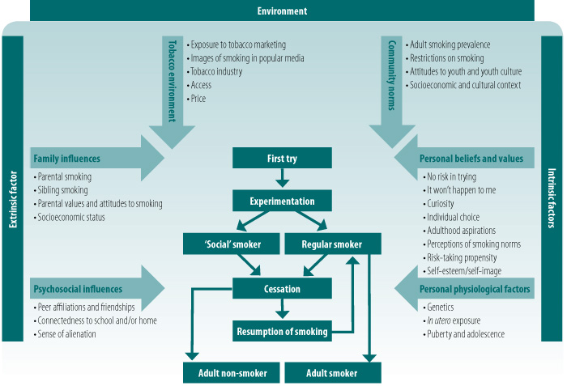
Drivers of smoking uptake in children and adolescents
Source: Personal communication to Margaret Winstanley from Dr Lisa Wood, Department of Population Health, University of Western Australia, e-mail 2008
Tobacco in Australia - https://www.tobaccoinaustralia.org.au/chapter-5-uptake/5-2-factors-influencing-uptake-by-young-people-ove

Slide 3
Lower educational attainment
Higher personal income
Older age
Parents smoking
Indigenous
Greater number of friends and family smoking
Lower self-rated academic performance
Trauma/anxiety
Not owning property
Tasmanian predictors are consistent with those found nationally and internationally
National Health Survey
Australian Secondary Students Alcohol and Drug Survey
Effective interventions in other places should be effective in Tasmania
Notes:
Seana

Slide 4
 | Strongly disagree | Disagree | I am not sure | Agree | Strongly agree
Helps people to relax | 4% | 22% | 23% | 44% | 8%
They are addicted | 2% | 14% | 17% | 50% | 17%
Because parents or siblings smoke | 2% | 12% | 24% | 49% | 14%
Cope with stress | 2% | 12% | 24% | 46% | 16%
Look cool | 5% | 12% | 14% | 40% | 30%
Exciting to break the rules | 7% | 16% | 18% | 40% | 19%
Friends pressure them into it | 8% | 21% | 20% | 37% | 14%
Because it gives them a good feeling | 1% | 9% | 26% | 53% | 11%
Live with smokers | 2% | 11% | 27% | 45% | 15%
Want to stay slim or lose weight | 21% | 35% | 27% | 13% | 5%
Fit in with peers | 5% | 10% | 17% | 48% | 20%

Slide 5
 | Strongly disagree | Disagree | I am not sure | Agree | Strongly agree
Helps people to relax | 4% | 22% | 23% | 44% | 8%
They are addicted | 2% | 14% | 17% | 50% | 17%
Because parents or siblings smoke | 2% | 12% | 24% | 49% | 14%
Cope with stress | 2% | 12% | 24% | 46% | 16%
Look cool | 5% | 12% | 14% | 40% | 30%
Exciting to break the rules | 7% | 16% | 18% | 40% | 19%
Friends pressure them into it | 8% | 21% | 20% | 37% | 14%
Because it gives them a good feeling | 1% | 9% | 26% | 53% | 11%
Live with smokers | 2% | 11% | 27% | 45% | 15%
Want to stay slim or lose weight | 21% | 35% | 27% | 13% | 5%
Fit in with peers | 5% | 10% | 17% | 48% | 20%

Slide 6
Socioeconomic factors
Upstream
Focus on poverty through Tasmania Statement
Increasing school retention
Downstream
Mass media focus on lower SES groups
Community-based programs, e.g. free NRT
Parental smoking
Upstream
Focus on people of childbearing age in media campaigns
Downstream
CO monitoring in antenatal care
Peer, attitudes, beliefs
Upstream
Smoke free areas incl. schools
Downstream
Peer led intervention – ASSIST or KickAsh

Slide 7
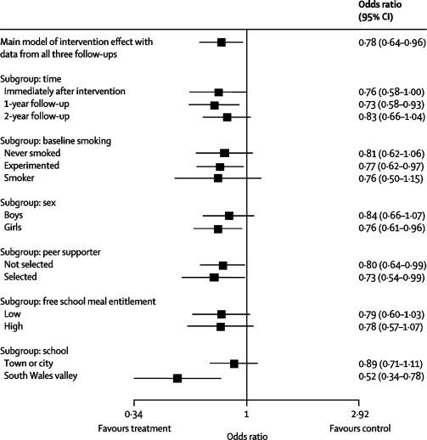
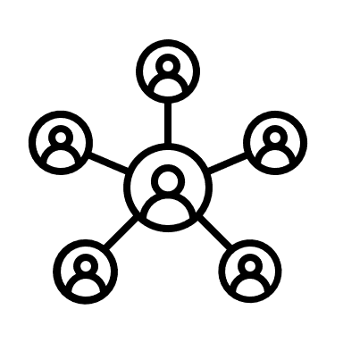
Harnessing peer networks to reduce smoking uptake – A Stop Smoking in Schools Trial (ASSIST)
Meets cost-effectiveness targets - $22,000 per QALY
$90,000 for Tasmanian implementation over 3 years + local staffing
Campbell et al. Lancet. 2008 May 10; 371(9624): 1595–1602.

Slide 8
Where to from here?
Harness government interest in ‘education’
Fund ASSIST evidence-based education program led by peers
Map and consolidate education efforts across school sector
Focus on evidence-based programs
Implement CO monitoring
Will drive down maternal smoking and reduce smoking in children
New Smoke Free Young People Strategy
Dedicated funding needed

