Slide 1
WORKSHOP: Choosing Tobacco or Health: Where to from here?
Tasmania
Young Tasmanian’s perspectives about tobacco uptake
Dr Suzie Waddingham

Slide 2
Tobacco 21 research aims
Address uncertainty regarding smoking in young people in Tasmania
Understand community sentiment about smoking and tobacco control, particularly T21
Create clearinghouse of relevant data to allow T21 evaluation if implemented
Secondary analysis NHS (15-24 years), ASSAD (12-17 years), Census, TSHS
Online survey, n=194 stakeholders
n=8 studies identified
Interviews, n=29 stakeholders
Smokers, non-smokers

Slide 3
Original research approach
Focus Groups
COVID-19
Amended research approach
Online survey
Interviews
Online survey
n=527
15-24 years
24% smokers
Interviews
n=12
13-19 years
All current or recent smokers
Information sheet
Extra layer of screening
Consent
Information sheet
Youth worker present
Consent
Notes:
Effort made to engage with kids not in mainstream school.
We also spoke with youth workers, teachers and counsellors who work closely with kids in alternative education

Slide 4
Young people who experiment with smoking
… and do not become a regular smoker
… and go on to smoke regularly
Access from peers close in age
Older people including parents
“if you knew how to roll and stuff, you paid 50 cents for a rolly, but for a tailor, you'd pay $1, $1.50 or what not, and it would be like, if I know how to roll, it's 50 cents a dart.”
Notes:
There was a high level of understanding about long-term health effects of smoking.
… and do not become a regular smoker
Are being rebellious, taking a risk
Are fitting in, going with the flow
More likely to be at mainstream school
… and go on to smoke regularly:
Are more likely to be living with trauma/anxiety
Less likely to be at mainstream school
Are surrounded by smoking
Use smoking to cope with stress
Some creative ‘solutions’
Mostly regular smokers
Butt runs, targeting particular strangers, sharing of pouch tobacco + whole packets among groups

Slide 5
Max is 14 years old. He does not attend mainstream school.
He had a good knowledge about the harmful effects of smoking.
He first tried a cigarette in late primary school.
By grade 7 he was smoking regularly.
Free to choose at 18?
Average that Tasmanians smoked a full cigarette was 16.4 years.
Youth say the age is younger (supported by youth workers)
For youth who are addicted to nicotine at 18, is it their choice?

Slide 6
Progression to smoking – influence of age-based restrictions
Young Tasmanians start smoking experimentation around this age
Delaying experimentation reduces the risk of becoming a regular smoker
Youth workers and young people report addiction by this age
Teens report infrequent socialising with 21 year olds
14 years old
- Average age of smoking uptake around 1997
21 years old
-these young people are NOT at school and will reduce peer supply
13 years old
- Experimentation with smoking starts
16 years old
- The average age of smoking uptake is around 16 years old
17 years old
-Many young people are already addicted to tobacco
18 years old
-these young people are still at school and can easily supply younger peers
As more schools go to year 12, there will be more tobacco available in schools.
Legal age for the sale of tobacco was 16 years until 1997
Public Health Act (1997) raised legal age of sale to 18 years
Notes:
Difference between tobacco and other drugs in terms of addiction – effects of smoking are invisible
Highlight that although there will be an inconvenience to 18 to 21 year olds at time of introduction, the real benefits will be on people who are 10 years old at the time of introduction. This is a measure to prevent smoking uptake that has an off target consequence of affecting current smokers aged 18-21. There has been discussion among tobacco control experts about the fact that today’s 10 year olds have the greatest opportunities to be the ‘smoke free generation’. This group of children have grown up in an environment where they have not seen tobacco in shops, there has not been smoking in cars, there have been expansions of smoke free areas and higher than ever anti-smoking advertisements. If there was ever a generation that was ripe for the introduction of an endgame strategy like T21, it is today’s young people.

Slide 7
Why
“The first cigarette I probably had was when I was in Grade 7, just got in Grade 7. I don't know; I kind of was doing it because everyone was kind of doing it at the time, and then I just kind of went on from that.”
“Honestly, it just feels like breathing. You see everyone smoking and it's just, oh, all right; I've got to smoke.”
“…now it will be when I'm really really stressed out or really really angry. I'll go out and have a ciggy.”
Notes:
Themes for regular smokers
Surrounded by smoking; it’s a part of life
Calms down when stressed or angry
Social reasons – fit in, blend in, being social
Addicted

Slide 8
Immediate impact
“Yeah, I didn’t expect it to come on so fast. I knew eventually it was going to completely just shred my lungs, but I expected it to be when I was in my early 40s. I hadn’t expected it to come so fast.”
Notes:
Many expressed surprise about the immediate effects:
Shortness of breath and how quickly that came about
Hair smell
Coughing up black gunk
Inability to play sport like used to
Overall sentiment was that “kids definitely shouldn’t be smoking”
Re some longer-term health impacts, many felt they are going to get some form of disease when they are older anyway.

Slide 9
Hard to give up
“I’ve been trying to quit recently, but I’ve got back on the cigarettes. But now if I ever do get cigarettes I get a pouch and I roll them all up and I put them in a pack, but I try to minimise the use of them.”
Now the habit is costing her nearly $100 a week in ouch tobacco and although she wants to quit, it is hard when others around her smoke as well.
The Mercury September 13, 2020
Notes:
The topic of quitting comes up in conversation.
Most had attempted to quit but unsuccessful
They felt the cessation options are more for adults
patches burnt, the inhalers made them feel sick, too hard when friends are not quitting, ads on TV are for older people

Slide 10
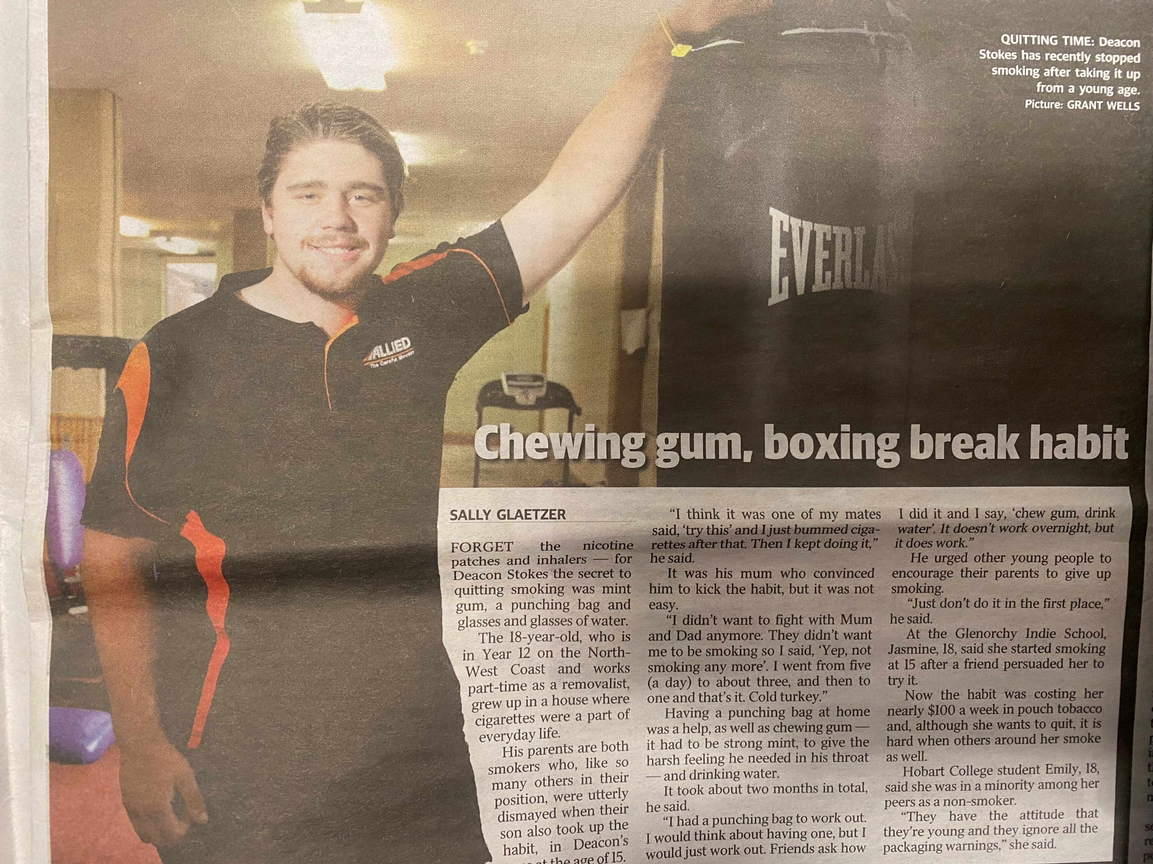
Some find their own way
Notes:
Deacon.
Parent smoked but Mum pleaded him to give up.
He used mint gum, a punching bag and water
He said giving up made him feel angry

Slide 11
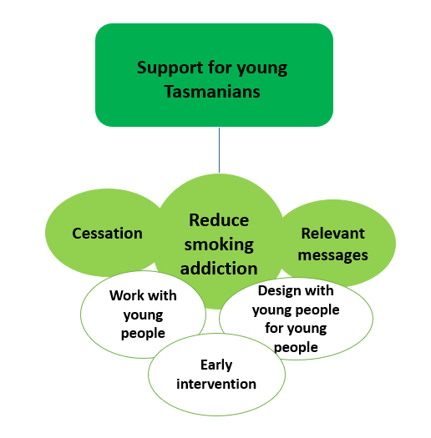
Solutions
Youth interviews (n=12)
Supported by youth online surveys (n=527)
Notes:
All young people who smoked felt something had to be done to stop young people starting
Cessation strategies developed with young people.
Start interventions in late primary school – focus on how many chemicals are in a cigarette.
Focus on immediate effects, include long-term too.
Campaigns and strategies developed with young people (especially young smokers) and relevant for young people. E.g. work with alternative education centres
It was also mentioned that the advertising campaigns need to be more targeted to young people by focusing on the immediate effects and ‘what is in tobacco’, e.g. the harmful ingredients (“All of the ad campaigns have grown ups on them. You’ll never see a young, a youth kid on it”). They talked about not relating to anti-smoking messages about potential health consequences in the future.

Slide 12
Reflections and summary
The voice of young people has been lost in this debate.
Young smokers and non-smokers, and youth workers, agreed something needed to be done to stop the uptake of smoking among young people.
They said this should be started in late primary school.
Young people said they got their first cigarette from friends.
On a side note – research funding should include resources to ‘close the loop’ back to community/consumers
Summary
Notes:
The voice of young people has been lost in this debate. Young smokers and non-smokers, and youth workers, agreed something needed to be done to stop the uptake of smoking among young people. Even though many had not heard of T21 and did not fully understand it, there was good support to try it. Young people said they got their first cigarette from friends.

Slide 13
Questions
“Just don’t try it in the first place, just don’t get into it. If you don’t get into it you’re not going to get addicted.”
Acknowledgements
Research was conducted by A/Prof Seana Gall and Dr Suzie Waddingham with support from Dr Tan Bui and Dr Sabah Rehman. The research was guided by a working group including researchers, tobacco control experts and Department of Health staff.
All projects were approved by the Tasmanian Social Sciences Human Research Ethics Committee. Funding was provided by the Minderoo Foundation and A/Prof Gall is supported by National Heart Foundation of Australia Future Leader Fellowship.
We would like to thank the participants in the various components of the research.

