Slide 1

WORKSHOP:
Choosing Tobacco or Health:
Where to from here?
Tasmania
Vaping – effects on the lung, exacerbations of COVID-19
Sukhwinder Singh Sohal

Slide 2
Smoking and COVID-19
Lungs of smokers are severely compromised and are susceptible to respiratory infections and, recently SARS-CoV-2
The SARS-CoV-2 attachment receptor protein ACE2 enables viral attachment and entry
Electronic cigarettes and heat-not-burn (IQOS) devices, could also enhance users susceptibility to such infectious diseases

Slide 3
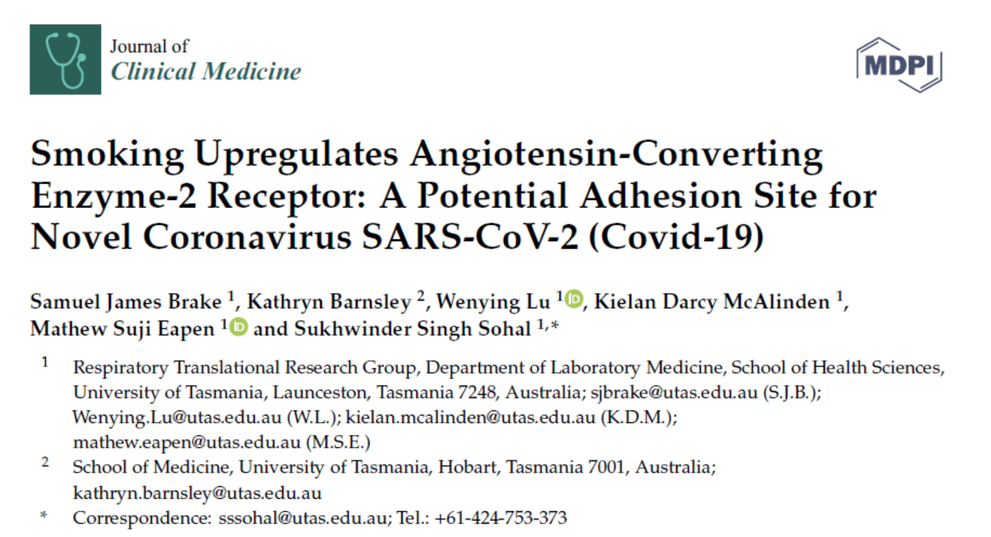
Brake SJ et al J. Clin. Med. March 2020

Slide 4
Brake SJ et al J. Clin. Med. March 2020

Slide 5
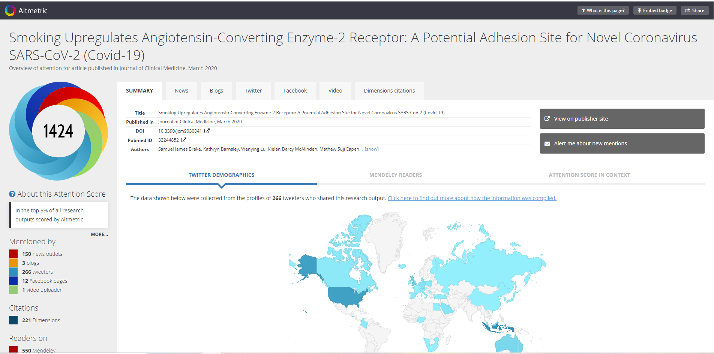

Slide 6
Eapen et al Am J Physiol Lung Cell Mol Physiol 2021

Slide 7
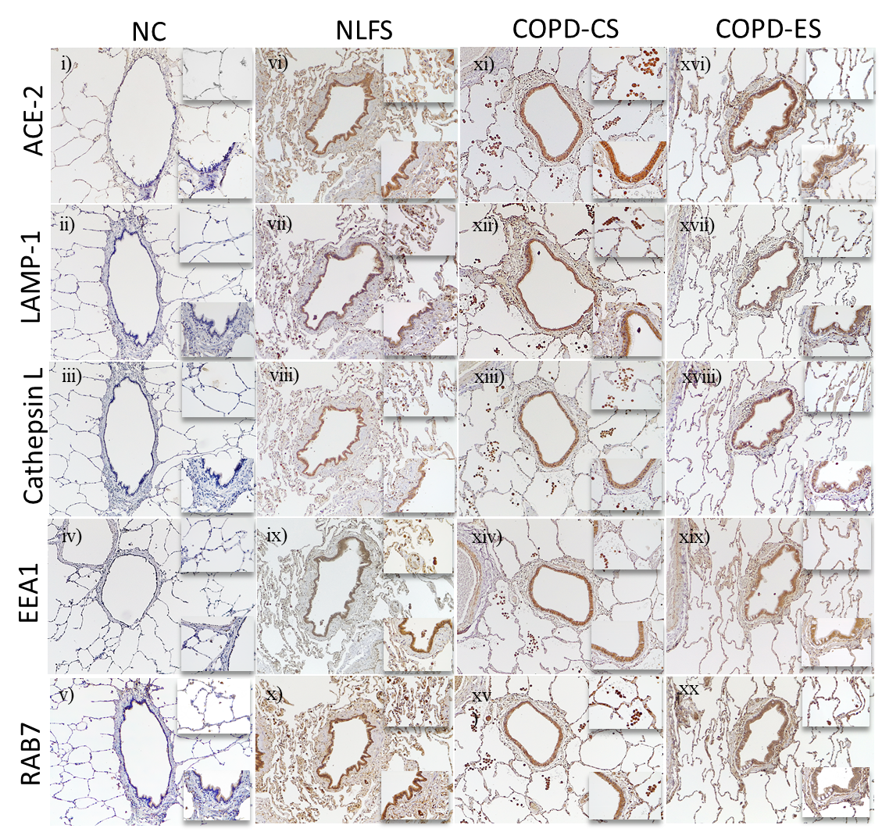
Eapen et al Am J Physiol Lung Cell Mol Physiol 2021

Slide 8
Eapen et al Am J Physiol Lung Cell Mol Physiol 2021

Slide 9
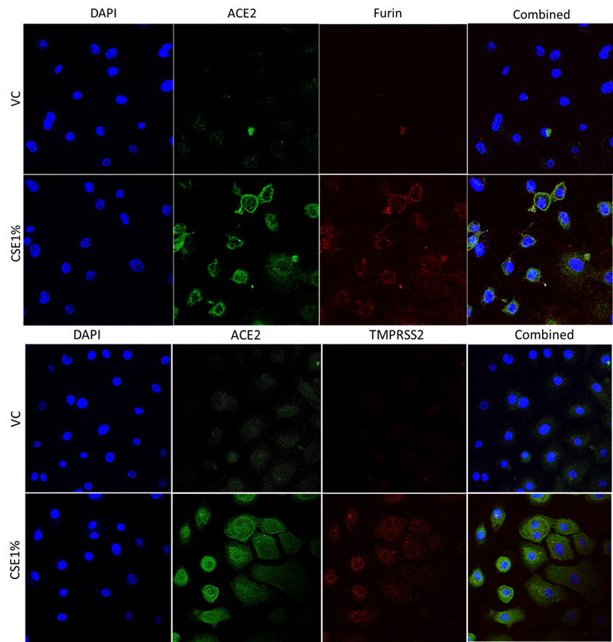
Primary small airway cells exposed to CSE and stained for ACE2, TMPRSS and Furin

Slide 10
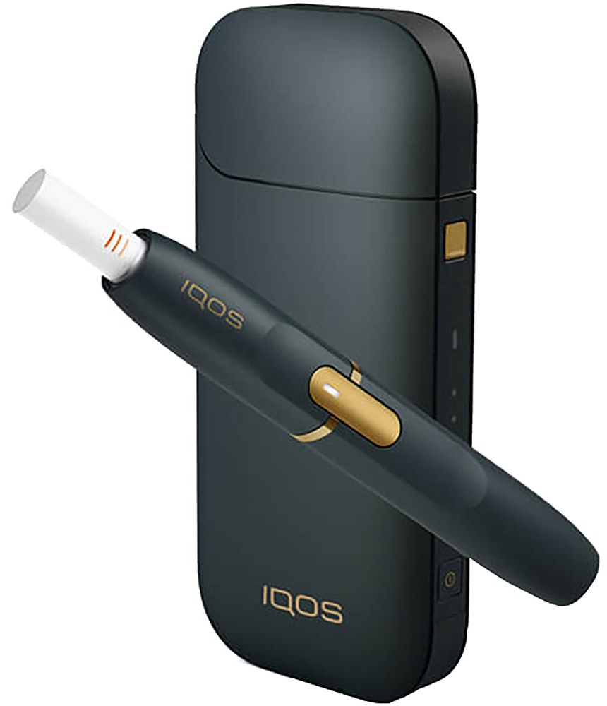
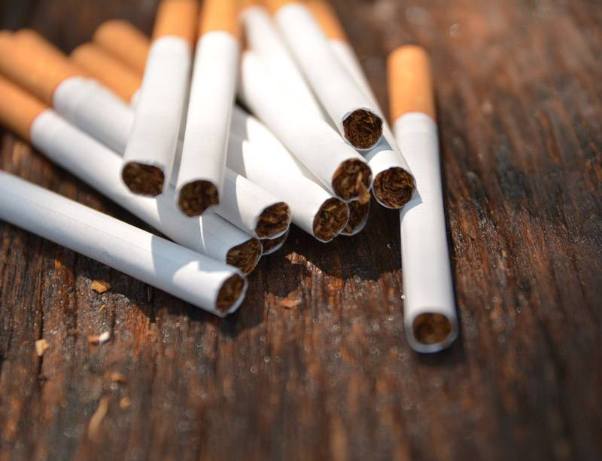

Sohal SS et al, ERJ Open Research 2019
First study to compare all 3 tobacco products and first report on IQOS

Slide 11
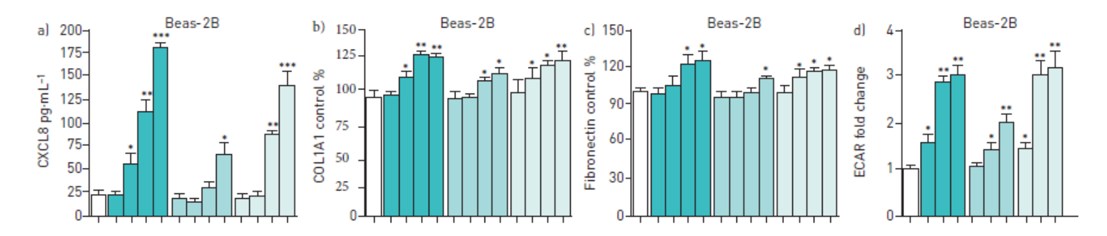
Comparison of the effects of cigarette smoke extract (CSE), electronic cigarette (eCig) vapour and IQOS aerosol exposure on a–d) human airway epithelial cells (Beas-2B)
Sohal SS et al, ERJ Open Research 2019

Slide 12
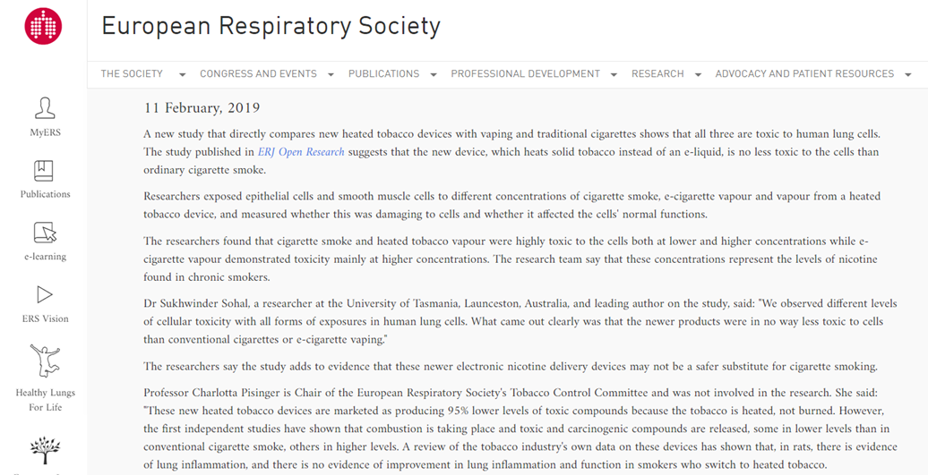
Our study led to ERS Position Paper on new tobacco products

Slide 13
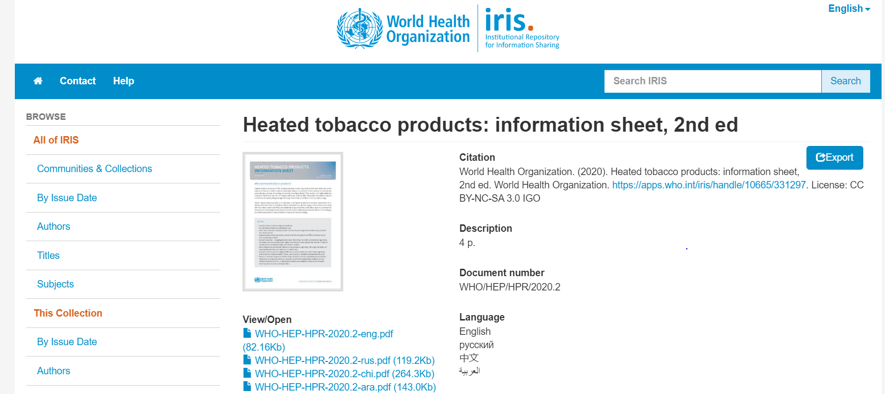

Slide 14
Miyashita et al, ERJ 2018

Slide 15
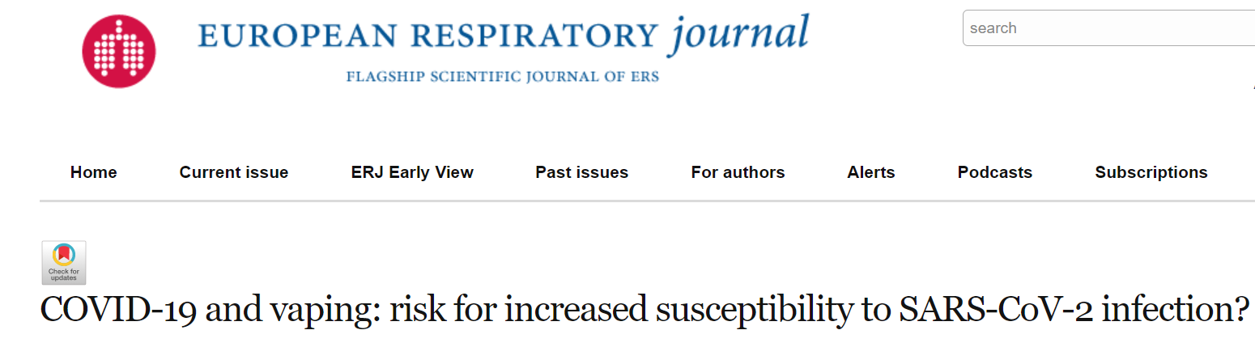

Slide 16
McAlinden et al J. Clin. Med. 2021

Slide 17
ACE2 protein expression of BEAS-2B cells following electronic cigarette aerosol (WM)
McAlinden et al J. Clin. Med. 2021

Slide 18
ACE2 protein expression of SAECs following CSE and electronic cigarette aerosol
McAlinden et al J. Clin. Med. 2021

Slide 19
Conclusions
We as a research community have not yet thoroughly investigated the health risks of these products
Great caution must be taken with promoting these as safe smoking cessation tools
This is not a smoking cessation policy as claimed by tobacco industry but a policy to have long term users!

Slide 20
