Slide 1

WORKSHOP:
Choosing Tobacco or Health:
Where to from here?
Tasmania
Dr Nick Towle
The role of health professions in advocacy for tobacco control

Slide 2
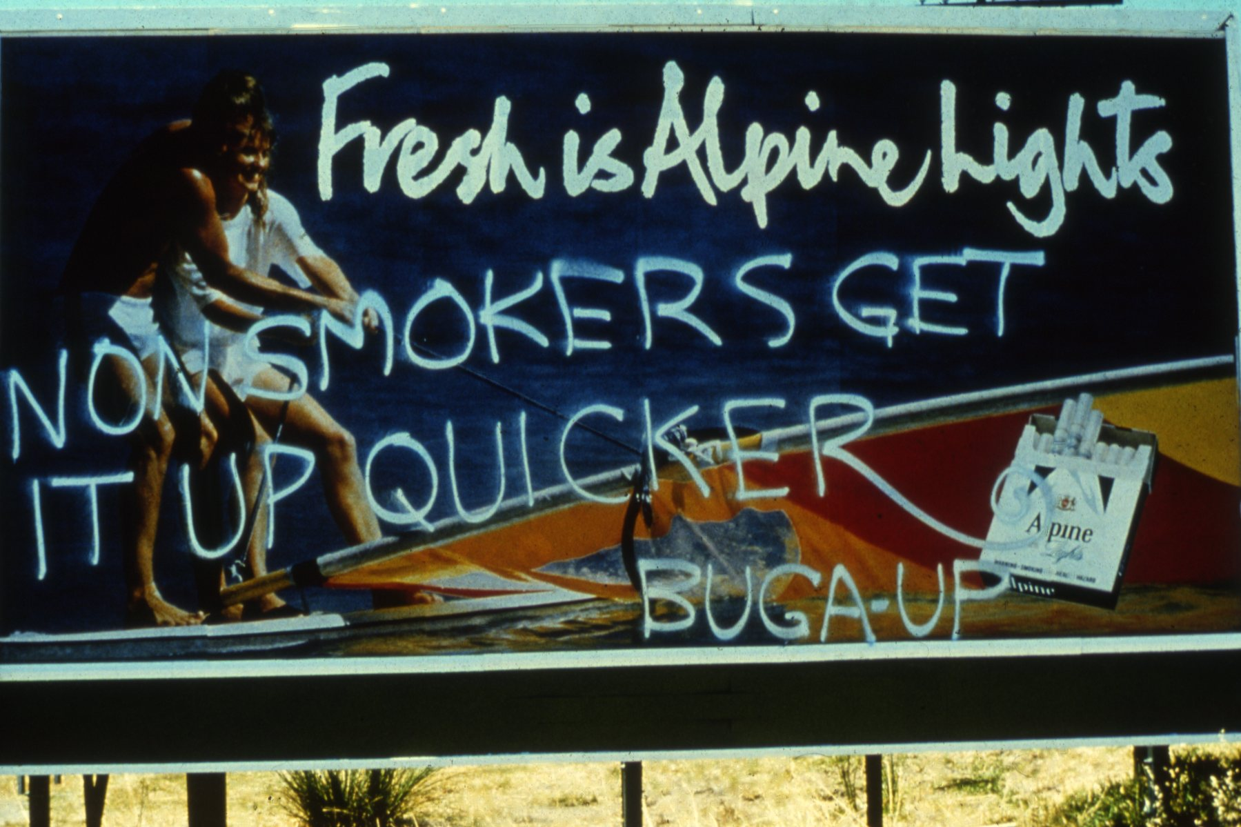

Dr Arthur Chesterfield-Smith
Re-facing a drug sellers billboard

Slide 3
Health professionals as advocates for tobacco control
Invisible barriers
Reasons for health professionals to be more engaged
Threat
Where to focus advocacy efforts

Slide 4

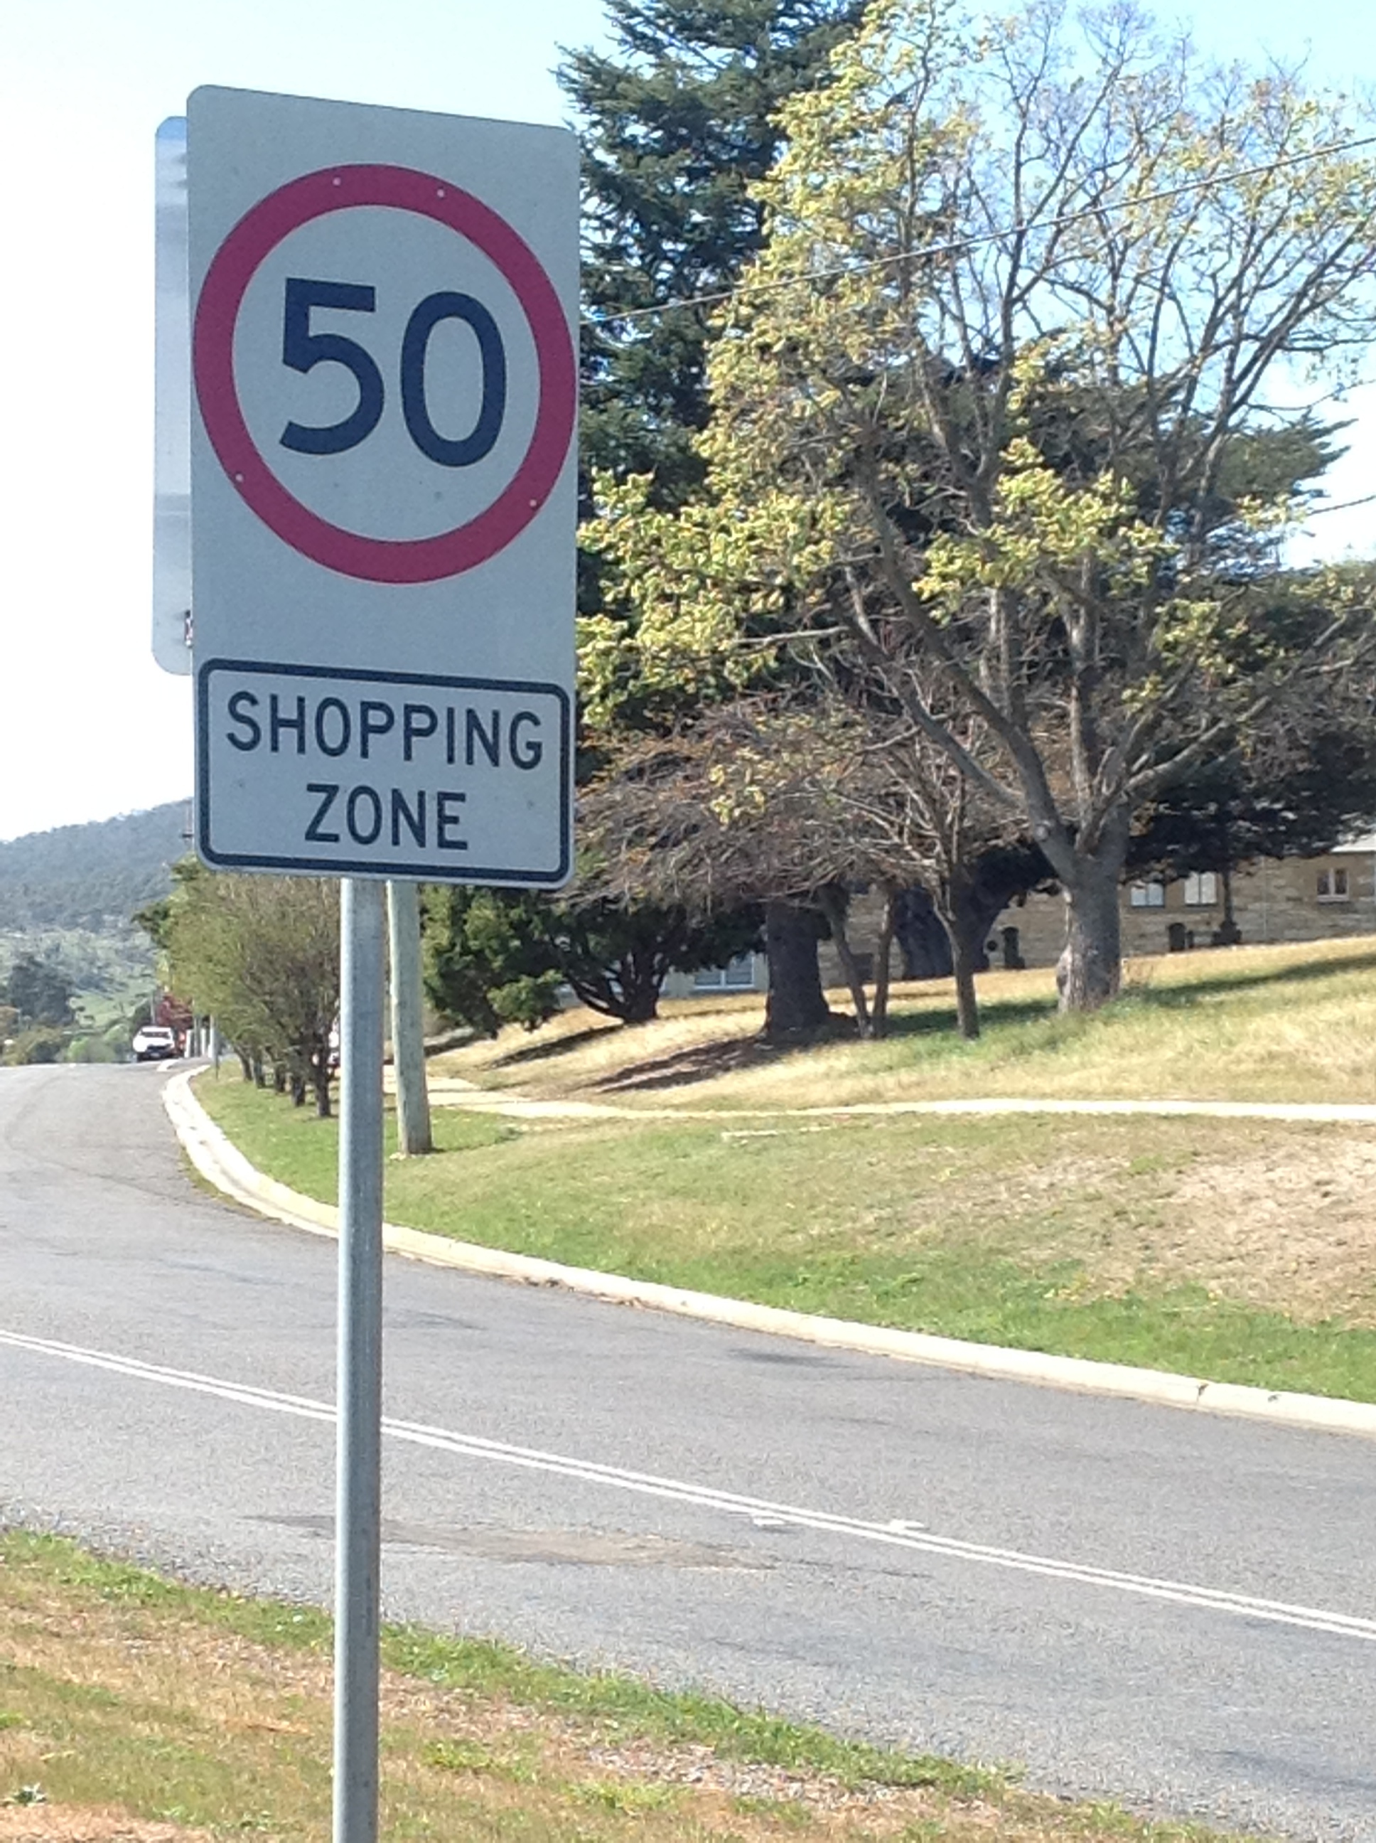
Implicit messages in our neoliberal world
You are all consumers
You shape your world by the way you consume
You are more valuable to society if your efforts contribute to growing GDP

Slide 5
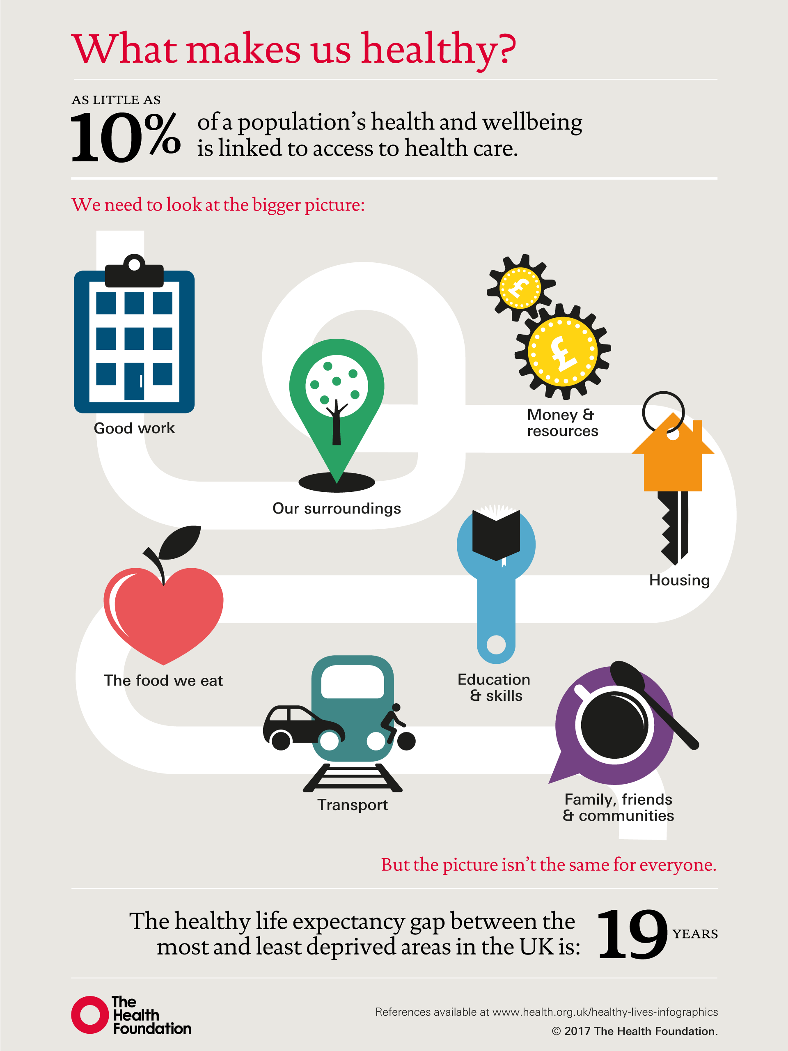
Implicit messages within current health debates
Treating disease = Improving health
Hospitals and clinics create a healthy society
More hospital beds, doctors, nurses and allied health staff will create better health outcomes.
Health professionals are the experts here, if you’re not a health professional your opinion is not important.

Slide 6
These dominant cultural stories lead us to blame individuals for poor health outcomes and then divert our gaze inward into the health/disease care system in the false belief that this is where we will find major solutions to advancing societal health and wellbeing.

Slide 7
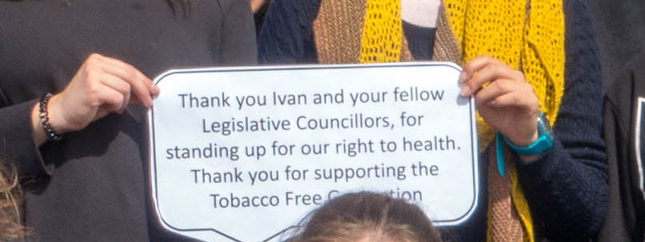
Why should health professionals engage in tobacco control advocacy?
Students begin with a strong motivation to improve the lives of others
A credible public voice
An opportunity to work in less stressed clinical environments

Slide 8
Dr Bronwyn King AO
Radiation oncologist
Founder and CEO, Tobacco Free Portfolios

Slide 9
The tobacco industry is ruthless and will seek to turn the tables on doctors and other health professionals in an effort to maintain credibility and maximise profit.

Slide 10
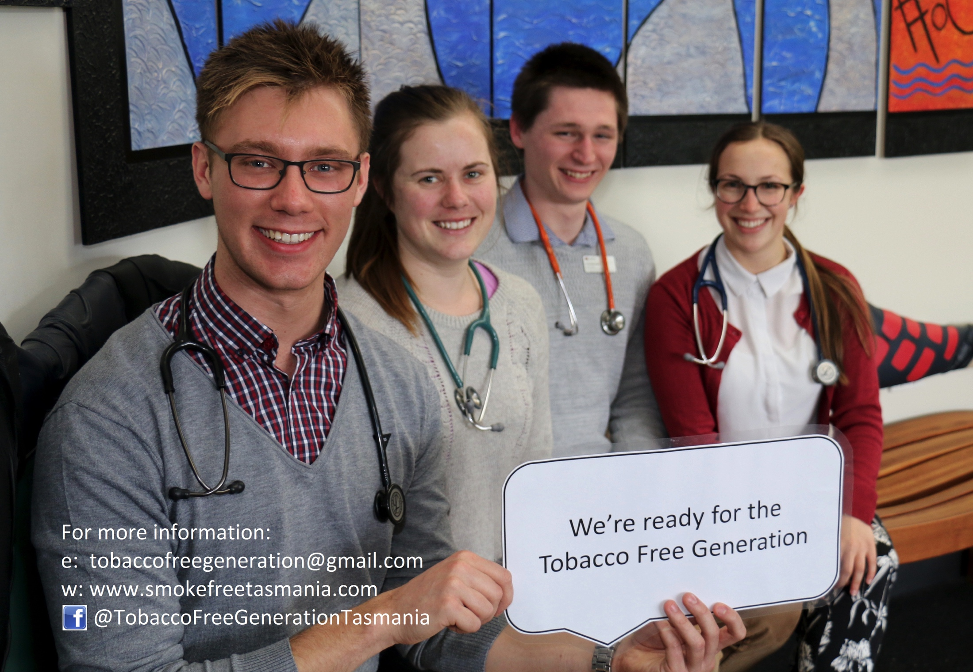
Where might health professional advocacy be most useful?
Advocacy for action on the SDoH
Collaboration with those with expertise outside the health profession to strengthen collective voice.
Advocacy for political donations reform.
Direct engagement with the tobacco industry.
Divest from tobacco and speak publicly about this
Ensure tobacco control remains in public view and on the political agenda

Slide 11
How might you support health professional advocacy on tobacco control?
Keep health professional training organisations accountable to their social and environmental health mandates.
Identify opportunities to collaborate, to create stronger voices through diverse coalitions.

